Slide 2

The EU-ProPER study
Europa Uomo Prostate Partners’ Experience Research
A ground-breaking survey examining quality of life in partners of men with prostate cancer by the European prostate cancer patients’ coalition

Slide 3
This presentation
This presentation is for prostate cancer patient groups and the general public.
You are welcome to publicise the results without permission, but you must always credit Europa Uomo and the EU-ProPER study.
If you reproduce any of the charts, they must be credited to Europa Uomo and the EU-ProPER study.

Slide 4
About EU-ProPER

Slide 5

EU-Proper study key findings
Prostate cancer brings significant changes to the lives, and quality of life, of partners supporting men with prostate cancer
Prostate cancer and its treatments change men
The changes that come with prostate cancer can be positive, bring partners closer together
Notes:
These are the most important findings of Europa Uomo’s partners’ study. We will present them in more detail in the following presentation.

Slide 6
Significance of EU-ProPER study
A unique view on the effects of prostate cancer, through the eyes of their partners
Findings support action to provide services for partners, and to share more information with them about the effects of prostate cancer

Slide 7
Background to EU-ProPER study
Europa Uomo’s previous EUPROMS quality of life studies showed 83% of prostate cancer patients lived with a partner.
EUPROMS found that continence and sexual life of patients were significantly compromised.
Europa Uomo wanted to explore the effects on partners.

Slide 8
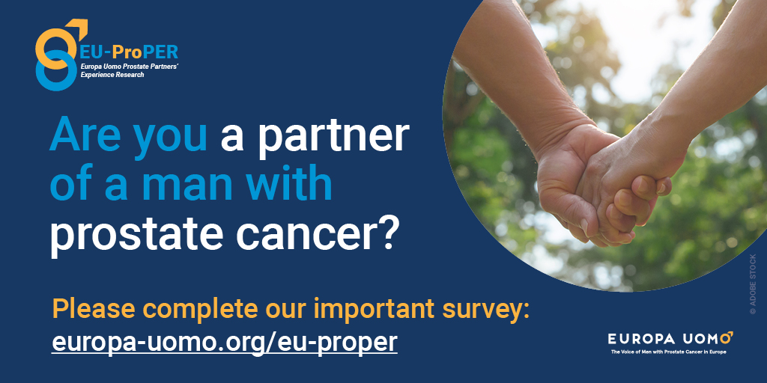
The EU-ProPER survey
20 minutes online survey
Developed with group of prostate cancer partners in the Netherlands
Available in 17 languages
Launched October 2023, closed December 2023
Publicised through Europa Uomo and supportive organisations

Slide 9
Who responded?
1135 valid responses
Responses from 23 European countries, plus USA and Canada
Half of responses from Netherlands, Norway and Germany
Median age: 68
Median age at diagnosis: 61
Analysis of data by Erasmus University, the Netherlands

Slide 10
What EU-ProPER discovered
Notes:
Here are the main findings of the study.

Slide 11
Notes:
One of the most striking findings of the study is that many partners believe that prostate cancer and its treatments change the man they live with. As we will see from the following slides, this change can involve alterations in mental health, continence, libido and sexual abilities.

Slide 12
Notes:
Many respondents felt that their male partners needed support for mental health issues. But they also acknowledged mental health problems themselves.

Slide 13
Notes:
Prostate cancer has a significant impact on the lives of partners, affecting their social life and resulting in many becoming lonely.

Slide 14
Notes:
For all the strains that prostate cancer brings to couples, it seems that communications channels stay open – and most partners feel that communication has remained good or improved since the prostate cancer diagnosis.

Slide 16
Notes:
It is worth noting that although nearly all patients and partners share information about a cancer diagnosis with close family, they are far less will to share information about more “taboo” subjects such as incontinence. More than a third of respondents said that no-one, apart from them, was aware of their partner’s incontinence.

Slide 17
Notes:
Another striking finding of the study is that although many partners think that prostate cancer has affected their relationship, most of them believe that the change has been for the better, bringing together rather than driving them apart.

Slide 21
Notes:
The influence of incontinence on quality of life is clearly substantial, affecting both social and sexual life. Even for partnerships that are coping well with the other side effects of prostate cancer and its treatments, coping with incontinence rem.ains difficult

Slide 22
Notes:
This result is probably the most unexpected of the whole study. Many partners are simply not receiving the information they need about the impacts of treatment before it begins. This means that the impacts on sex life can come as a shock and make changes harder to adapt to. It can also lead to regrets about having chosen the wrong treatment.

Slide 23

For more information
Go to the Europa Uomo website
https://www.europa-uomo.org/eu-proper/

