Slide 1

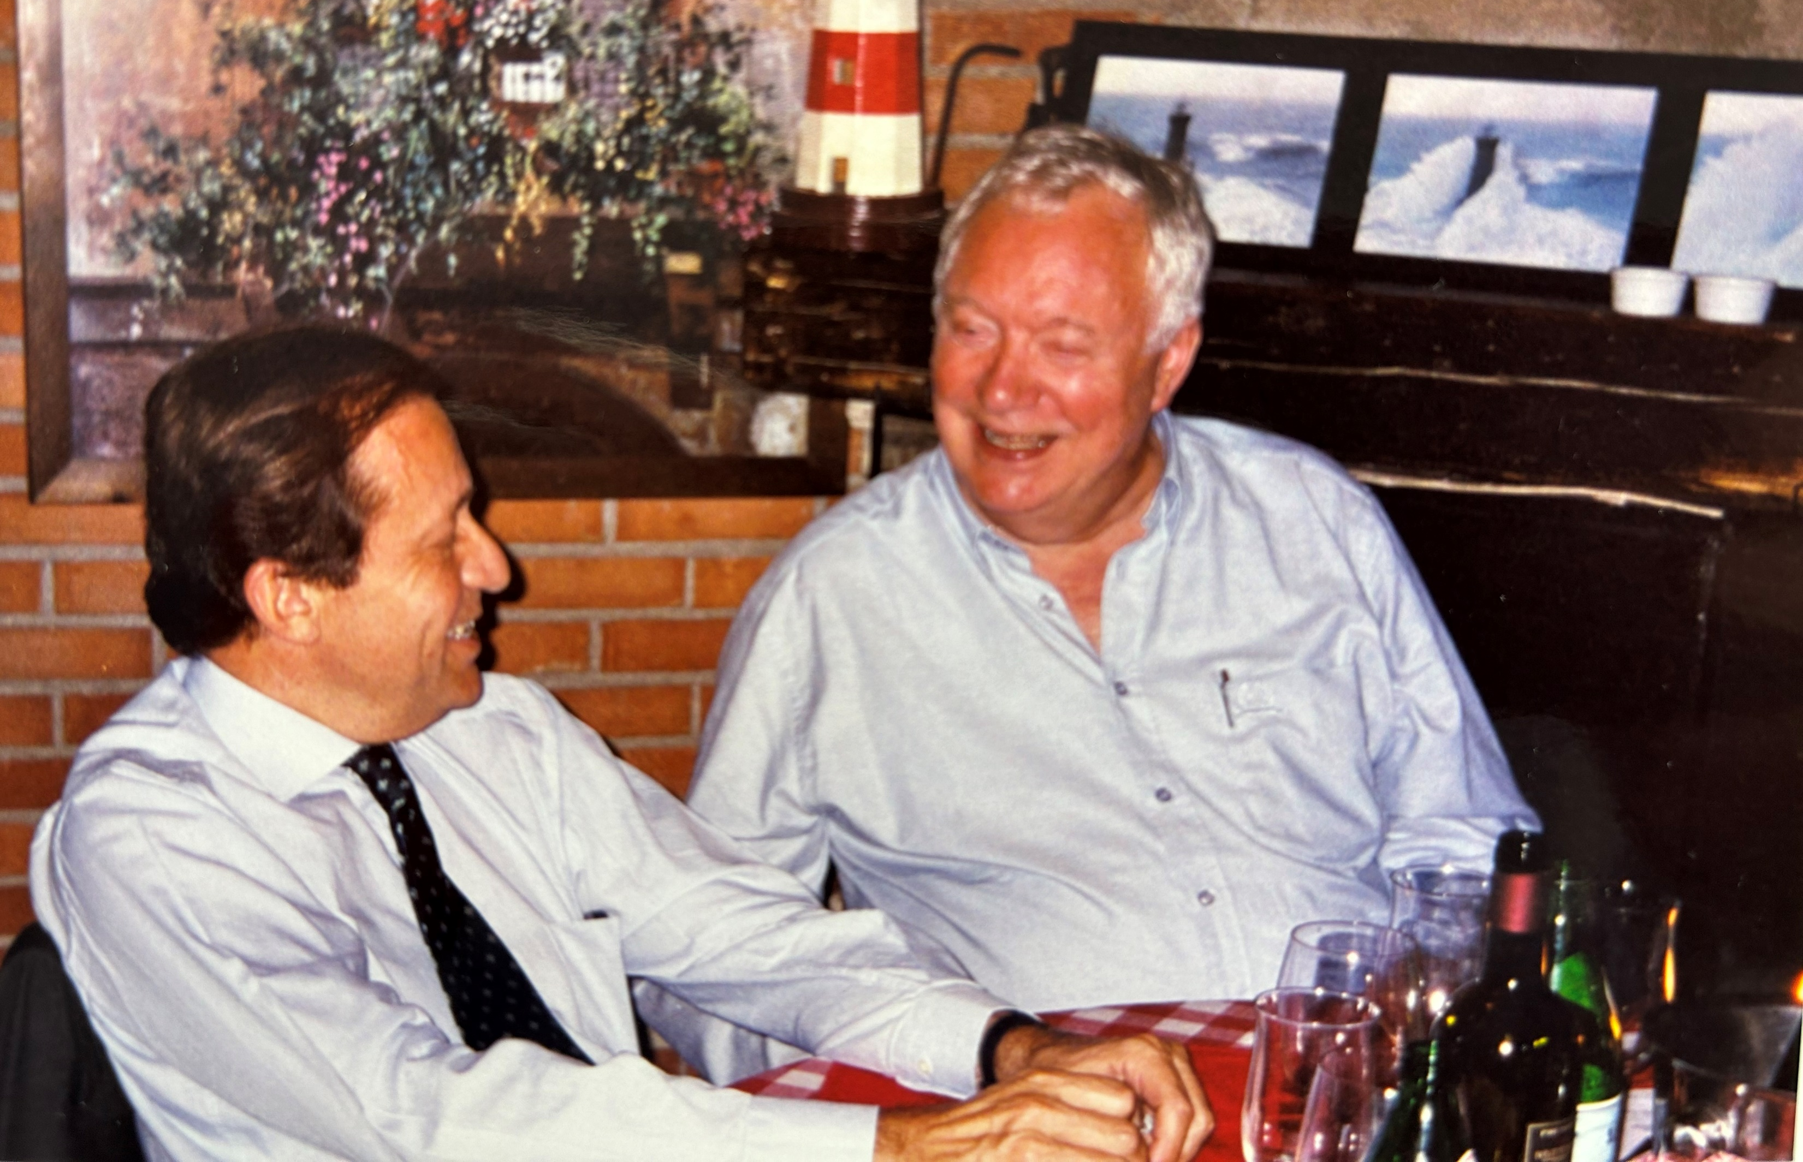
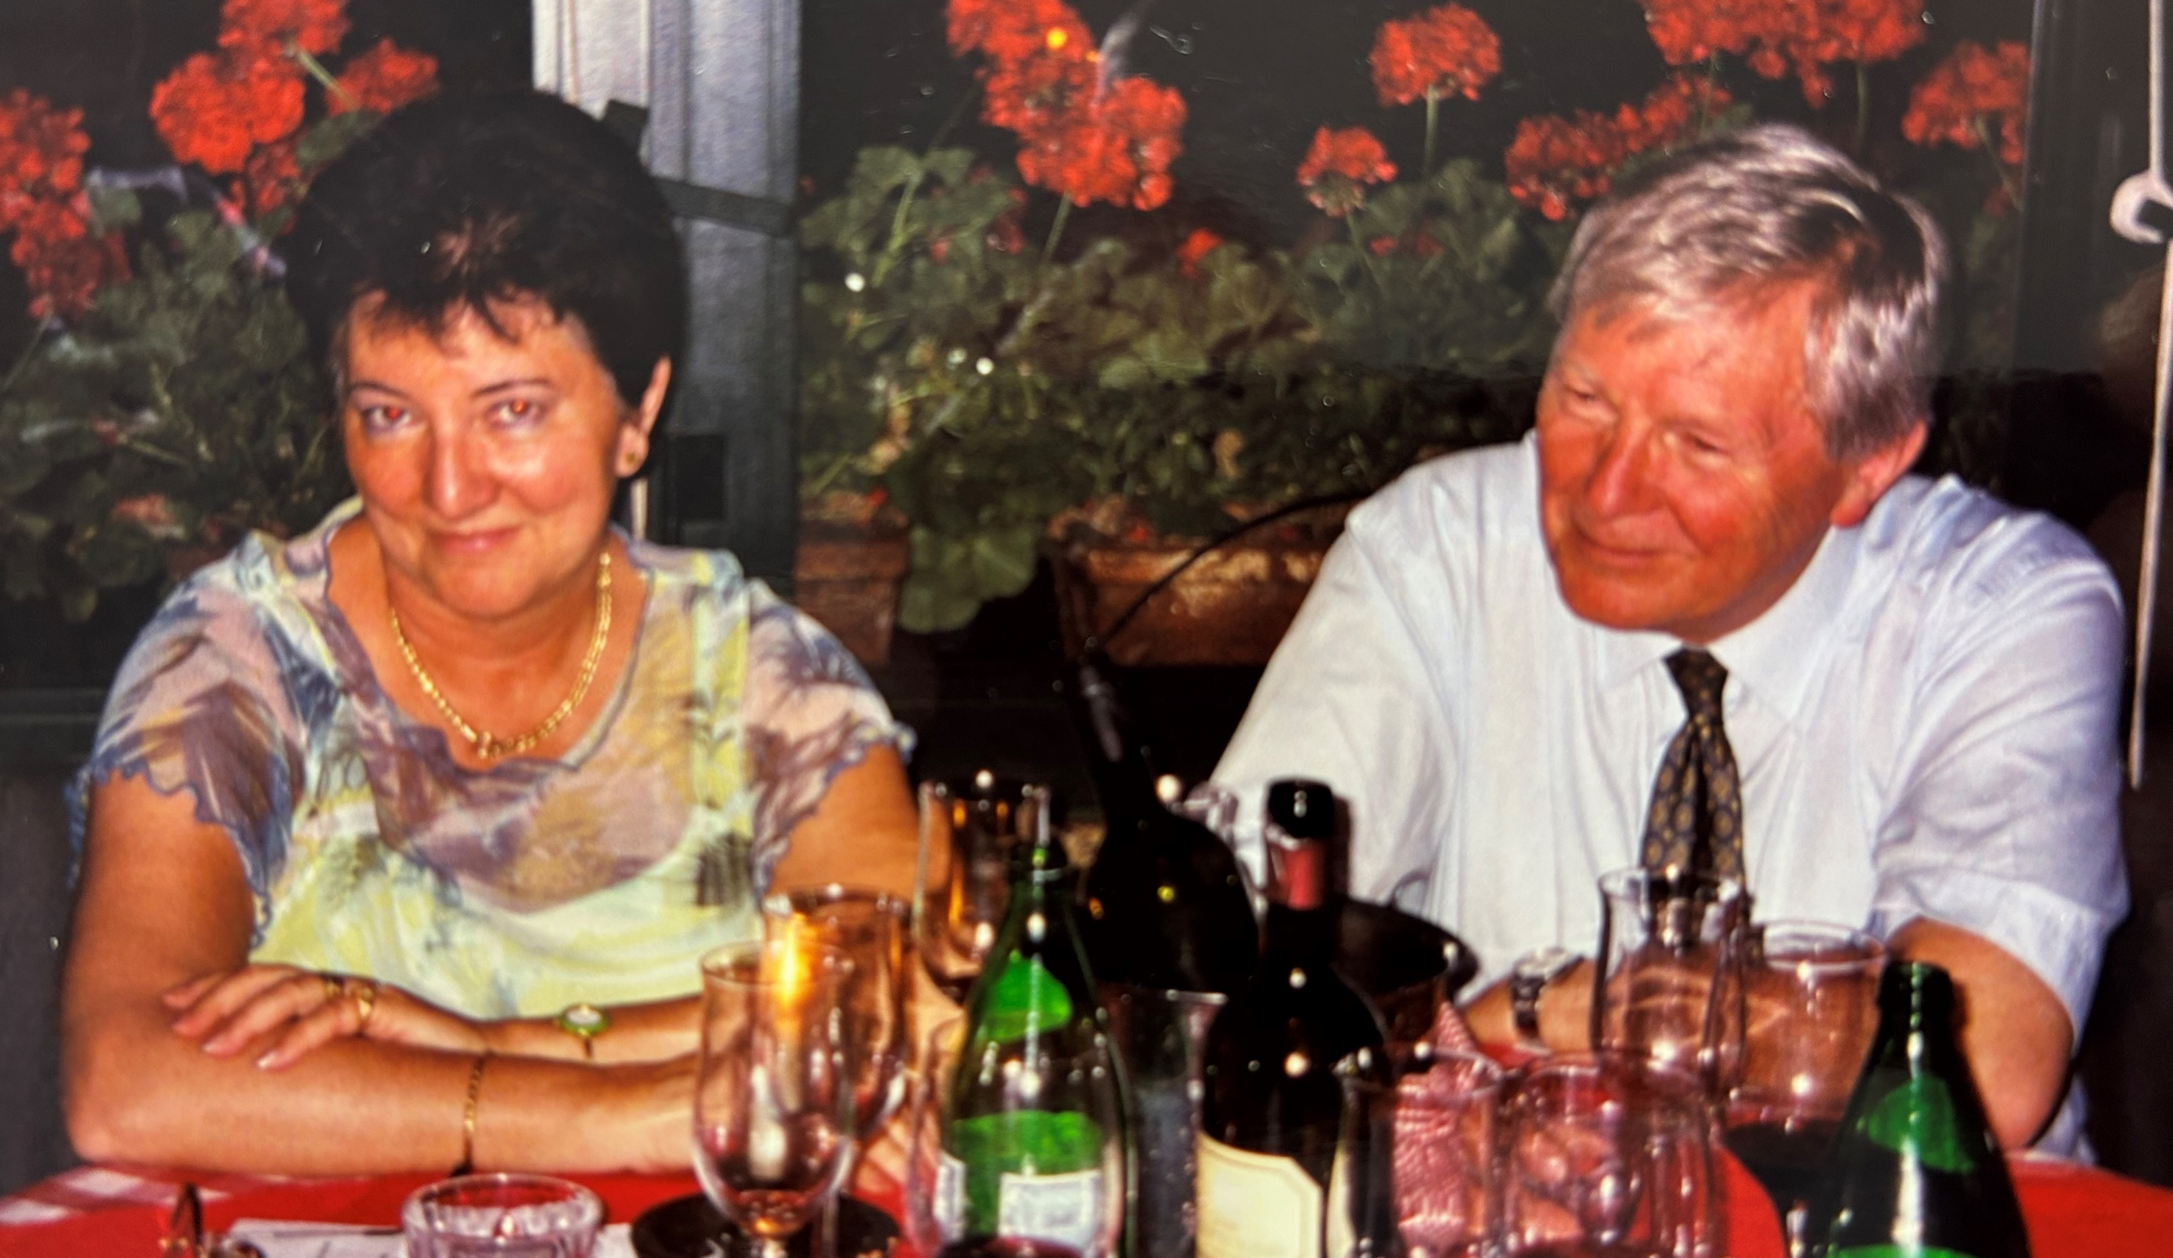

Birthday EuropaUomo, Milan 2004
Notes:
Patient-centred, multidisciplinary approach
Equitable access to novel technology
Personalized medicine
Consistent Health Technology Assessment (HTA) should be performed for optimised allocation of resources
Awareness campaigns
Survivorship cancer plans

Slide 2
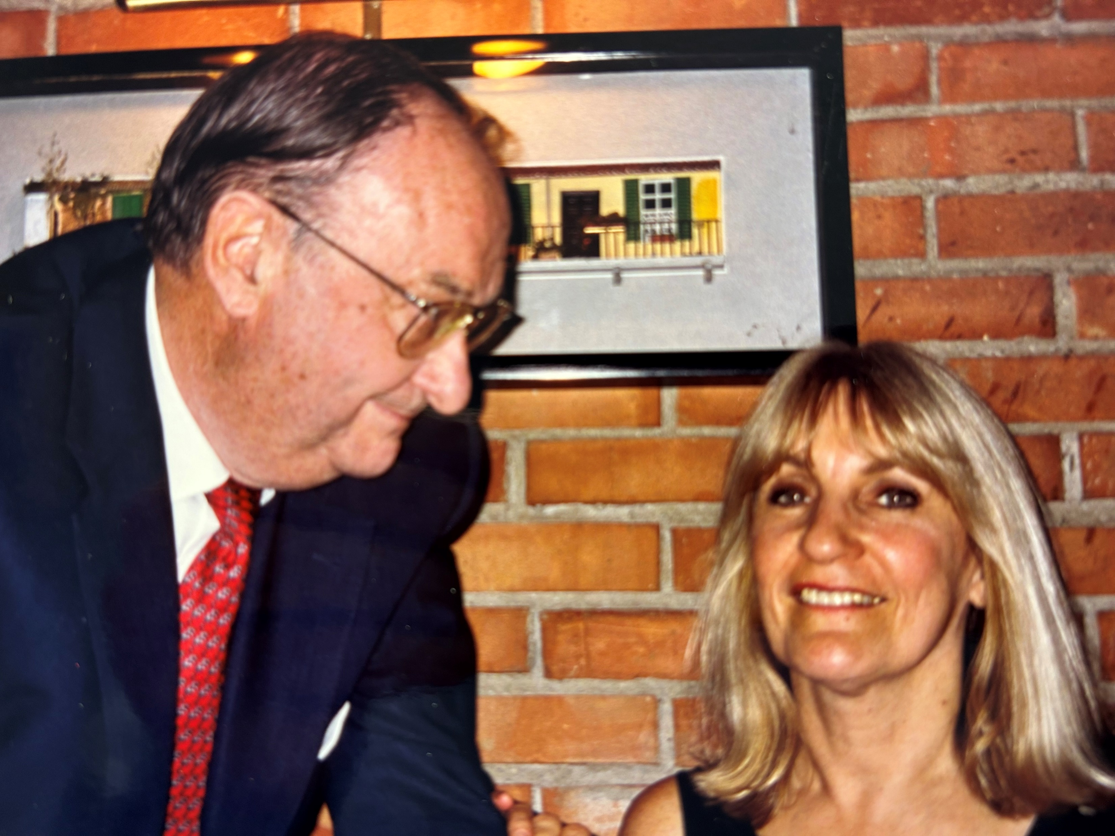
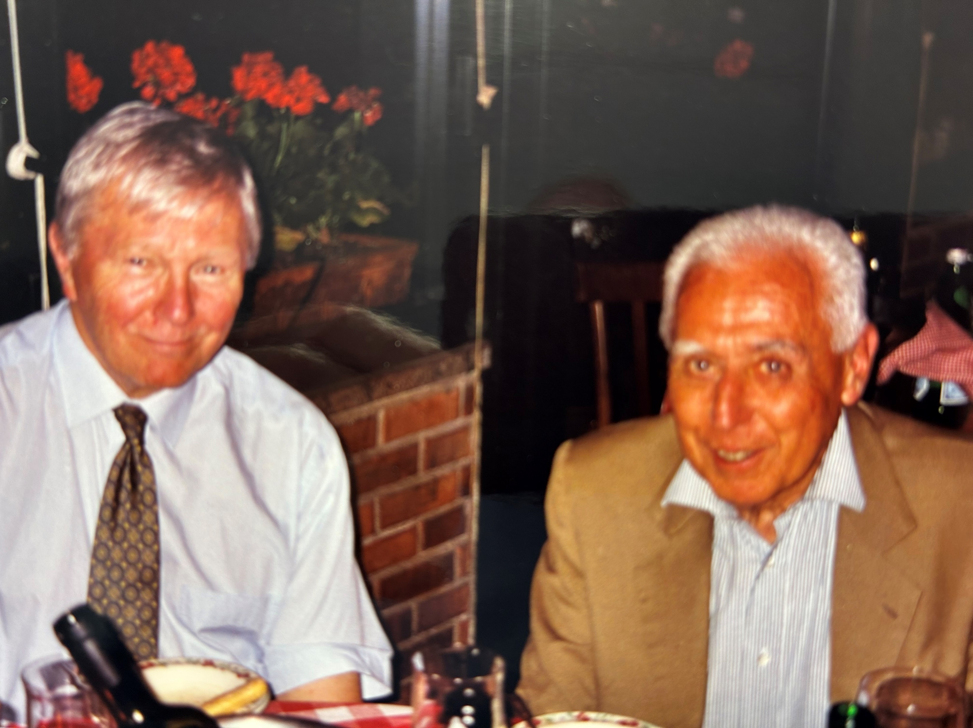
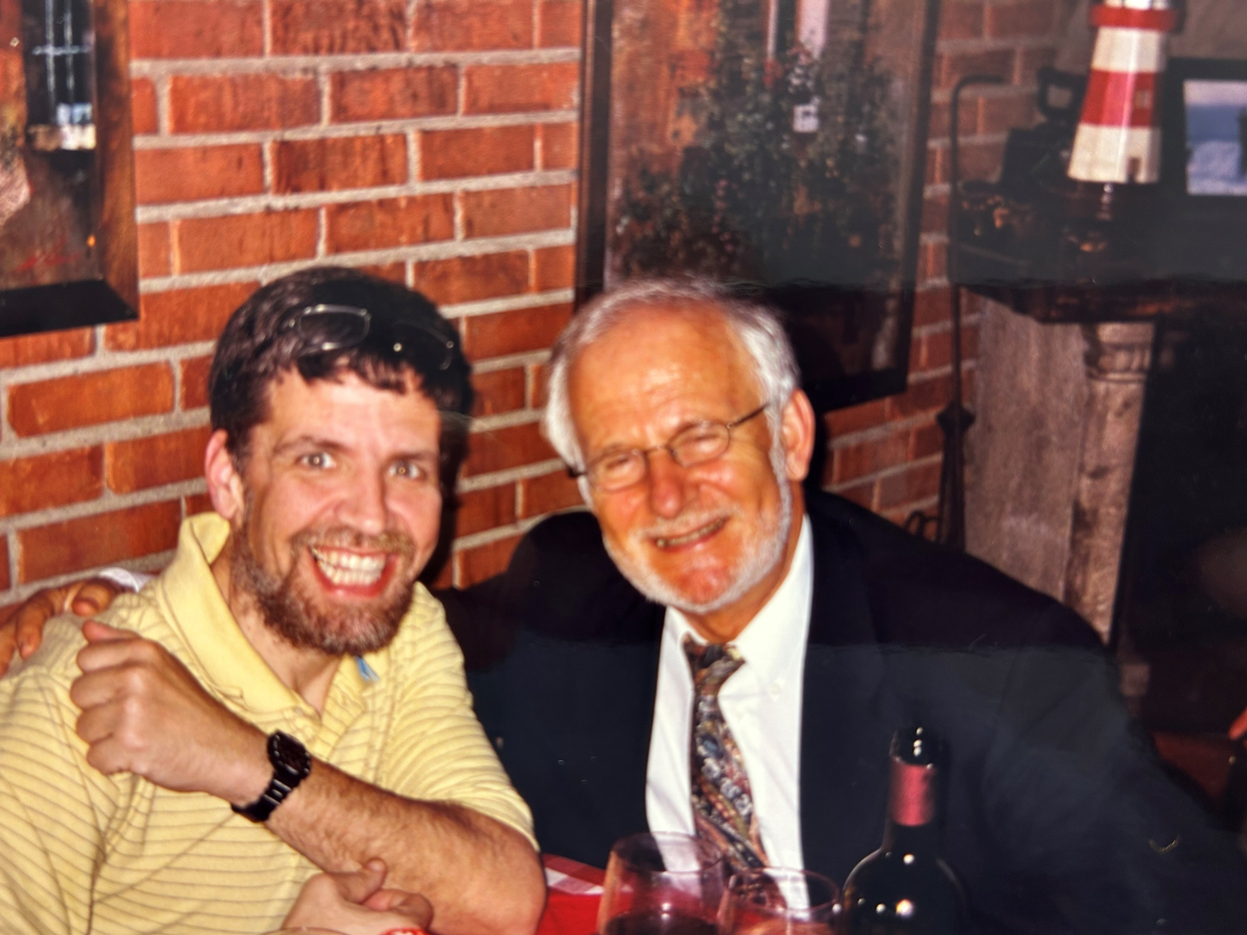
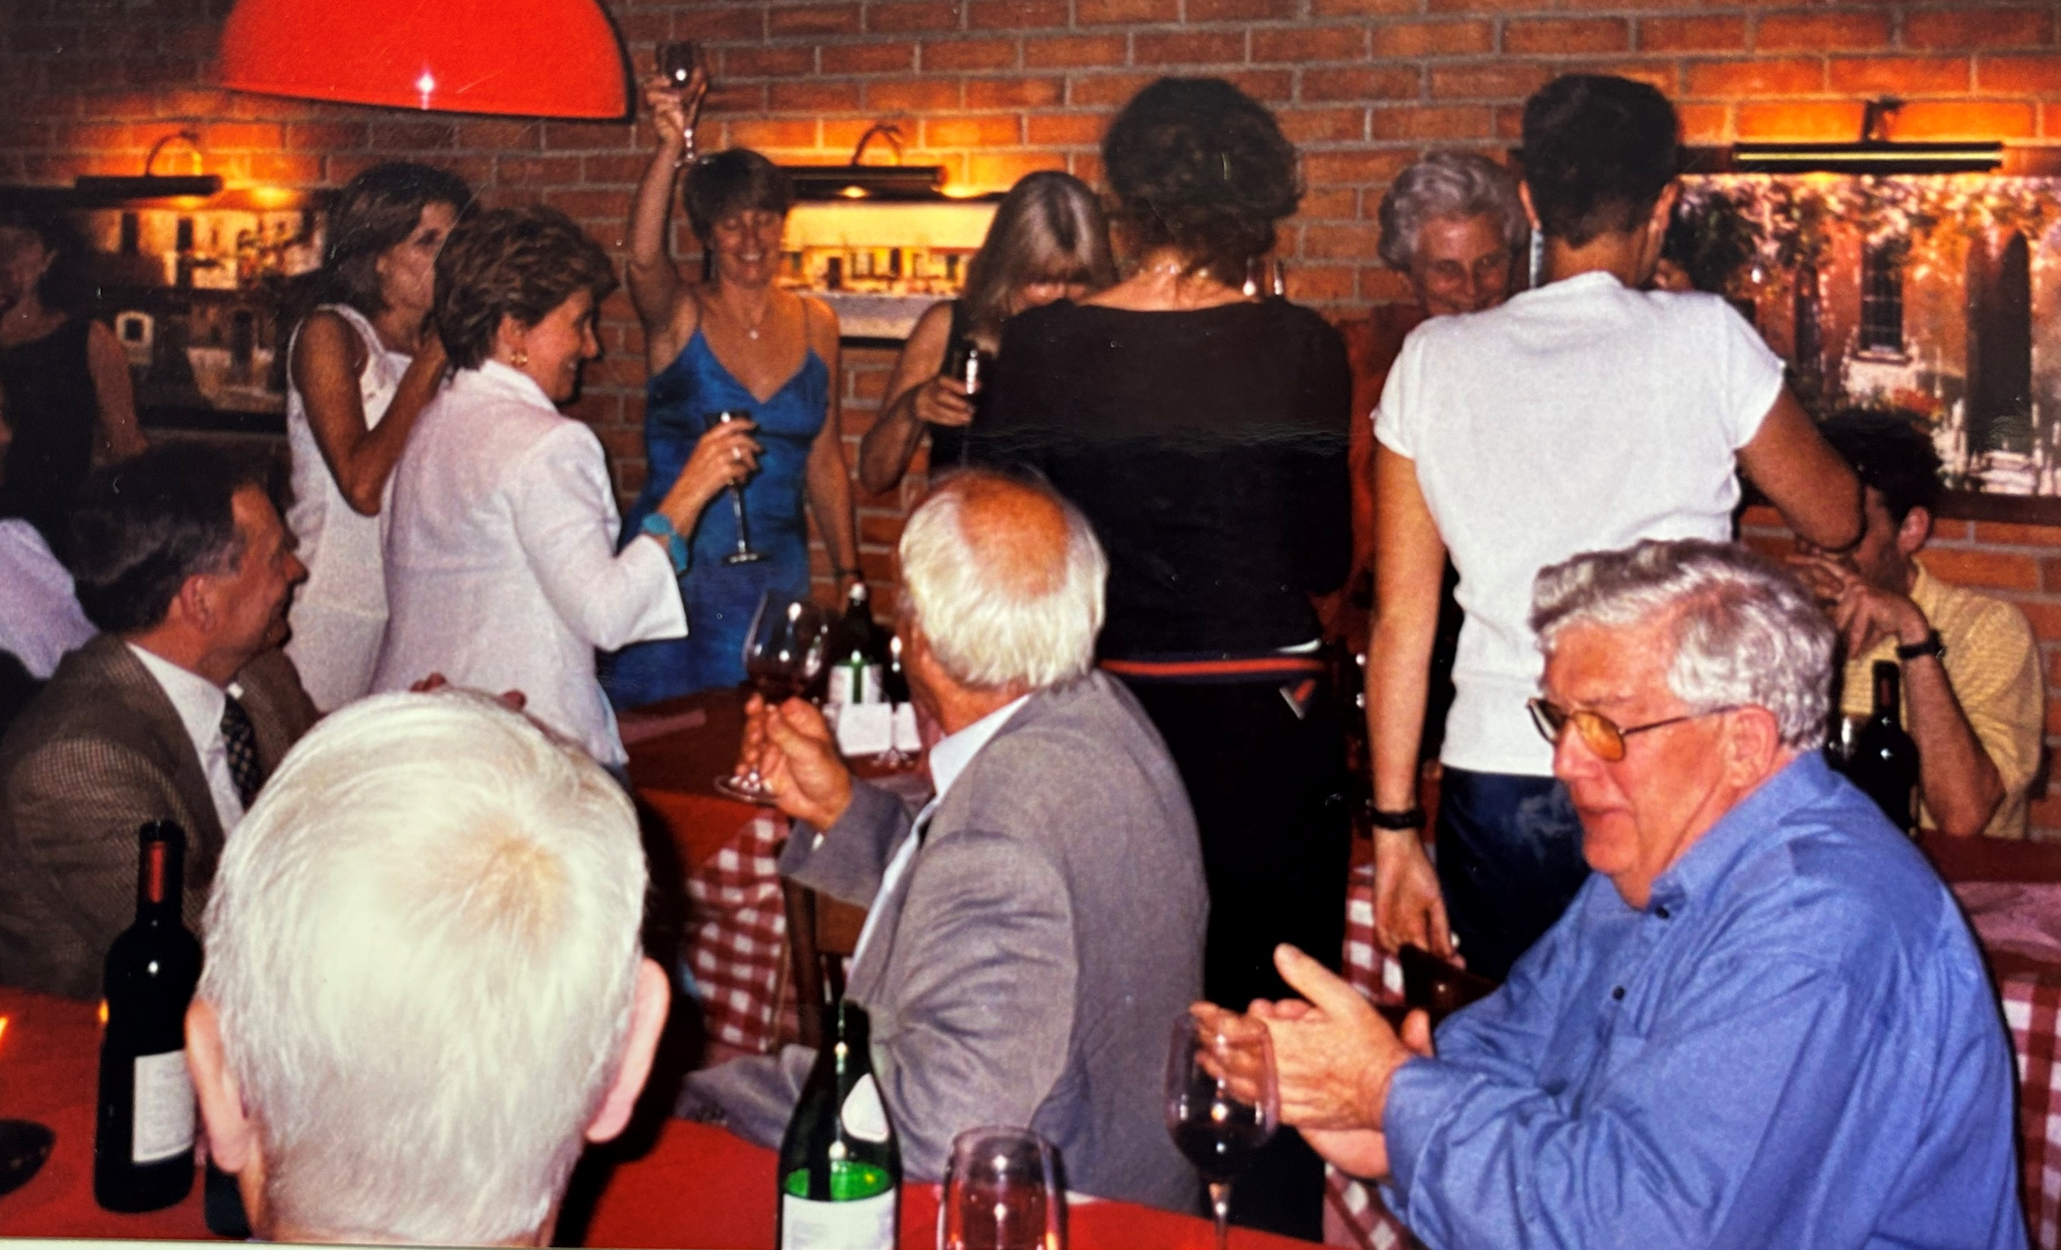
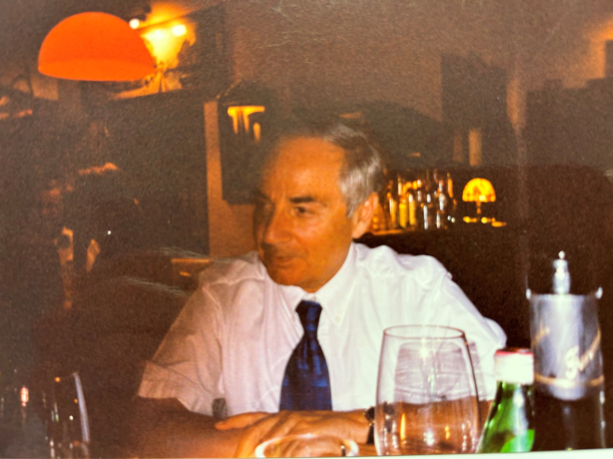
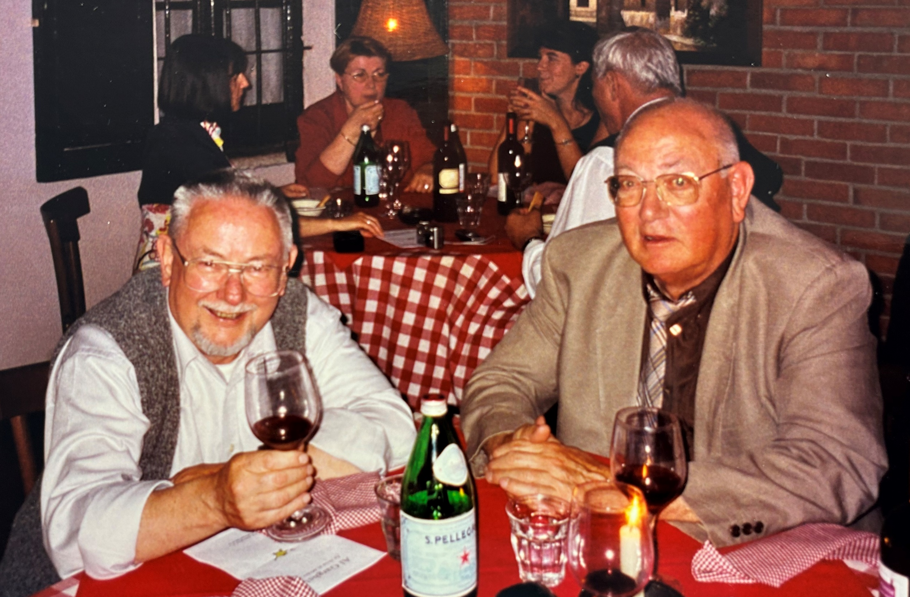
Fabio Sereni
John Page Christian Ligensa
Lynn Faulds Wood
Birthday EuropaUomo
Milan 2004
Eoghan Cahill Elias Valverde
Dan Gaffney and Kathy Redmond
Notes:
Patient-centred, multidisciplinary approach
Equitable access to novel technology
Personalized medicine
Consistent Health Technology Assessment (HTA) should be performed for optimised allocation of resources
Awareness campaigns
Survivorship cancer plans

Slide 3


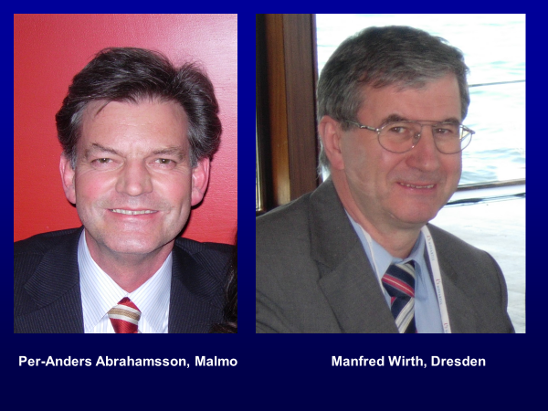
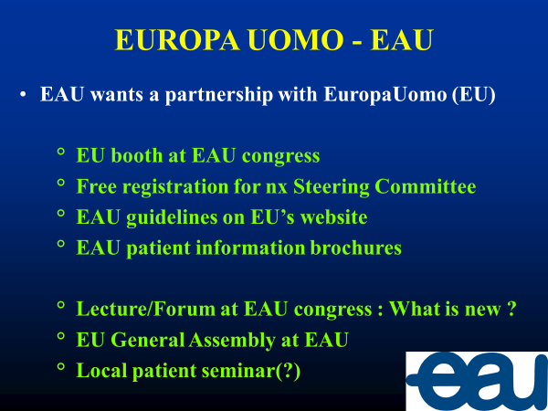
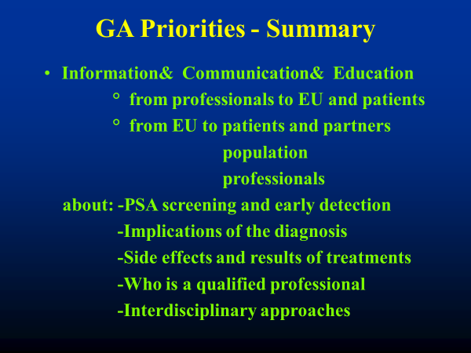
General Assembly 2006
Notes:
Patient-centred, multidisciplinary approach
Equitable access to novel technology
Personalized medicine
Consistent Health Technology Assessment (HTA) should be performed for optimised allocation of resources
Awareness campaigns
Survivorship cancer plans

Slide 4
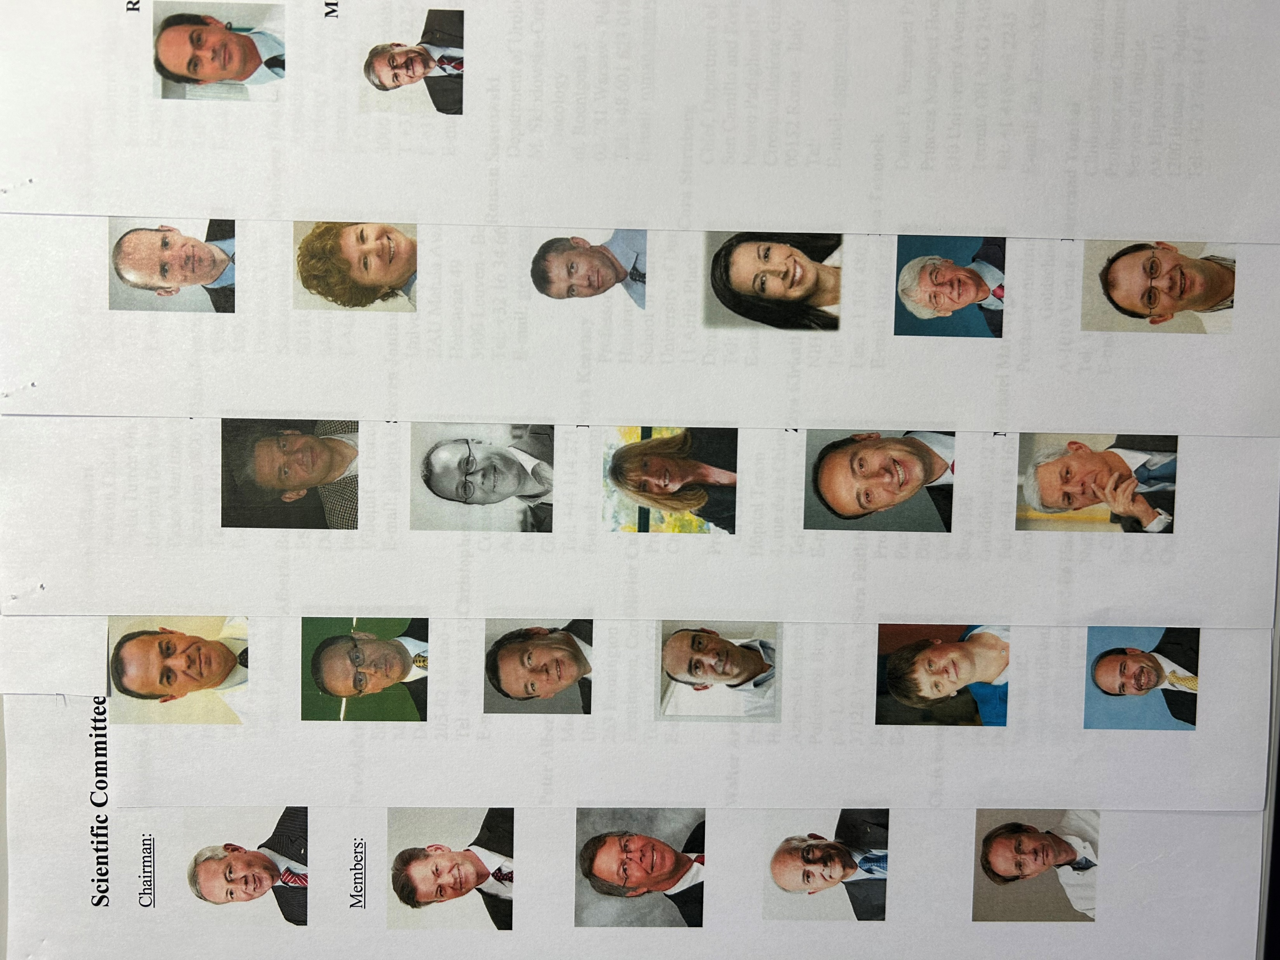
Notes:
Patient-centred, multidisciplinary approach
Equitable access to novel technology
Personalized medicine
Consistent Health Technology Assessment (HTA) should be performed for optimised allocation of resources
Awareness campaigns
Survivorship cancer plans

Slide 5



Notes:
Patient-centred, multidisciplinary approach
Equitable access to novel technology
Personalized medicine
Consistent Health Technology Assessment (HTA) should be performed for optimised allocation of resources
Awareness campaigns
Survivorship cancer plans

Slide 6
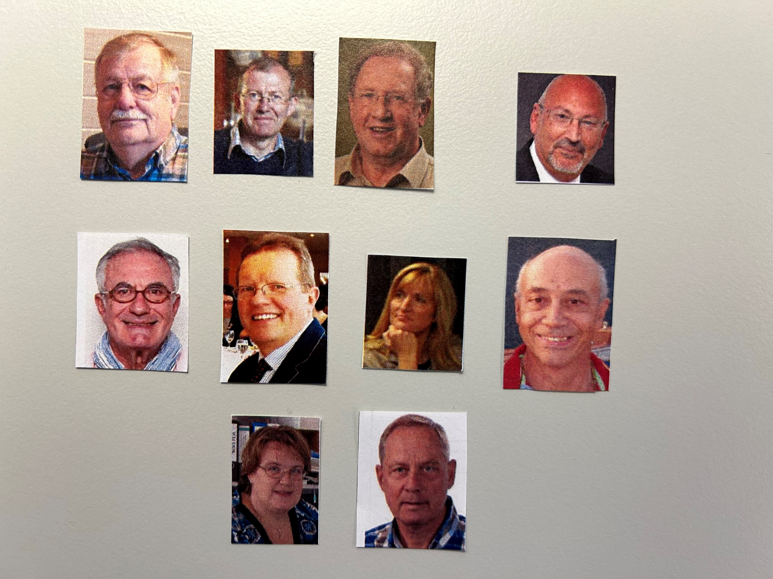
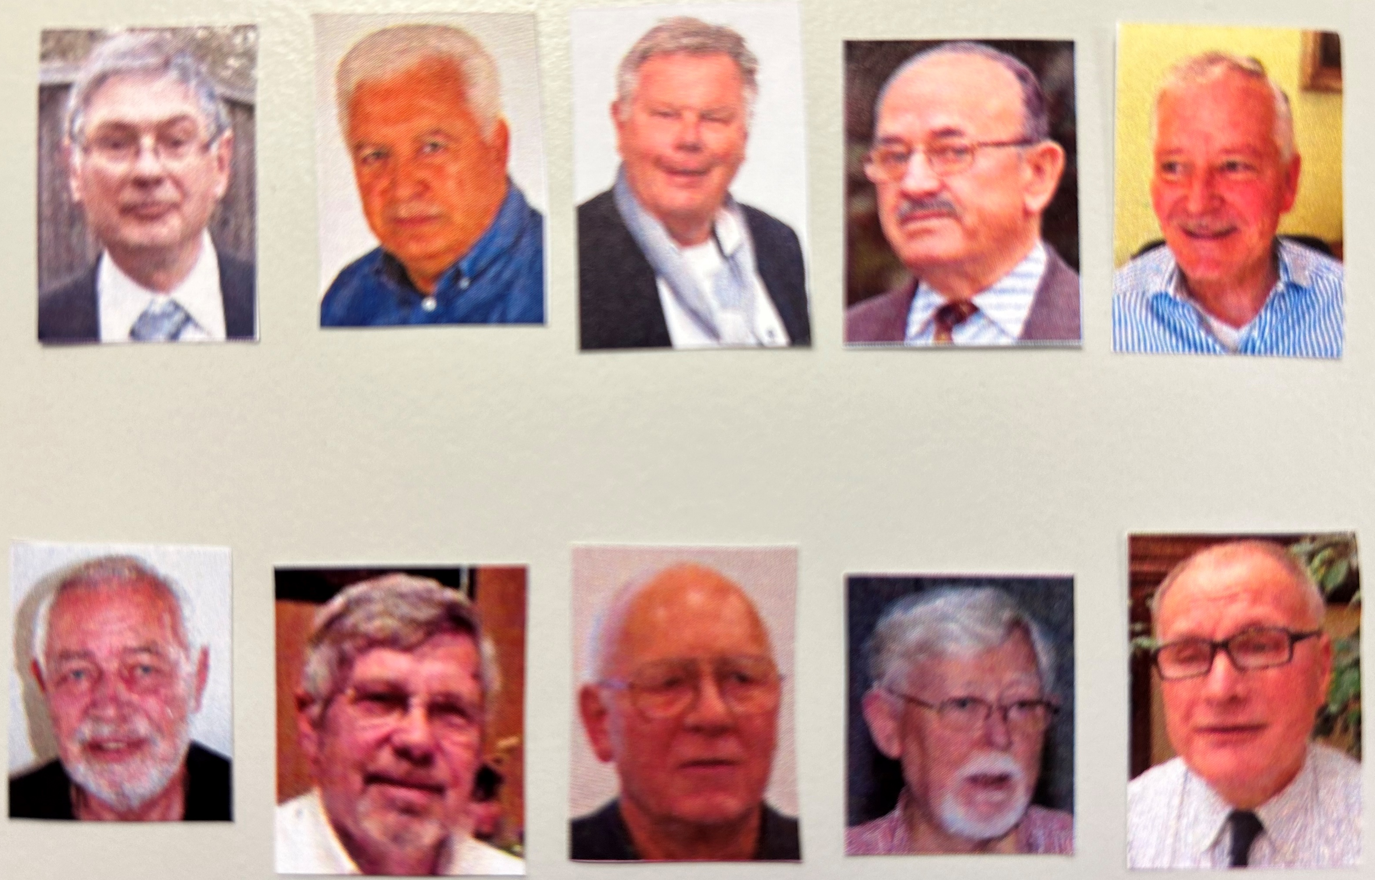
EUomo over the years
Notes:
Patient-centred, multidisciplinary approach
Equitable access to novel technology
Personalized medicine
Consistent Health Technology Assessment (HTA) should be performed for optimised allocation of resources
Awareness campaigns
Survivorship cancer plans

Slide 7
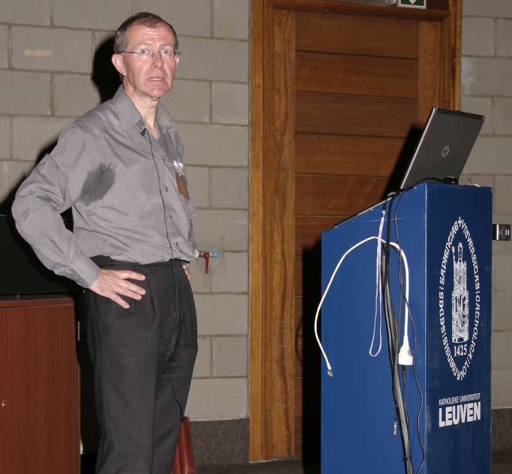
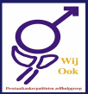
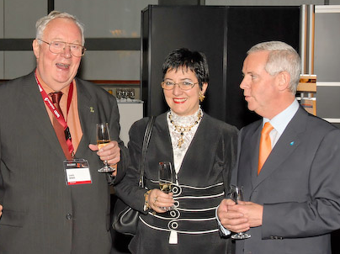
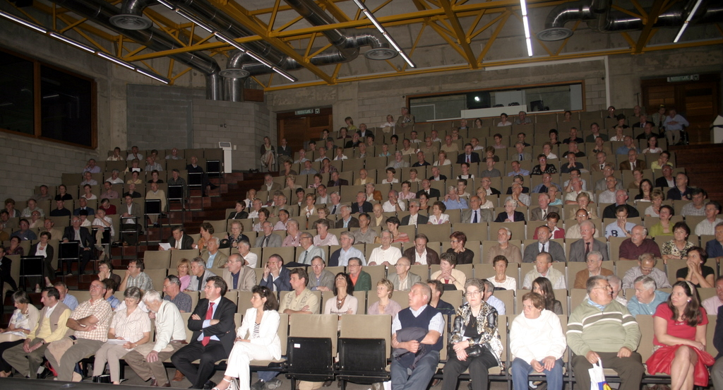
Kortrijk 2007
Leuven 2007
Notes:
Patient-centred, multidisciplinary approach
Equitable access to novel technology
Personalized medicine
Consistent Health Technology Assessment (HTA) should be performed for optimised allocation of resources
Awareness campaigns
Survivorship cancer plans

Slide 8
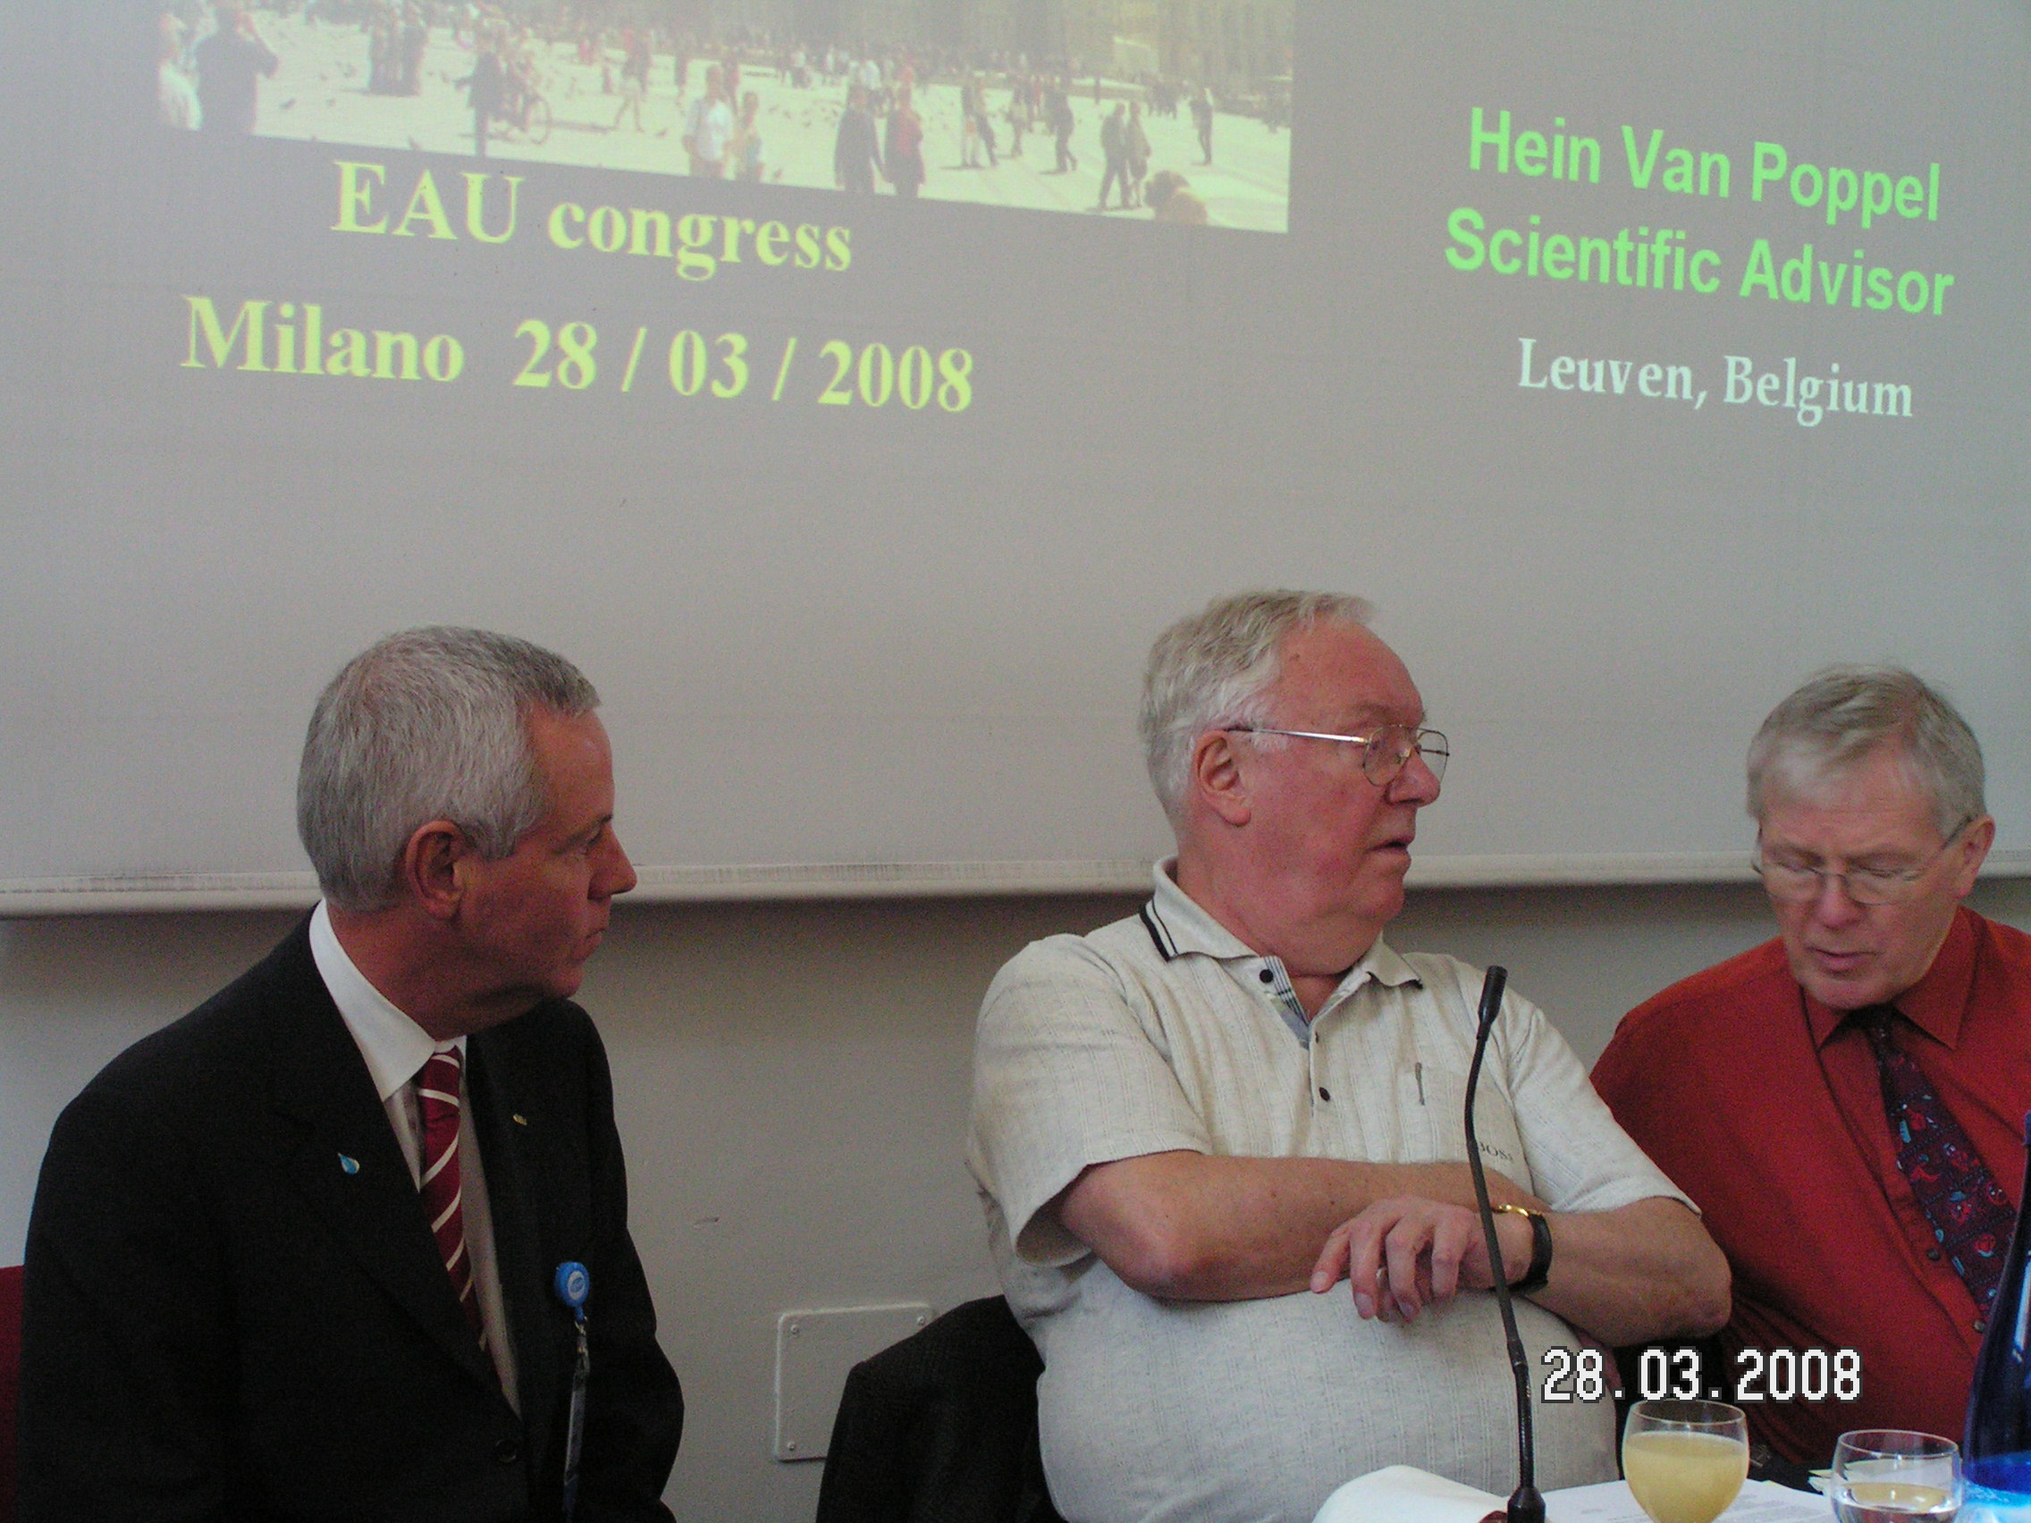
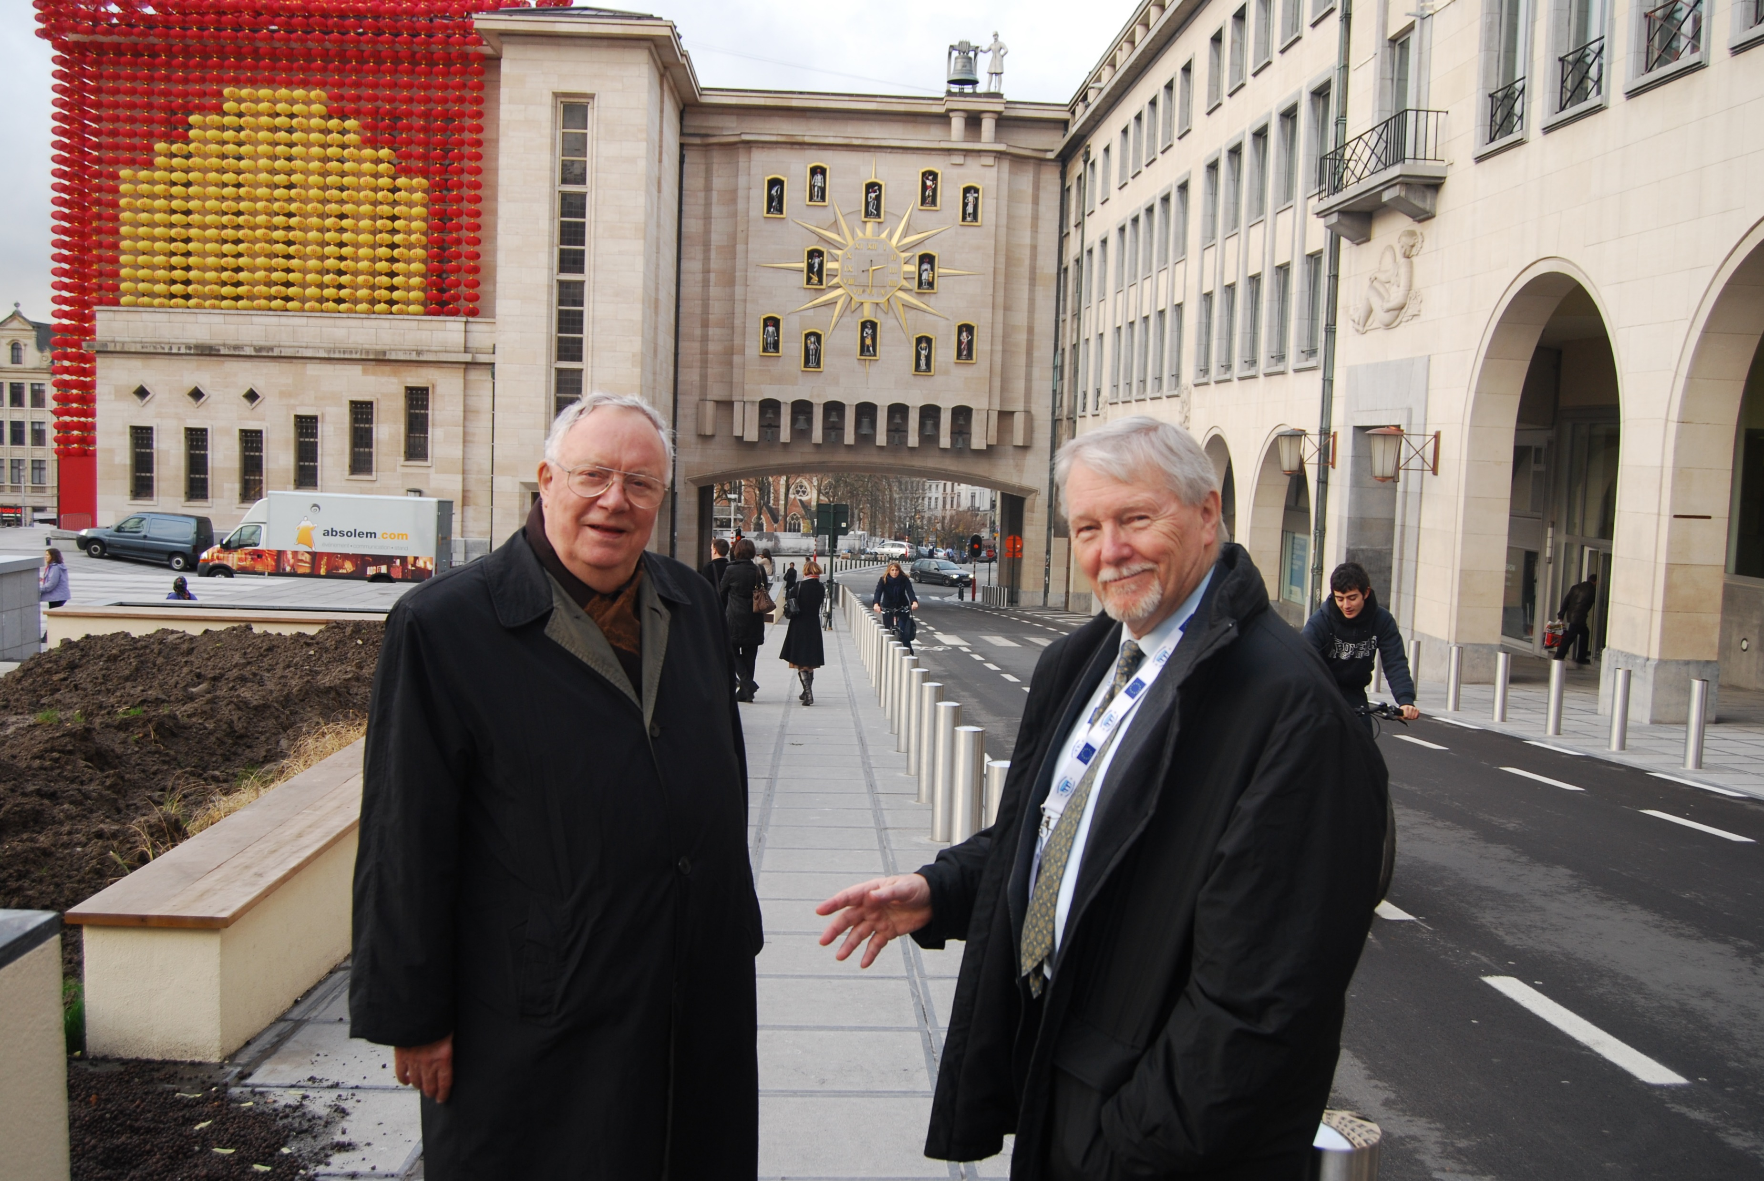
2008
Notes:
Patient-centred, multidisciplinary approach
Equitable access to novel technology
Personalized medicine
Consistent Health Technology Assessment (HTA) should be performed for optimised allocation of resources
Awareness campaigns
Survivorship cancer plans

Slide 9
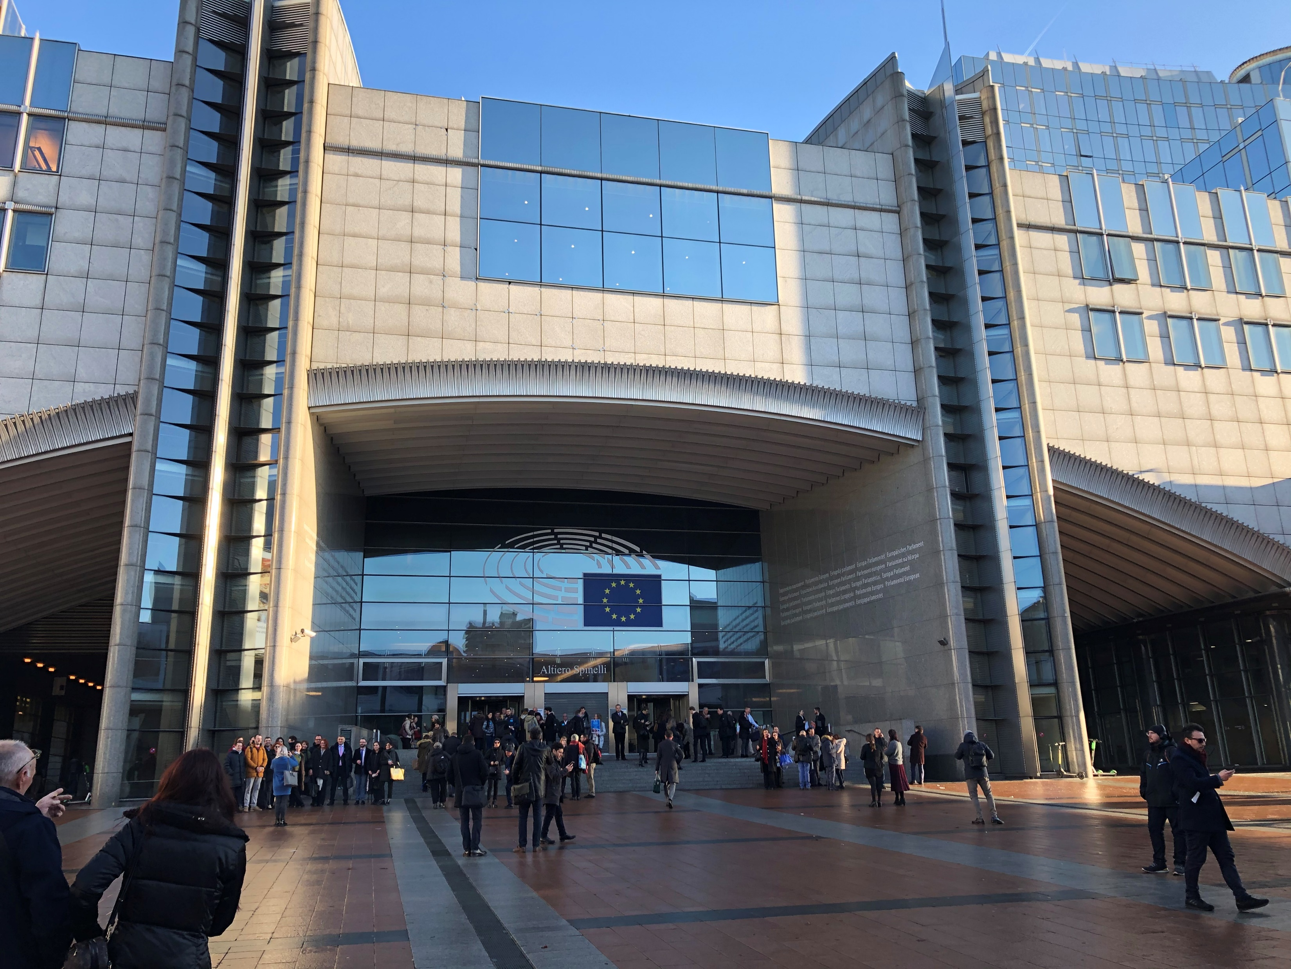
Spinelli Building European Parliament
Notes:
Patient-centred, multidisciplinary approach
Equitable access to novel technology
Personalized medicine
Consistent Health Technology Assessment (HTA) should be performed for optimised allocation of resources
Awareness campaigns
Survivorship cancer plans

Slide 10

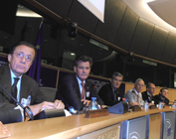

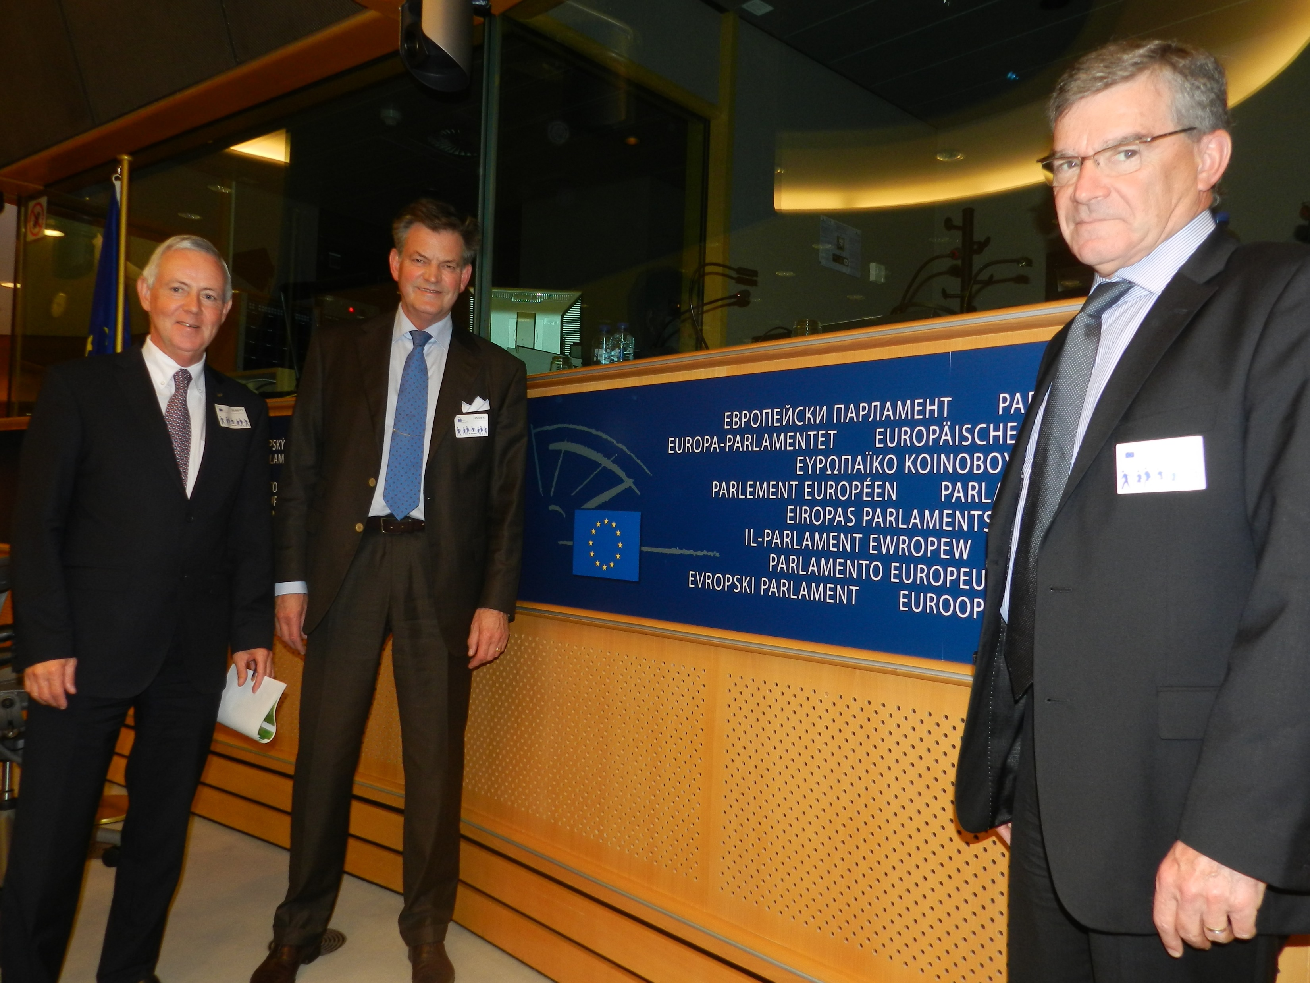


European Parliament 2012
2012
Notes:
Patient-centred, multidisciplinary approach
Equitable access to novel technology
Personalized medicine
Consistent Health Technology Assessment (HTA) should be performed for optimised allocation of resources
Awareness campaigns
Survivorship cancer plans

Slide 11


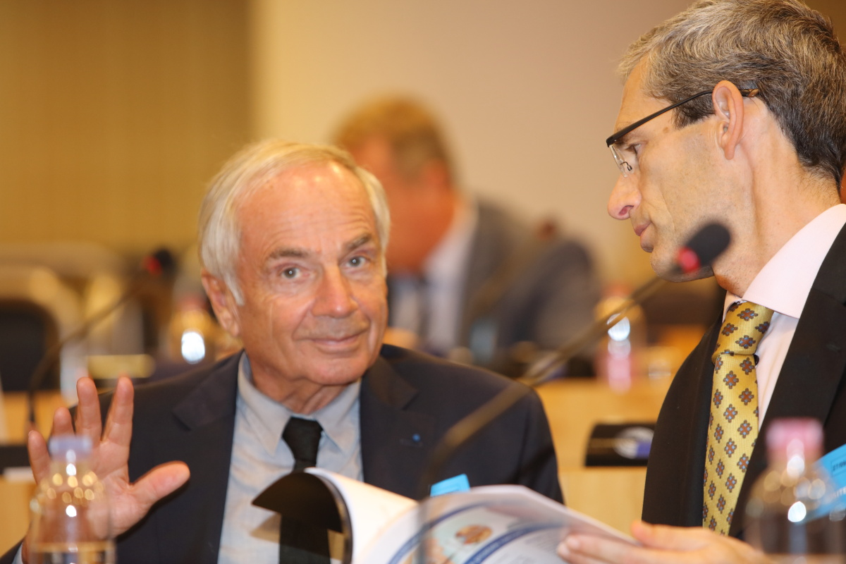

European Parliament 2017
Notes:
Patient-centred, multidisciplinary approach
Equitable access to novel technology
Personalized medicine
Consistent Health Technology Assessment (HTA) should be performed for optimised allocation of resources
Awareness campaigns
Survivorship cancer plans

Slide 12
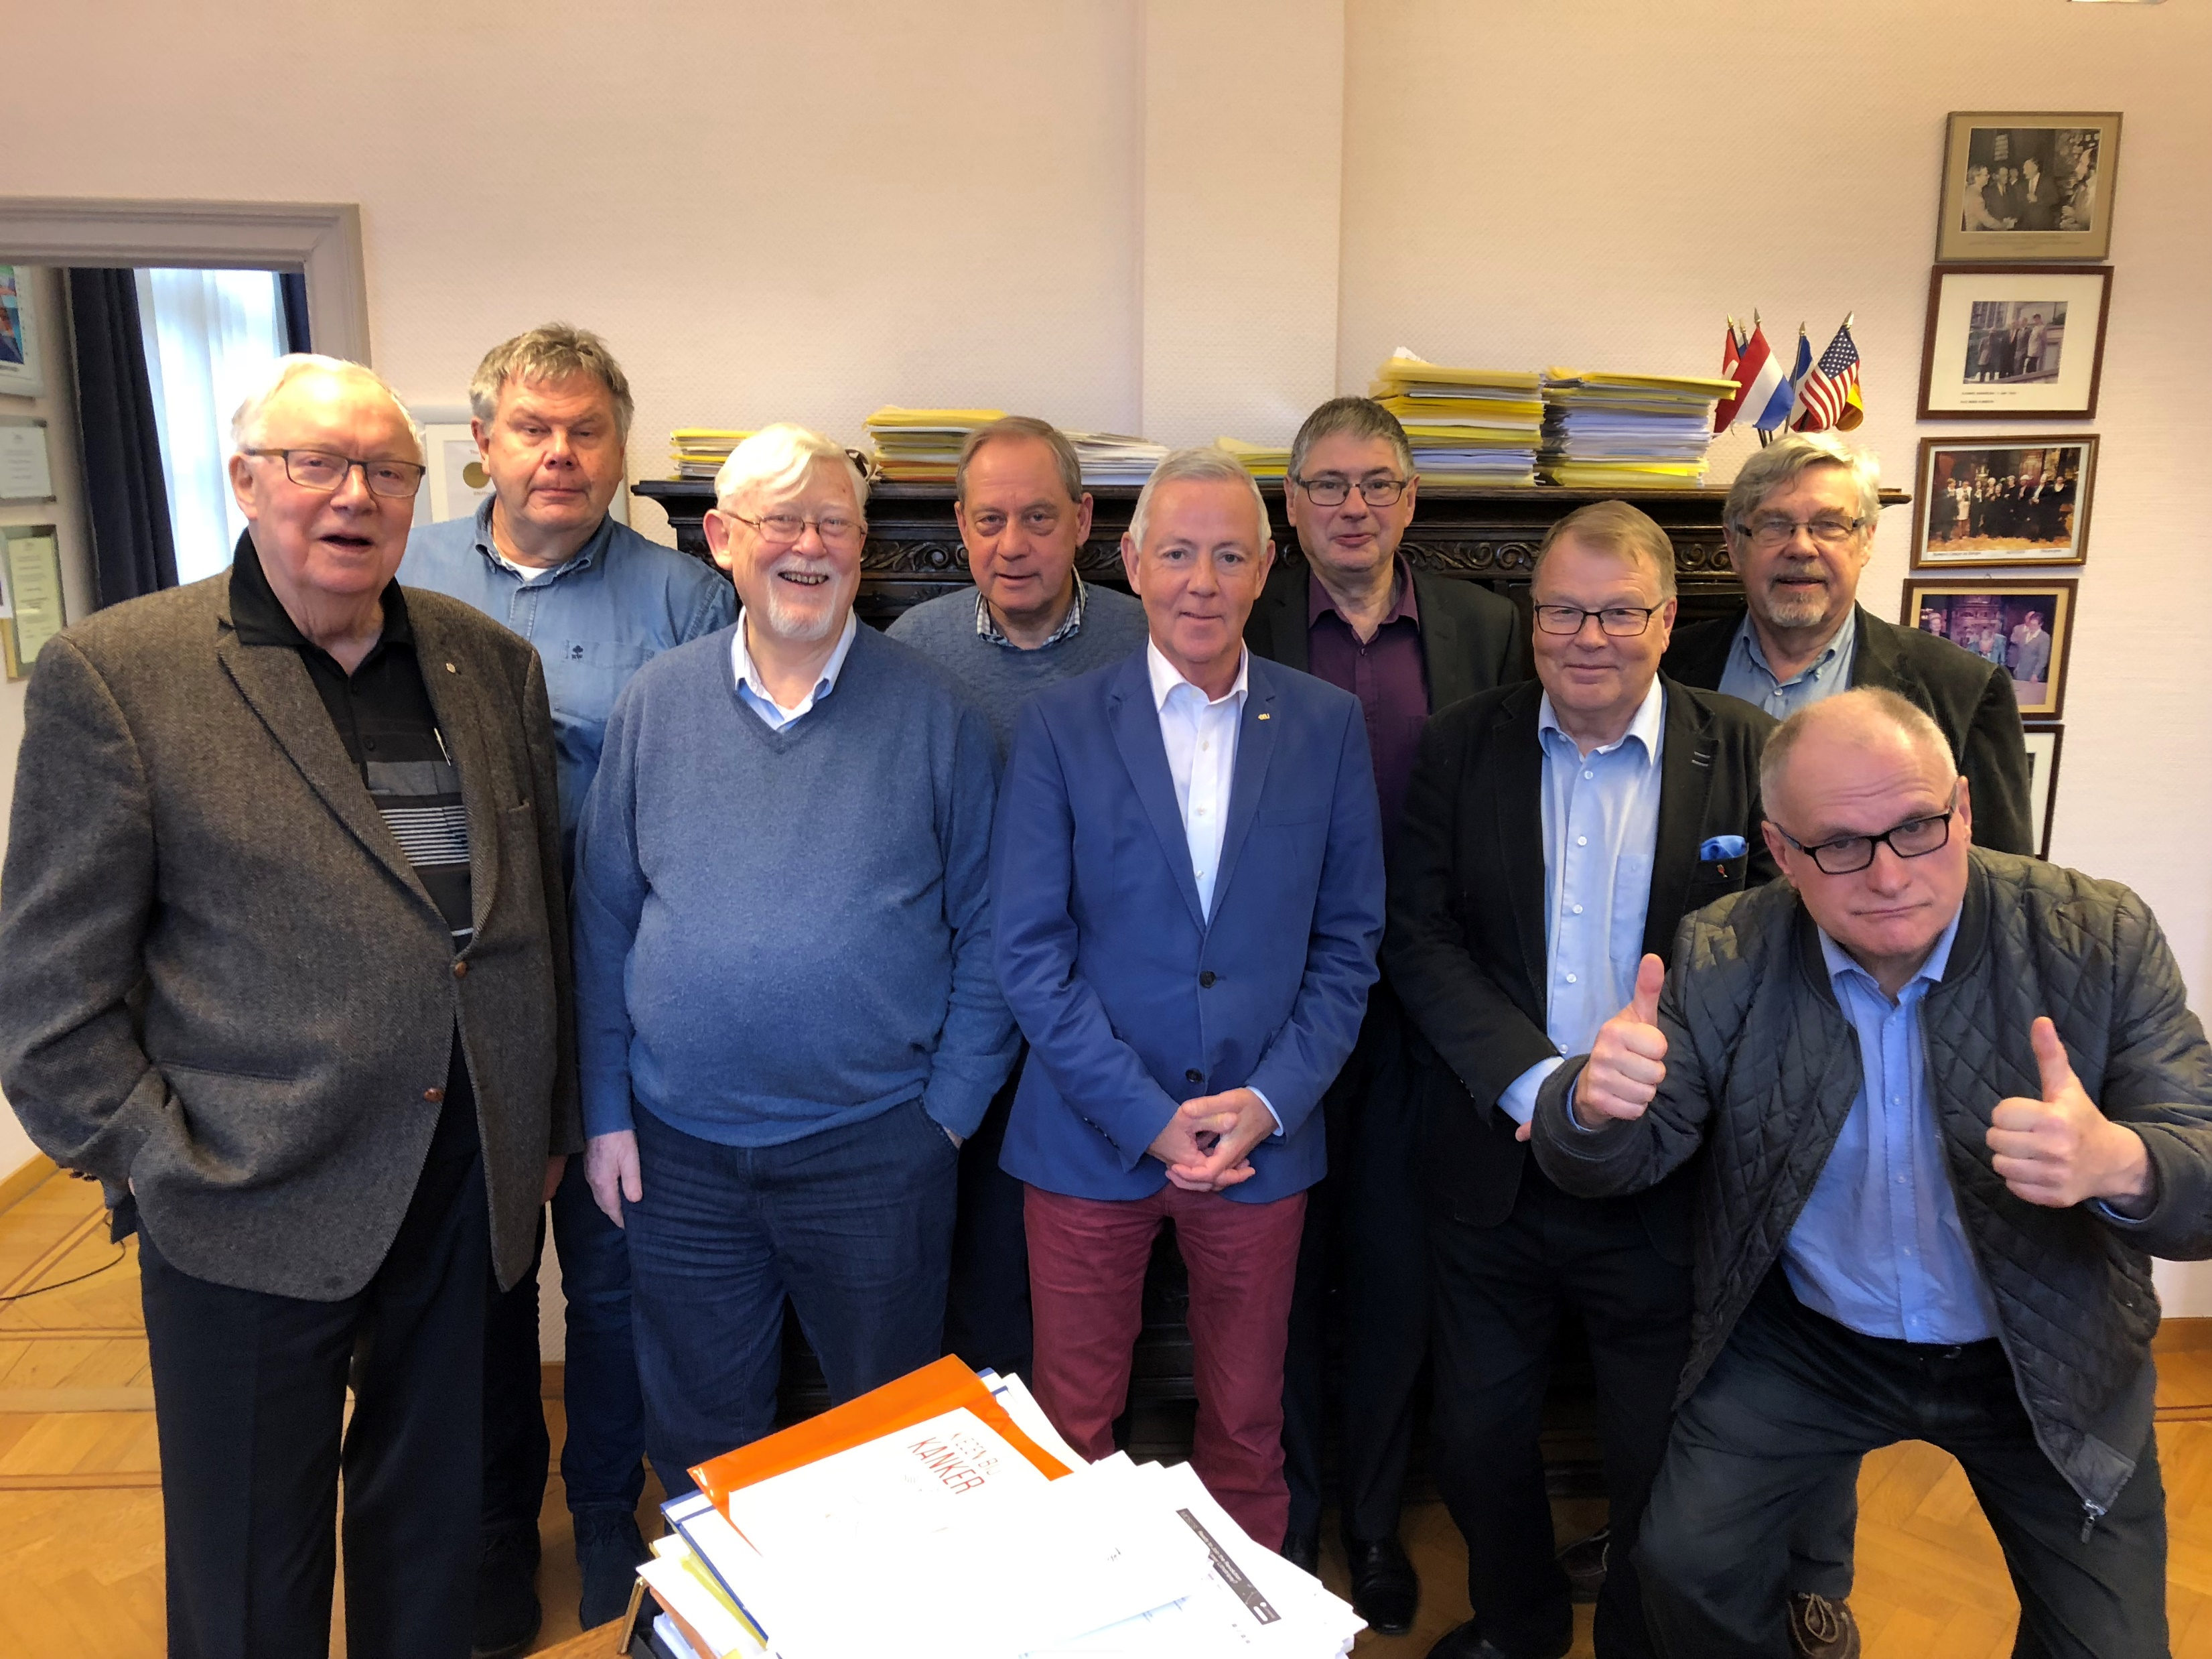
OCA
Antwerp
Notes:
Patient-centred, multidisciplinary approach
Equitable access to novel technology
Personalized medicine
Consistent Health Technology Assessment (HTA) should be performed for optimised allocation of resources
Awareness campaigns
Survivorship cancer plans

Slide 13
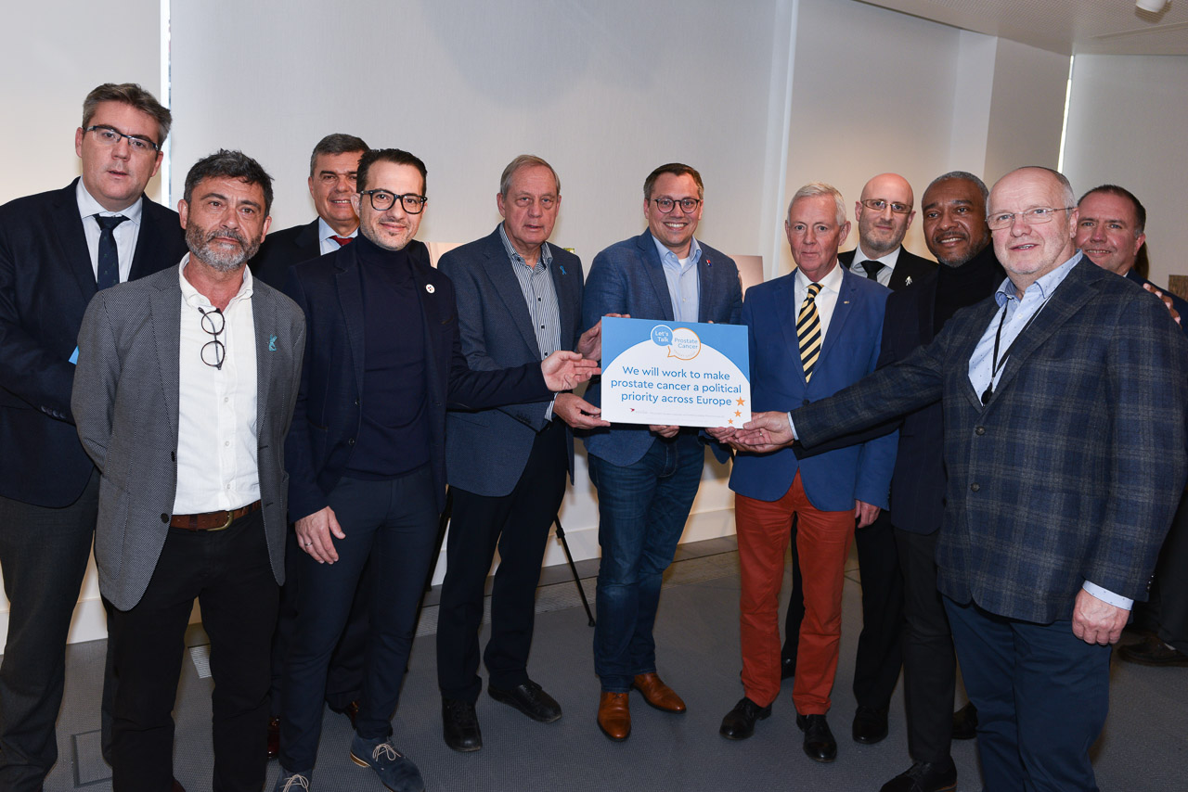
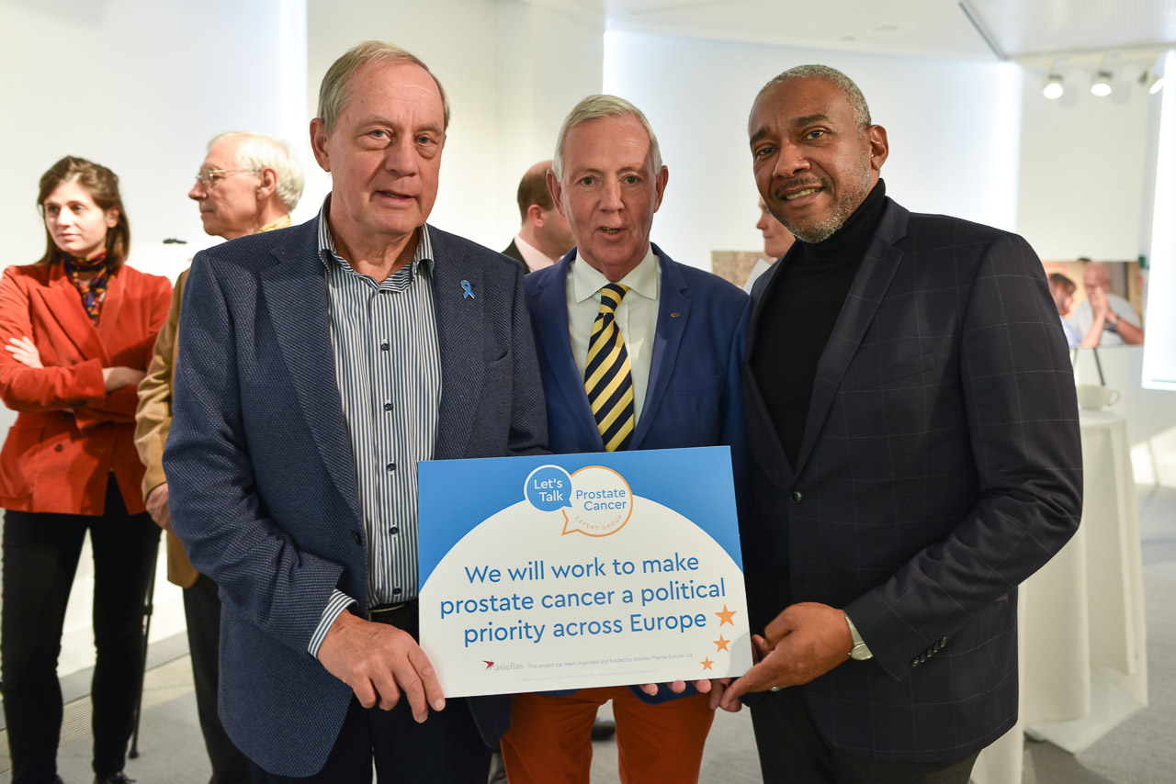
Real Men… LTPC
2018
Notes:
Patient-centred, multidisciplinary approach
Equitable access to novel technology
Personalized medicine
Consistent Health Technology Assessment (HTA) should be performed for optimised allocation of resources
Awareness campaigns
Survivorship cancer plans

Slide 14
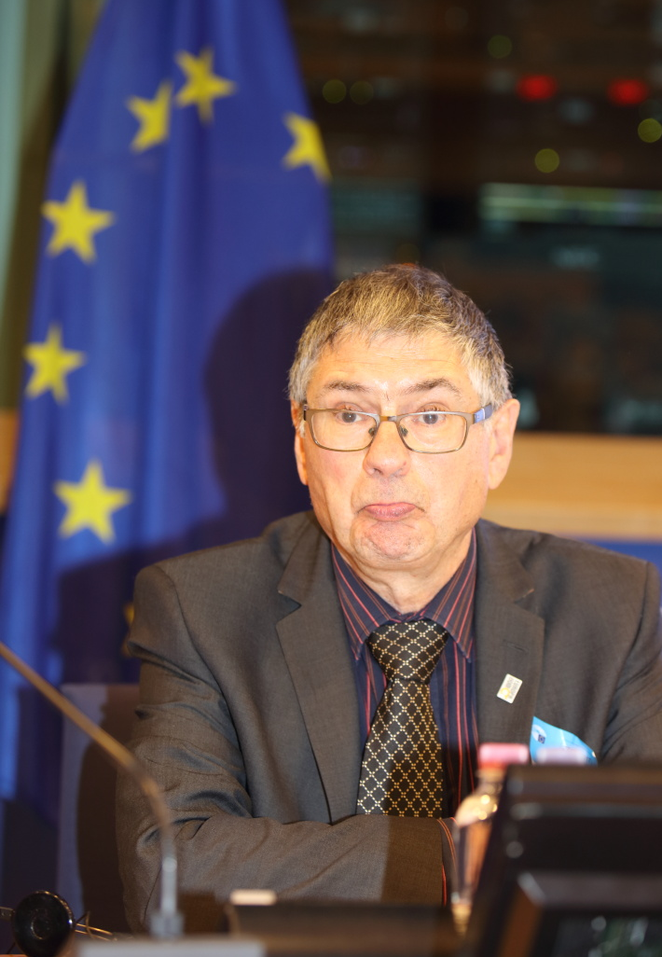
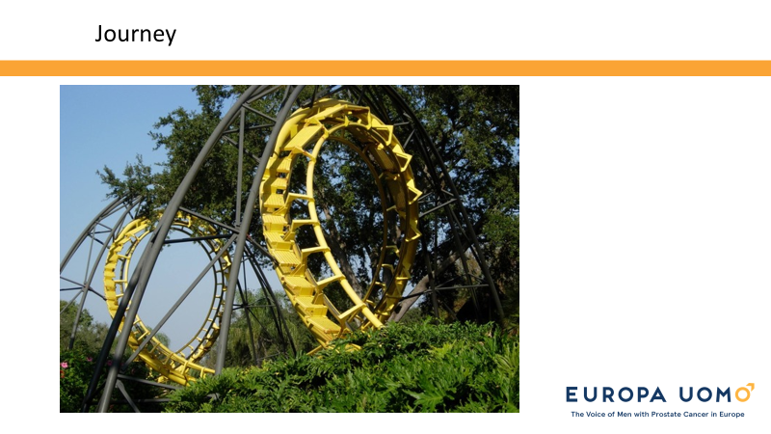

Ken Mastris
2018
Notes:
Patient-centred, multidisciplinary approach
Equitable access to novel technology
Personalized medicine
Consistent Health Technology Assessment (HTA) should be performed for optimised allocation of resources
Awareness campaigns
Survivorship cancer plans

Slide 15
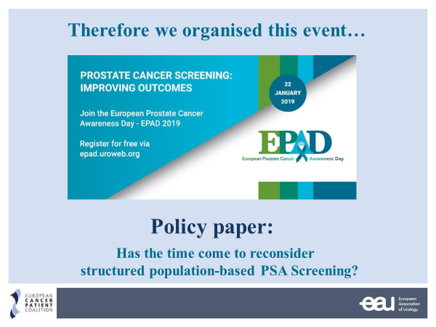
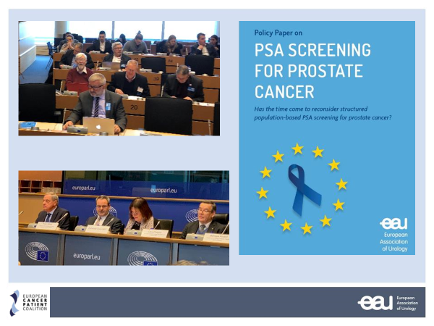

European Parliament 2019
Notes:
Patient-centred, multidisciplinary approach
Equitable access to novel technology
Personalized medicine
Consistent Health Technology Assessment (HTA) should be performed for optimised allocation of resources
Awareness campaigns
Survivorship cancer plans

Slide 16






EAU Patient Information
Copenhagen 2018 – Patient-oriented meeting
Bladder cancer
Kidney cancer
Prostate cancer
Collaboration with:
European Cancer Patient Coalition
Europa Uomo
IKCC
Fight Bladder Cancer UK
Mitrofanoff Support
EAUN
Notes:
Patient-centred, multidisciplinary approach
Equitable access to novel technology
Personalized medicine
Consistent Health Technology Assessment (HTA) should be performed for optimised allocation of resources
Awareness campaigns
Survivorship cancer plans

Slide 17
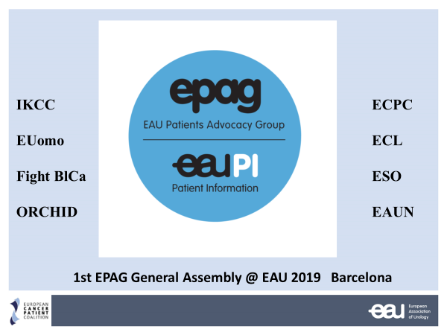
2019
Notes:
Patient-centred, multidisciplinary approach
Equitable access to novel technology
Personalized medicine
Consistent Health Technology Assessment (HTA) should be performed for optimised allocation of resources
Awareness campaigns
Survivorship cancer plans

Slide 18
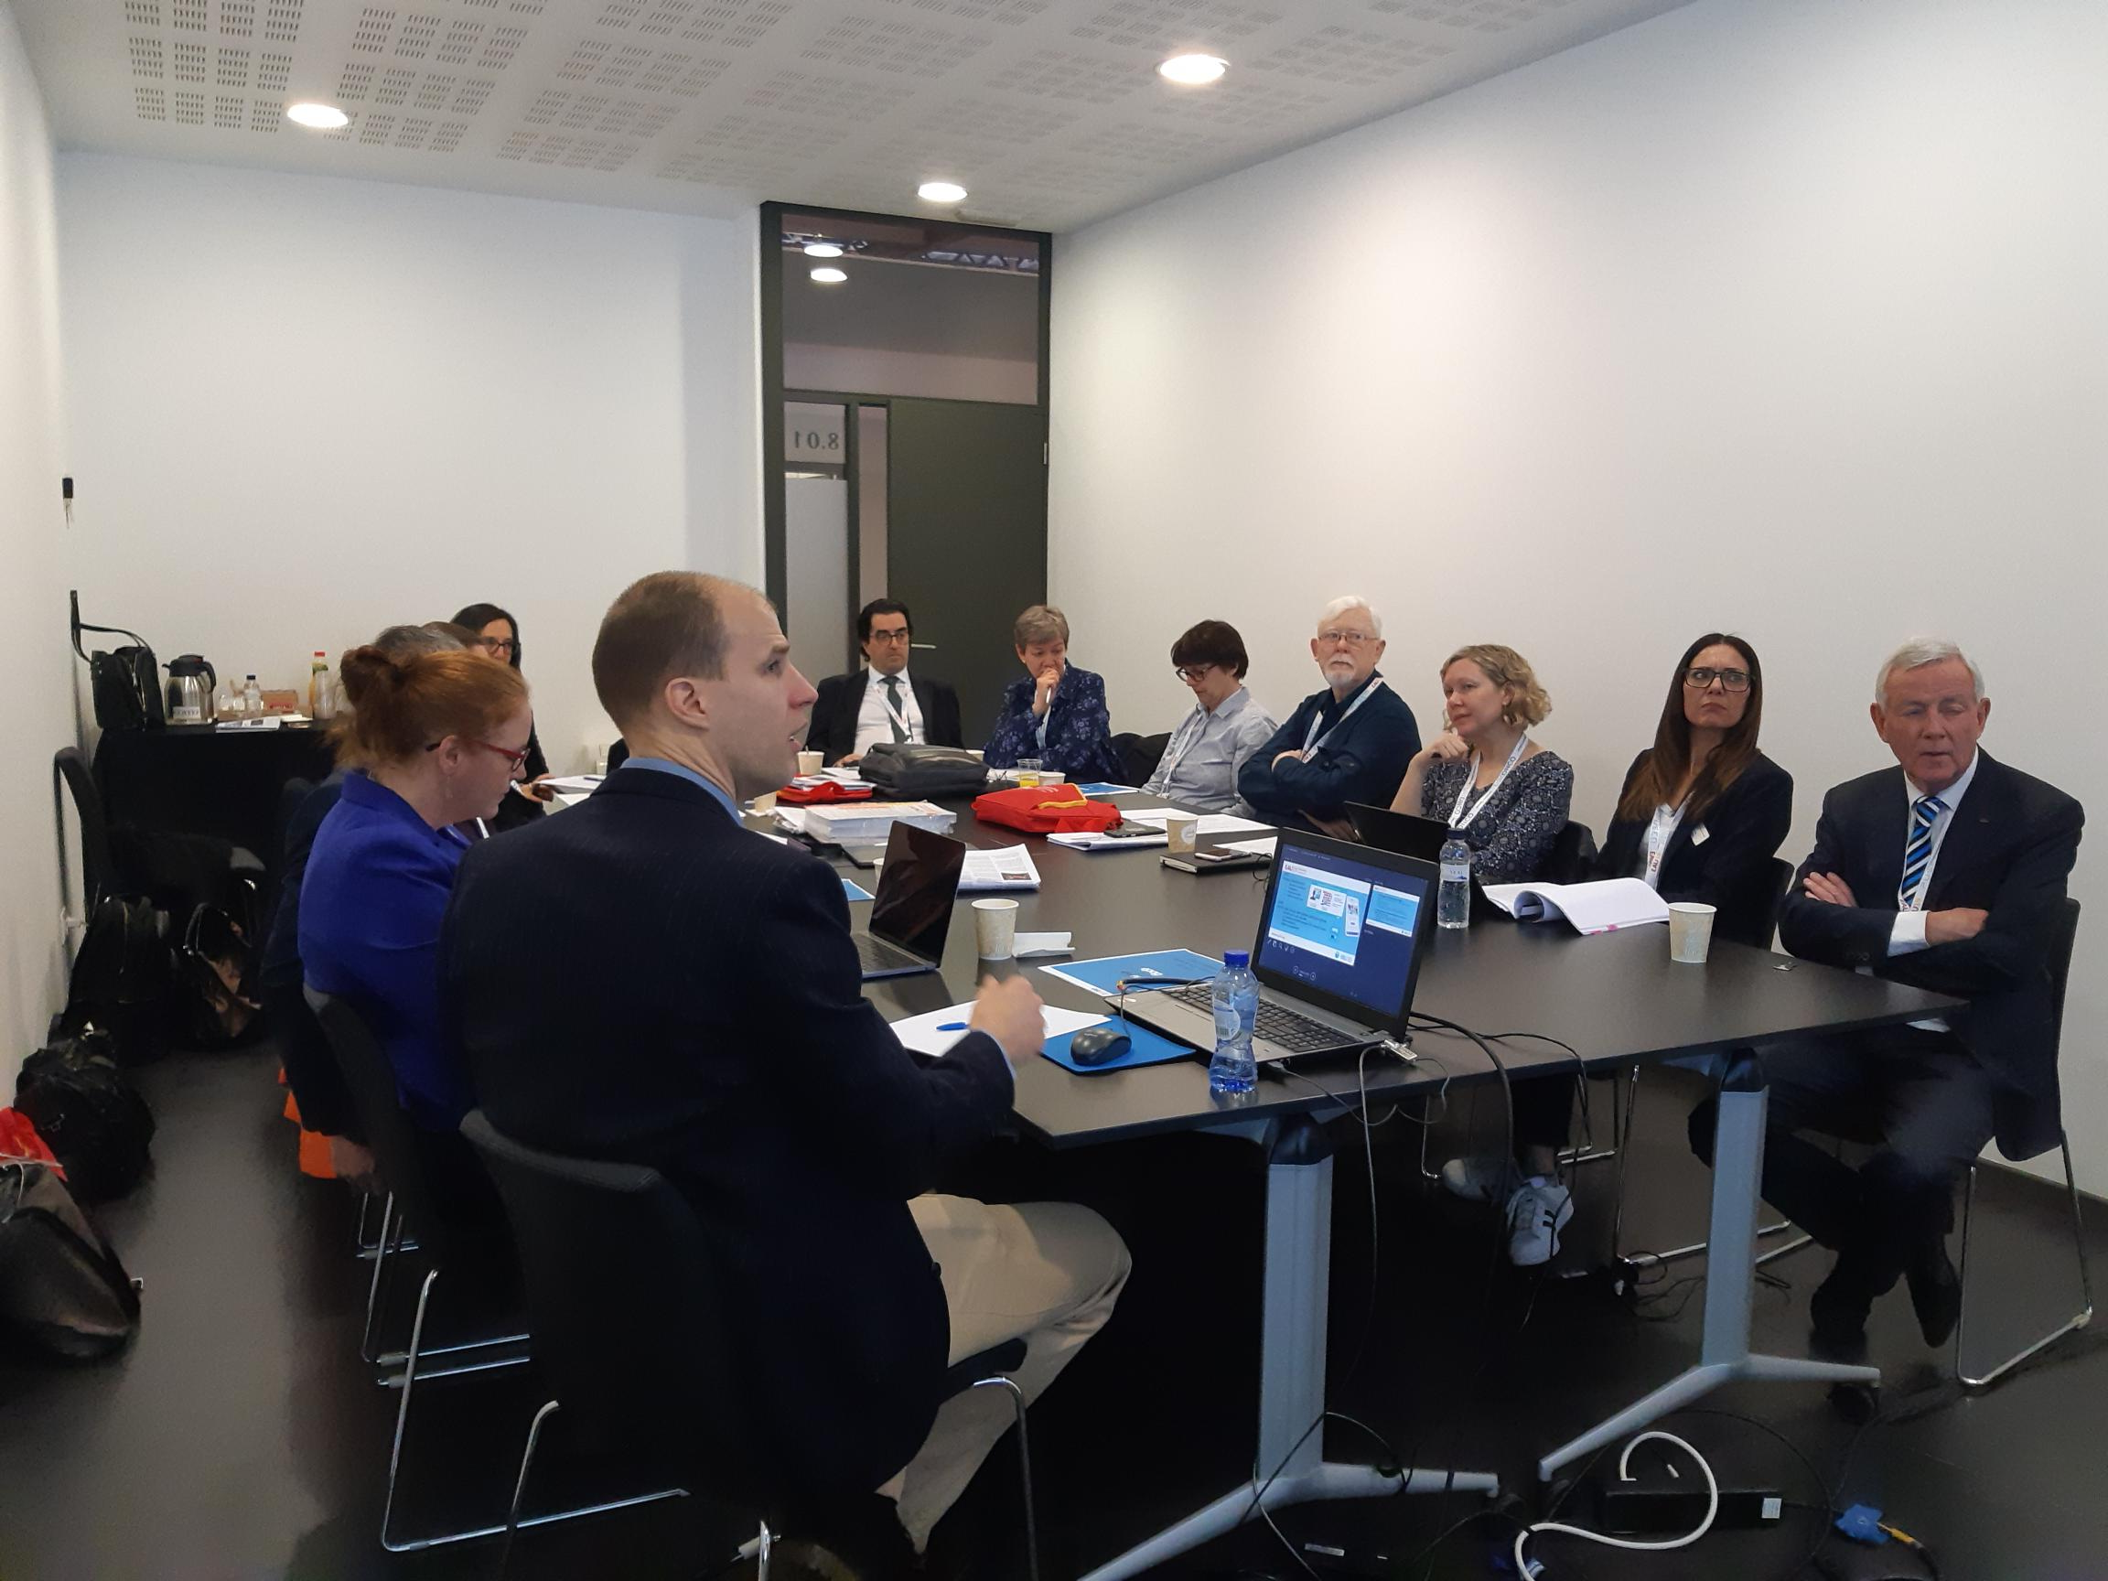
Barcelona EAU19
Notes:
Patient-centred, multidisciplinary approach
Equitable access to novel technology
Personalized medicine
Consistent Health Technology Assessment (HTA) should be performed for optimised allocation of resources
Awareness campaigns
Survivorship cancer plans

Slide 19
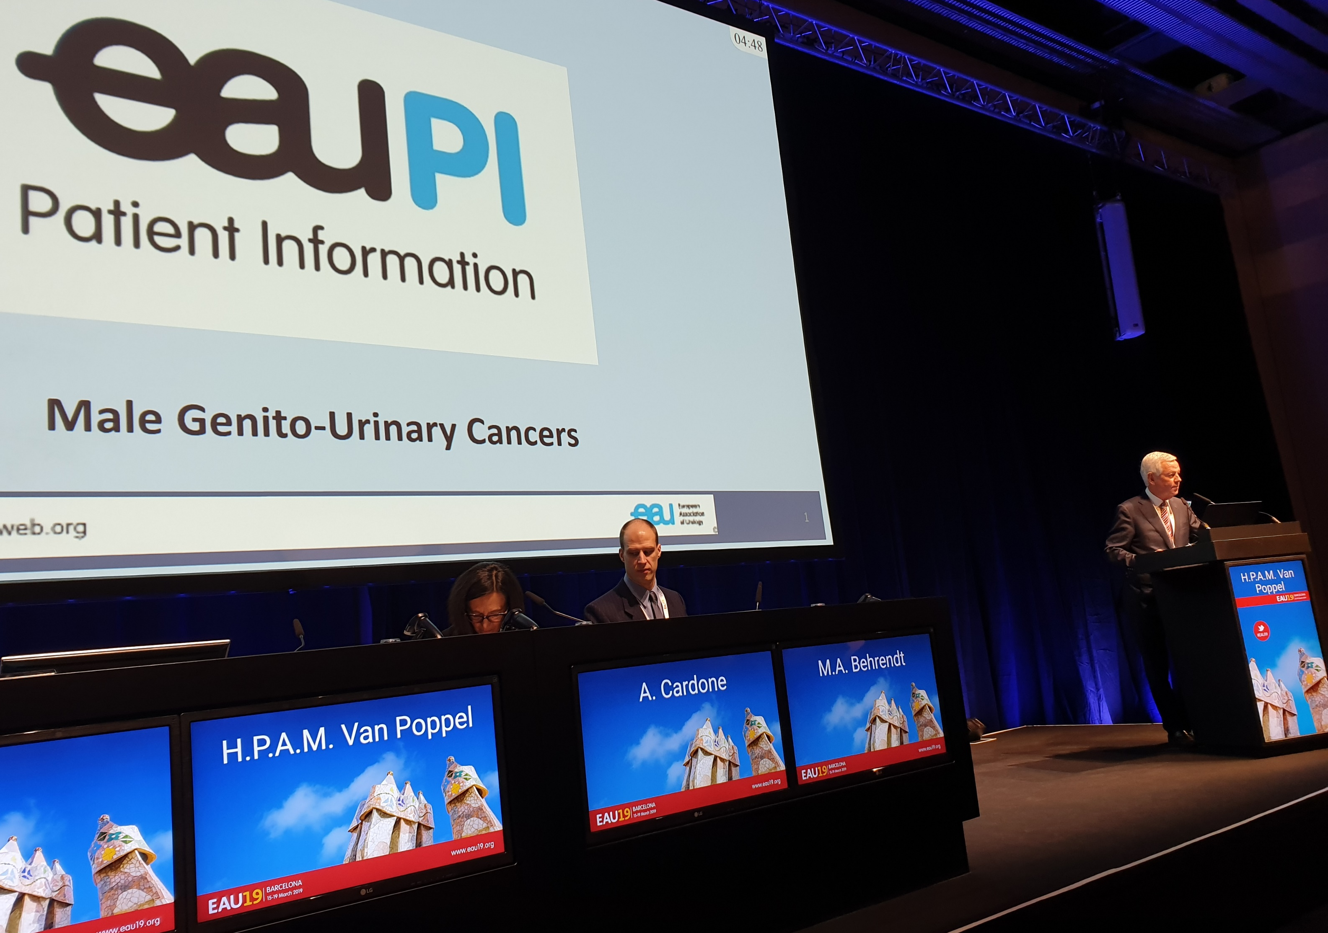
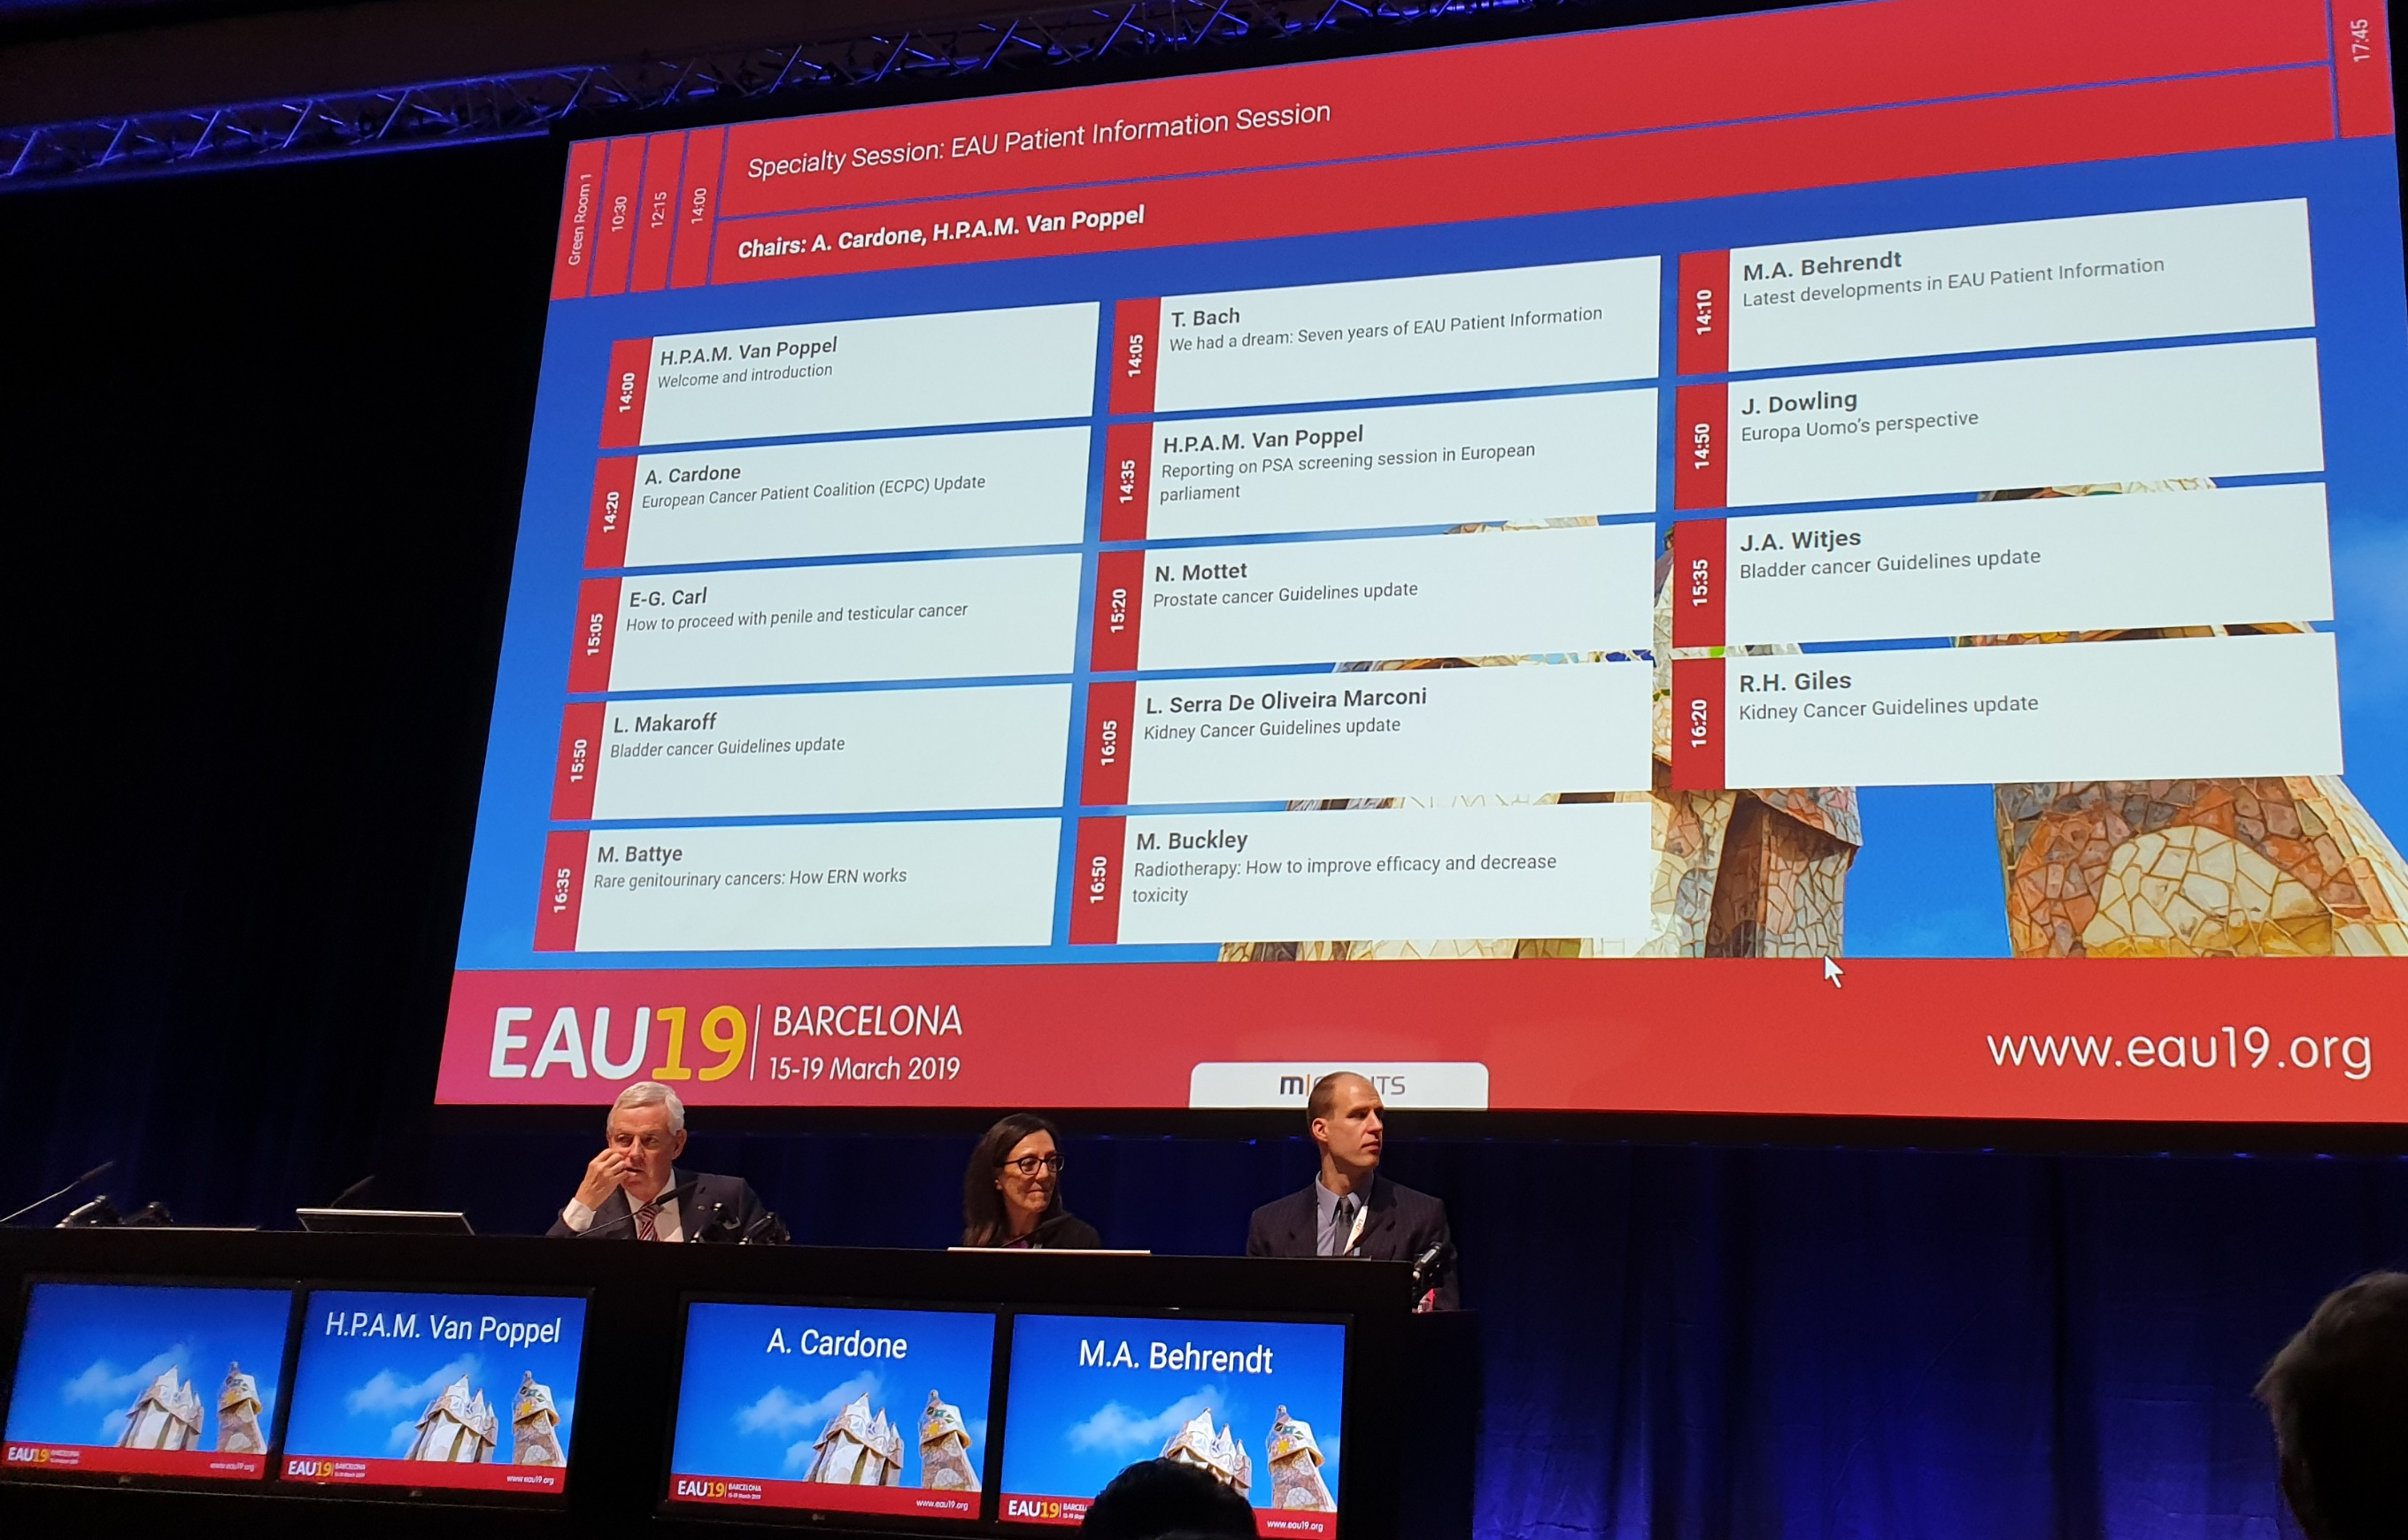
First EAUPI Thematic Session at EAU19 Barcelona
Notes:
Patient-centred, multidisciplinary approach
Equitable access to novel technology
Personalized medicine
Consistent Health Technology Assessment (HTA) should be performed for optimised allocation of resources
Awareness campaigns
Survivorship cancer plans

Slide 20

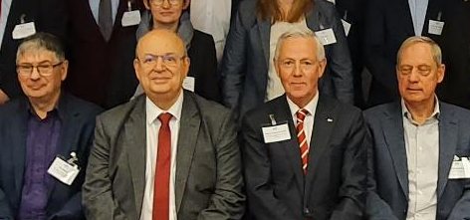
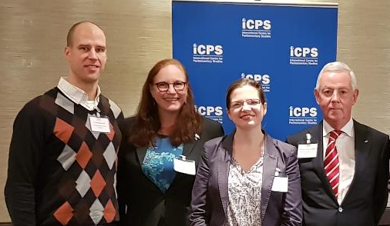
We need sustained patient support
Notes:
Patient-centred, multidisciplinary approach
Equitable access to novel technology
Personalized medicine
Consistent Health Technology Assessment (HTA) should be performed for optimised allocation of resources
Awareness campaigns
Survivorship cancer plans

Slide 21
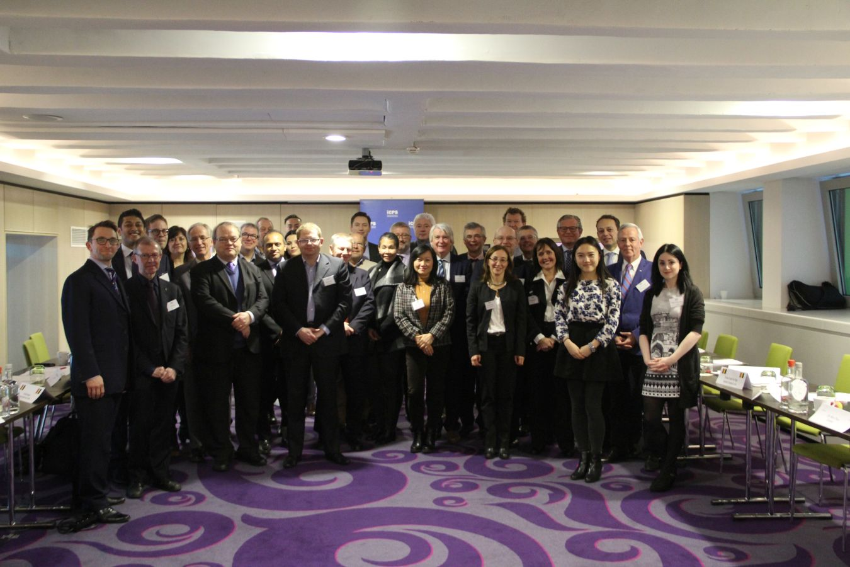
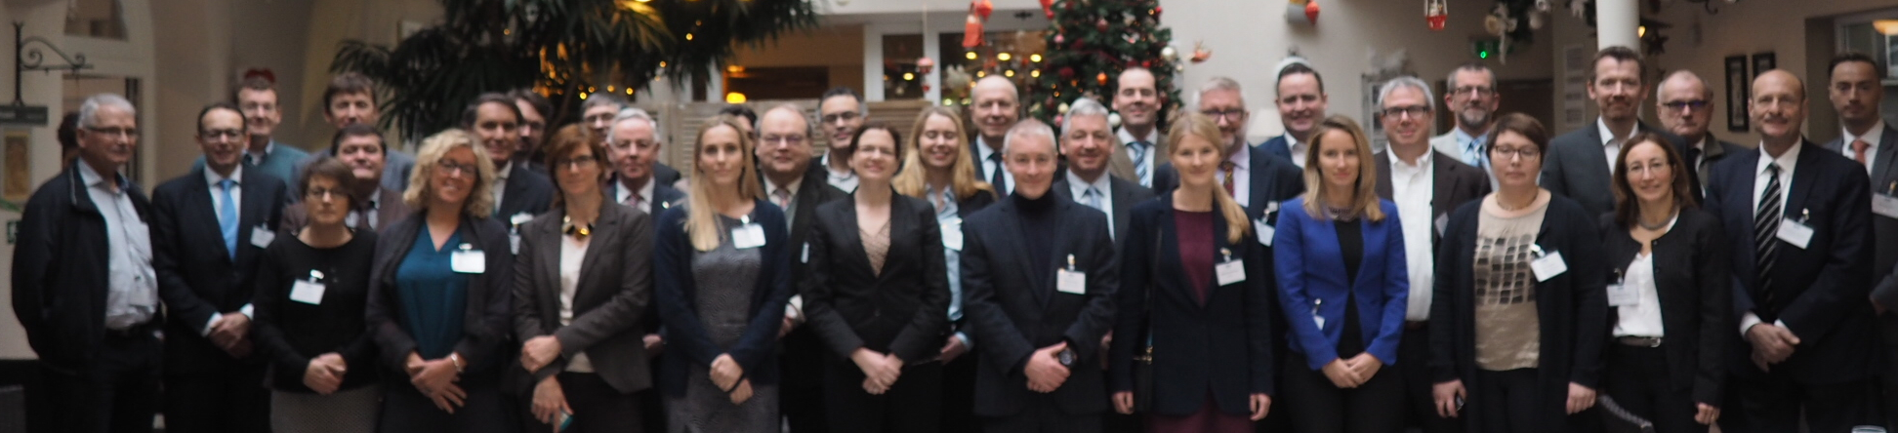
iCPS 2016
iCPS 2017
Notes:
Patient-centred, multidisciplinary approach
Equitable access to novel technology
Personalized medicine
Consistent Health Technology Assessment (HTA) should be performed for optimised allocation of resources
Awareness campaigns
Survivorship cancer plans

Slide 22
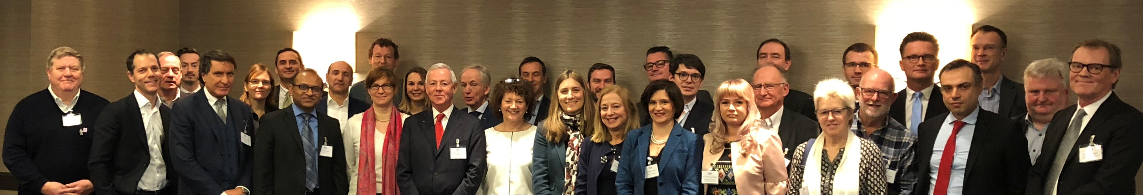
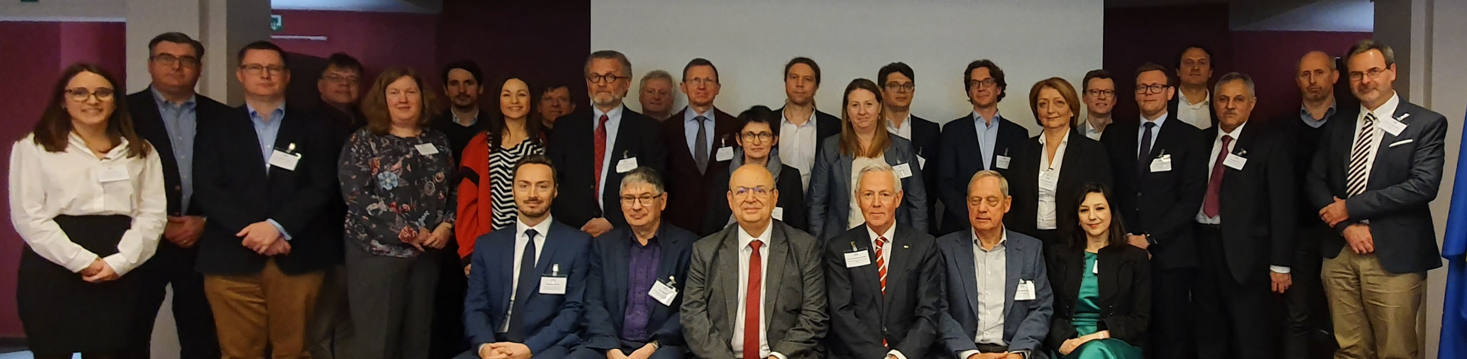
iCPS 2018
iCPS 2019
Notes:
Patient-centred, multidisciplinary approach
Equitable access to novel technology
Personalized medicine
Consistent Health Technology Assessment (HTA) should be performed for optimised allocation of resources
Awareness campaigns
Survivorship cancer plans

Slide 23
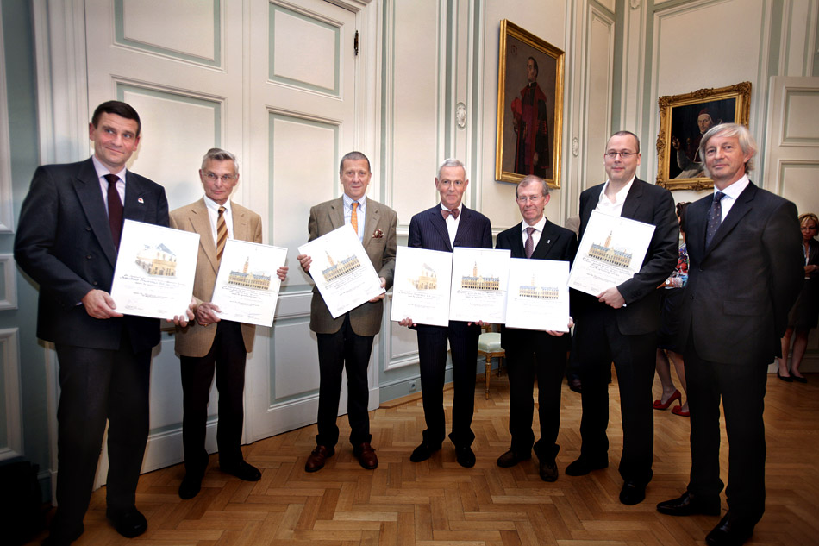
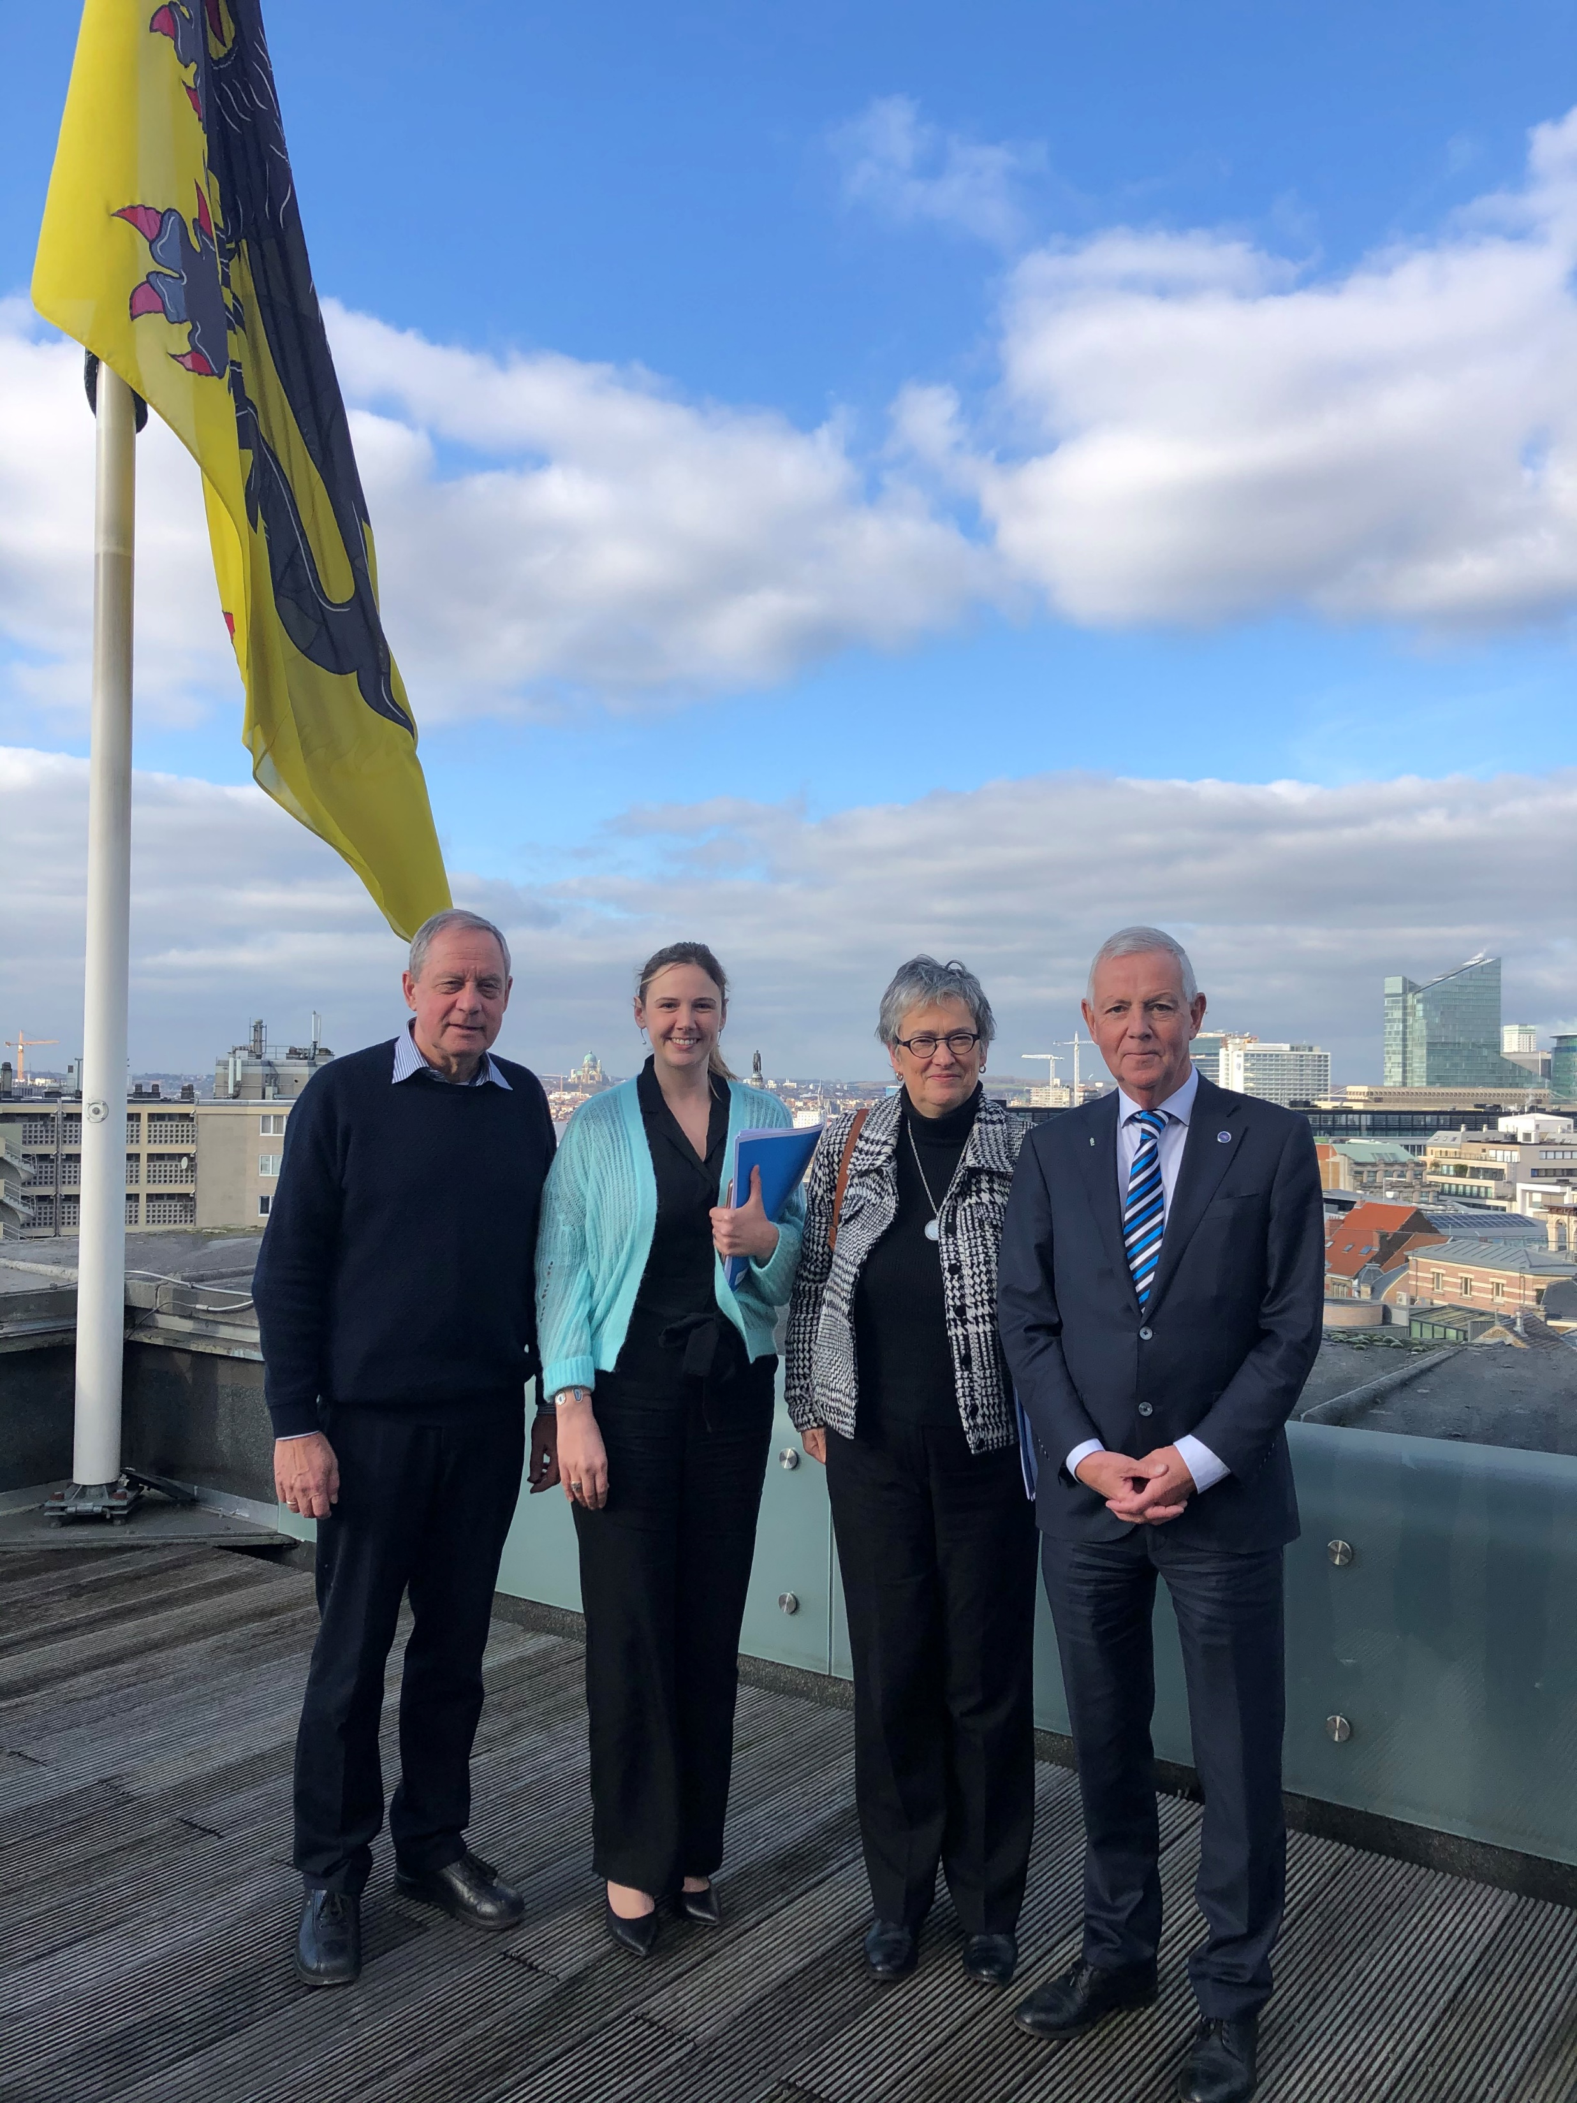

Notes:
Patient-centred, multidisciplinary approach
Equitable access to novel technology
Personalized medicine
Consistent Health Technology Assessment (HTA) should be performed for optimised allocation of resources
Awareness campaigns
Survivorship cancer plans

Slide 24
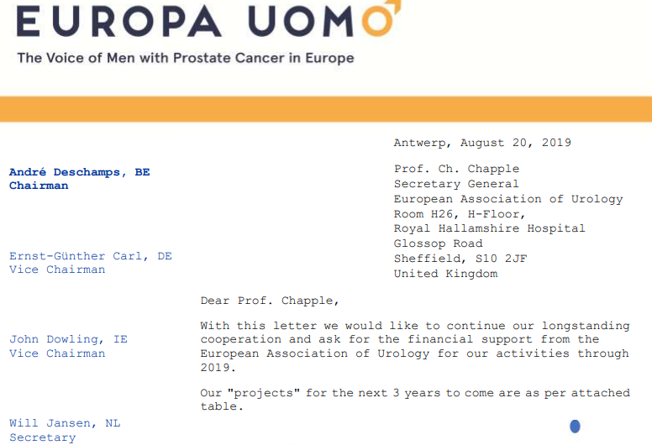

Notes:
Patient-centred, multidisciplinary approach
Equitable access to novel technology
Personalized medicine
Consistent Health Technology Assessment (HTA) should be performed for optimised allocation of resources
Awareness campaigns
Survivorship cancer plans

Slide 25

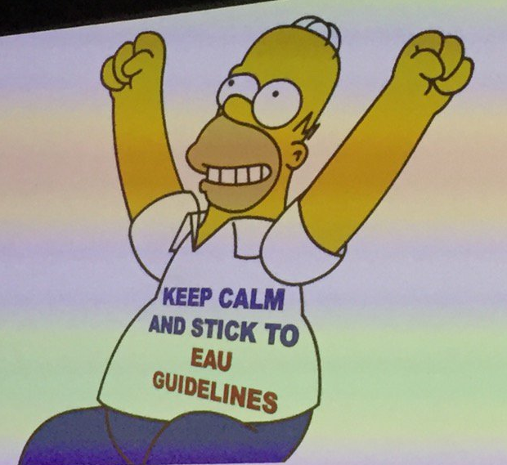

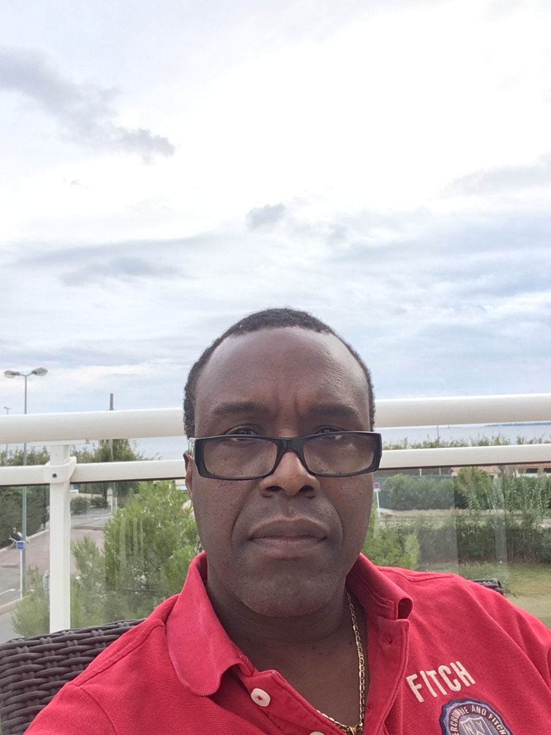

Notes:
Patient-centred, multidisciplinary approach
Equitable access to novel technology
Personalized medicine
Consistent Health Technology Assessment (HTA) should be performed for optimised allocation of resources
Awareness campaigns
Survivorship cancer plans

Slide 26
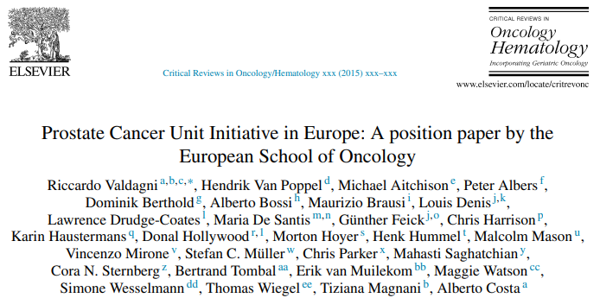
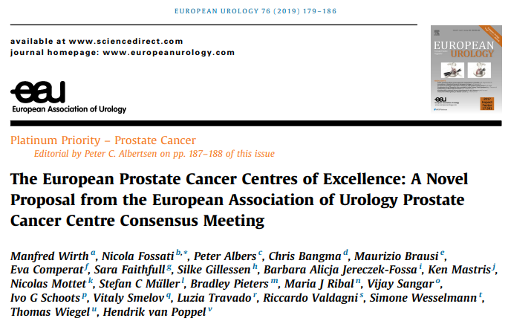
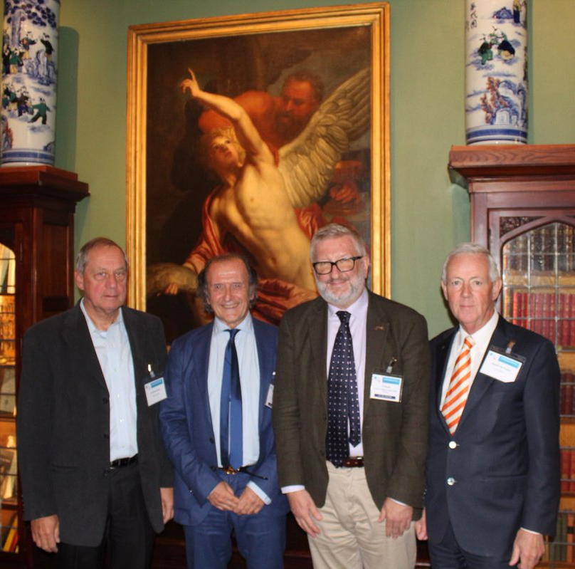
2015
2019
Notes:
Patient-centred, multidisciplinary approach
Equitable access to novel technology
Personalized medicine
Consistent Health Technology Assessment (HTA) should be performed for optimised allocation of resources
Awareness campaigns
Survivorship cancer plans

Slide 27
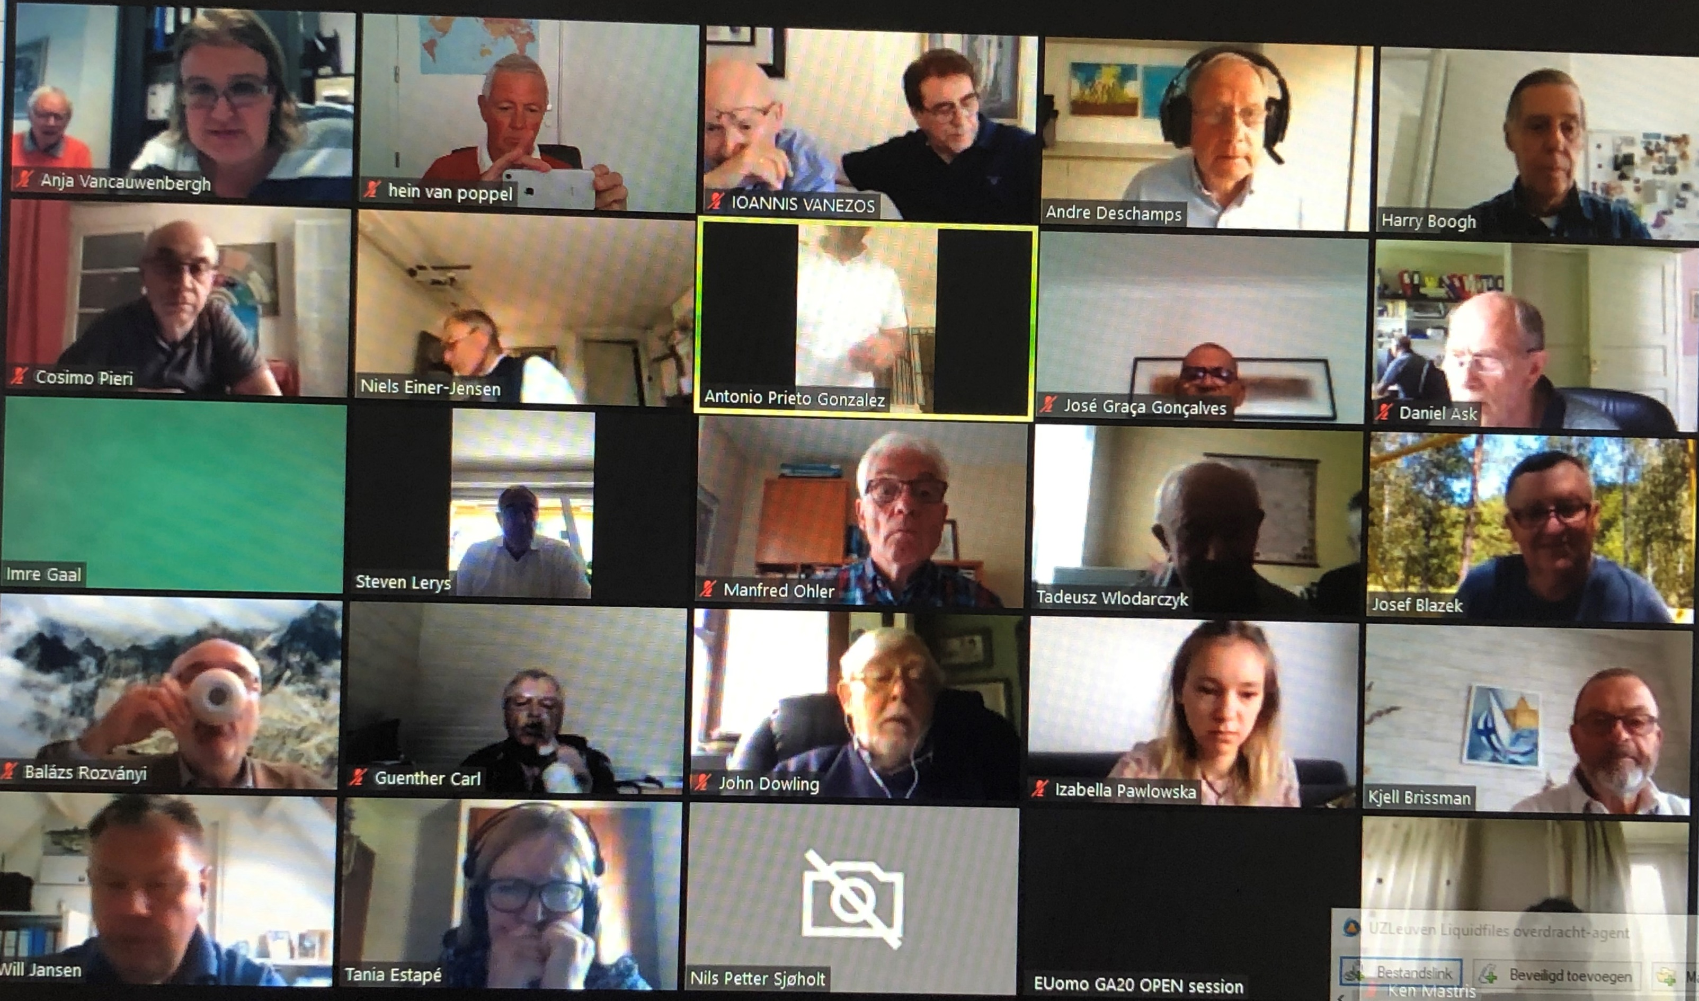
GA during COVID- Pandemic
Notes:
Patient-centred, multidisciplinary approach
Equitable access to novel technology
Personalized medicine
Consistent Health Technology Assessment (HTA) should be performed for optimised allocation of resources
Awareness campaigns
Survivorship cancer plans

Slide 28




Brussels 2023
Notes:
Patient-centred, multidisciplinary approach
Equitable access to novel technology
Personalized medicine
Consistent Health Technology Assessment (HTA) should be performed for optimised allocation of resources
Awareness campaigns
Survivorship cancer plans

Slide 29

EAU Patient Advocacy Medal of Excellence
Notes:
Patient-centred, multidisciplinary approach
Equitable access to novel technology
Personalized medicine
Consistent Health Technology Assessment (HTA) should be performed for optimised allocation of resources
Awareness campaigns
Survivorship cancer plans

Slide 30

Scientific work
EUPROMS I
EUPROMS II
EUPROPER
Webinars:
- Active Surveillance
Summer School 2024
Notes:
Patient-centred, multidisciplinary approach
Equitable access to novel technology
Personalized medicine
Consistent Health Technology Assessment (HTA) should be performed for optimised allocation of resources
Awareness campaigns
Survivorship cancer plans

Slide 31

Anja Vancauwenbergh
Already working (behind the scene) for Euomo since 2004.
Since the GA 2012 in Cyprus she went on to do a fulltime job, Secretary of Europa Uomo.
EUomo is why her heart beats…!?
6 years later:
- Ymke, birthday 21 March, so had her 6th birtday 😄
Notes:
Patient-centred, multidisciplinary approach
Equitable access to novel technology
Personalized medicine
Consistent Health Technology Assessment (HTA) should be performed for optimised allocation of resources
Awareness campaigns
Survivorship cancer plans

Slide 32



Notes:
Patient-centred, multidisciplinary approach
Equitable access to novel technology
Personalized medicine
Consistent Health Technology Assessment (HTA) should be performed for optimised allocation of resources
Awareness campaigns
Survivorship cancer plans

Slide 33
Notes:
Patient-centred, multidisciplinary approach
Equitable access to novel technology
Personalized medicine
Consistent Health Technology Assessment (HTA) should be performed for optimised allocation of resources
Awareness campaigns
Survivorship cancer plans

Slide 34
Notes:
Patient-centred, multidisciplinary approach
Equitable access to novel technology
Personalized medicine
Consistent Health Technology Assessment (HTA) should be performed for optimised allocation of resources
Awareness campaigns
Survivorship cancer plans

Slide 35

…………….
Notes:
Patient-centred, multidisciplinary approach
Equitable access to novel technology
Personalized medicine
Consistent Health Technology Assessment (HTA) should be performed for optimised allocation of resources
Awareness campaigns
Survivorship cancer plans

