Slide 1
20 Years of Europa Uomo
Dr Erik Briers MS PhD – Vice Chairman Europa Uomo

Slide 2
20Years of Europa Uomo

Slide 3
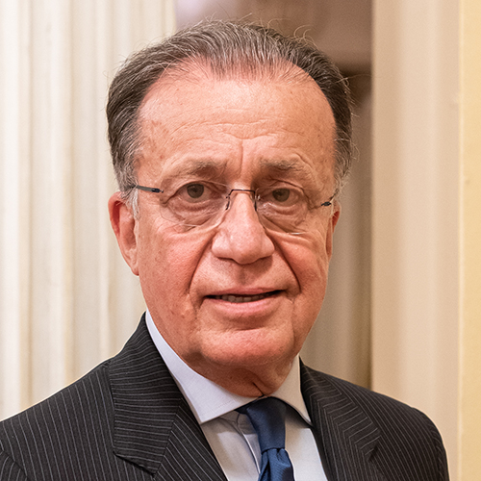
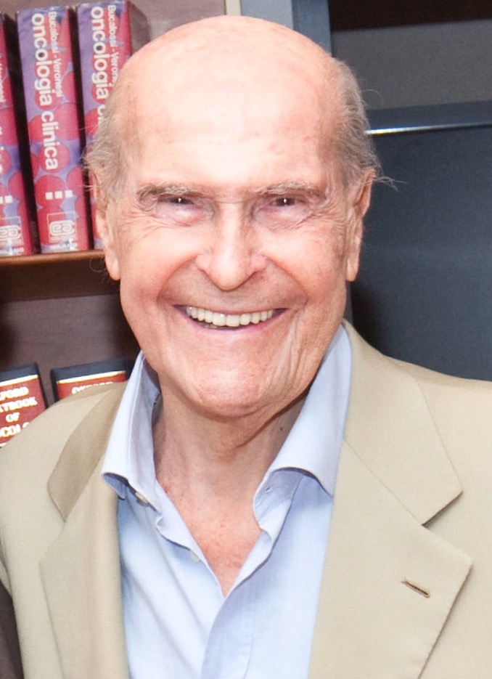
20Years of Europa Uomo
The early years of the European Prostate Cancer Coalition
Before 2002
European School of Oncology (ESO) created Europa Uomo informally because of unmet needs in prostate cancer (model was Europa Donna)
Actors: Dr Alberto Costa, Prof. Umberto Veronesi,
Tom Hudson (Ireland) and Louis Denis (Belgium)

Slide 4
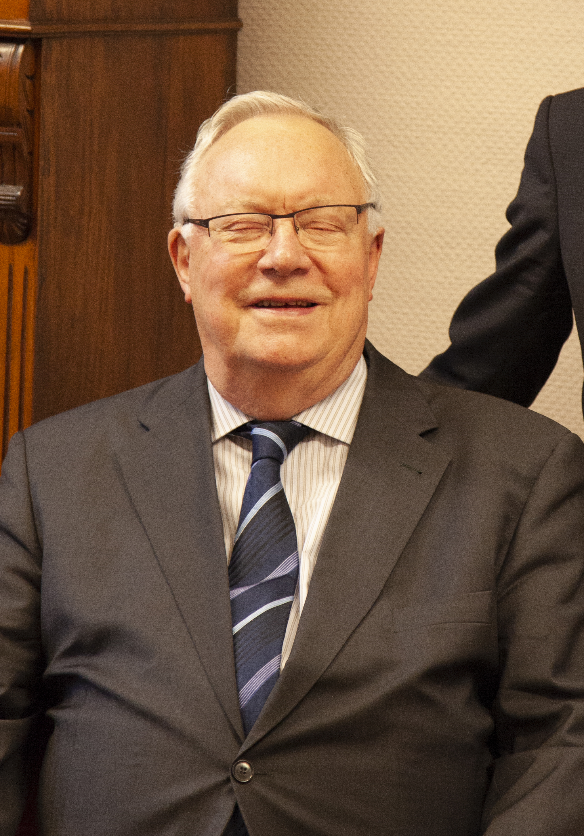
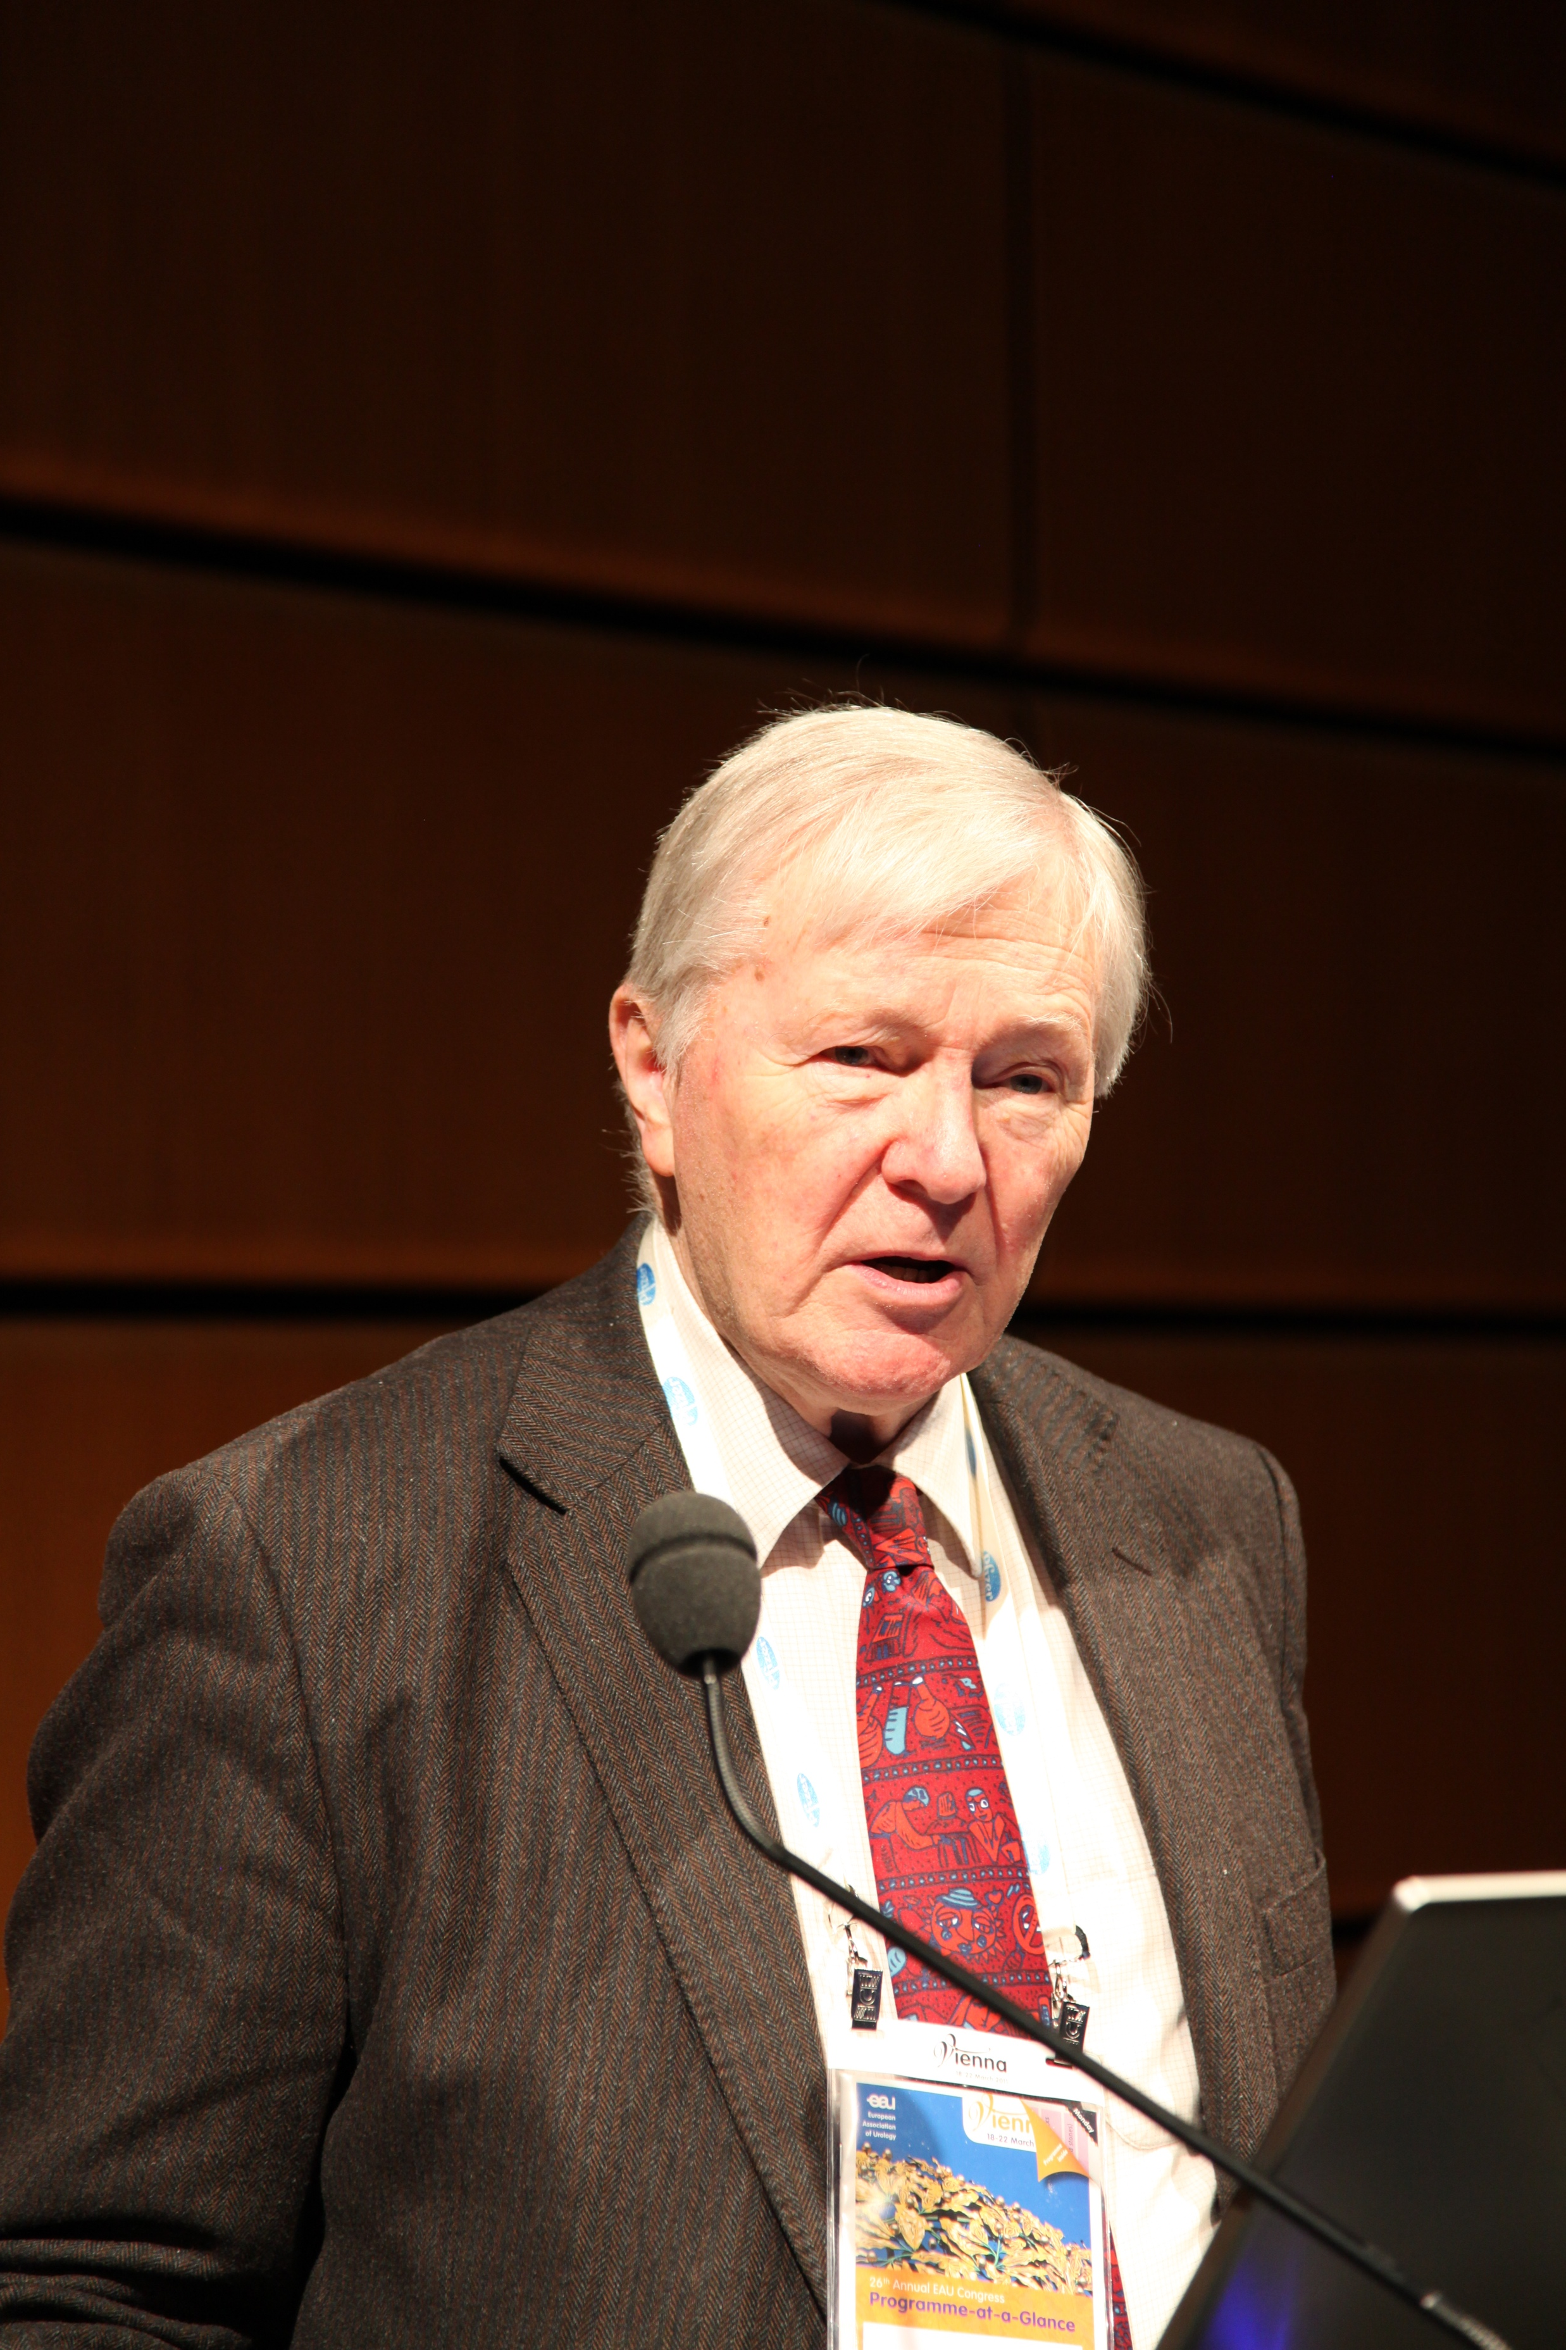
20Years of Europa Uomo
The early years of the European Prostate Cancer Coalition
2002-2004
European prostate cancer organizations came together to create the statutes and the manifesto of Europa Uomo under the leadership of
Tom Hudson (Ireland) and Louis Denis (Belgium)
And with support from ESO and OCA (Antwerp)

Slide 5
20Years of Europa Uomo
The founding fathers
11 June 2004 Milan

Slide 6
20Years of Europa Uomo
The founding fathers
Büchler Ekkehard
Pais Jacob
Van daele Henk
Eliason Lars
Wildblood Peter
Cahill Eoghan
Tavio Hannu
Briers Erik
Costa Alberto
Denis Louis
Estapé Jordi
Petter Wolfgang
Muntz Roland
Europa Uomo
McAuliffe Daniel
Valverde Elias
Hudson Tom
Gaffney Daniel
Page John
Ligensa Christian
Pokstefl Hans
Redmond Katherine
Sereni Fabio
Tuomisto Pekka
Van Poppel Hein

Slide 7
20Years of Europa Uomo
11 June 2004 Milan
First board
Chairman: Tom Hudson (Ireland)
Secretary: Jack Pais (Belgium)
Treasurer: Fabio Sereni (Italy)
Vice Chairman: Dan Gaffney (UK)
Members:
Hannu Tavio (Finland)
Roland Muntz (France)
Christian Ligensa (Germany)

Slide 8
20Years of Europa Uomo
The manifesto of Europa Uomo (2003)
To find ways and means to promote quality of life for prostate cancer patients and their families;
To promote the dissemination and exchange of evidence-based as well as factual and up to date information on prostate cancer;
To promote prostate awareness and appropriate diagnosis and prognosis;
To emphasise the need for appropriate early detection;
To campaign for provision of and access to optimum treatment;
To ensure quality, supportive care throughout and after treatment;
To promote multi-professional quality care and appropriate medical infrastructure;
To acknowledge good clinical practice and promote its development;
To ensure that all men fully understand any proposed treatment options, including entry into clinical trials and their right to a second opinion;
10.To promote the advancement of prostate cancer research.

Slide 9
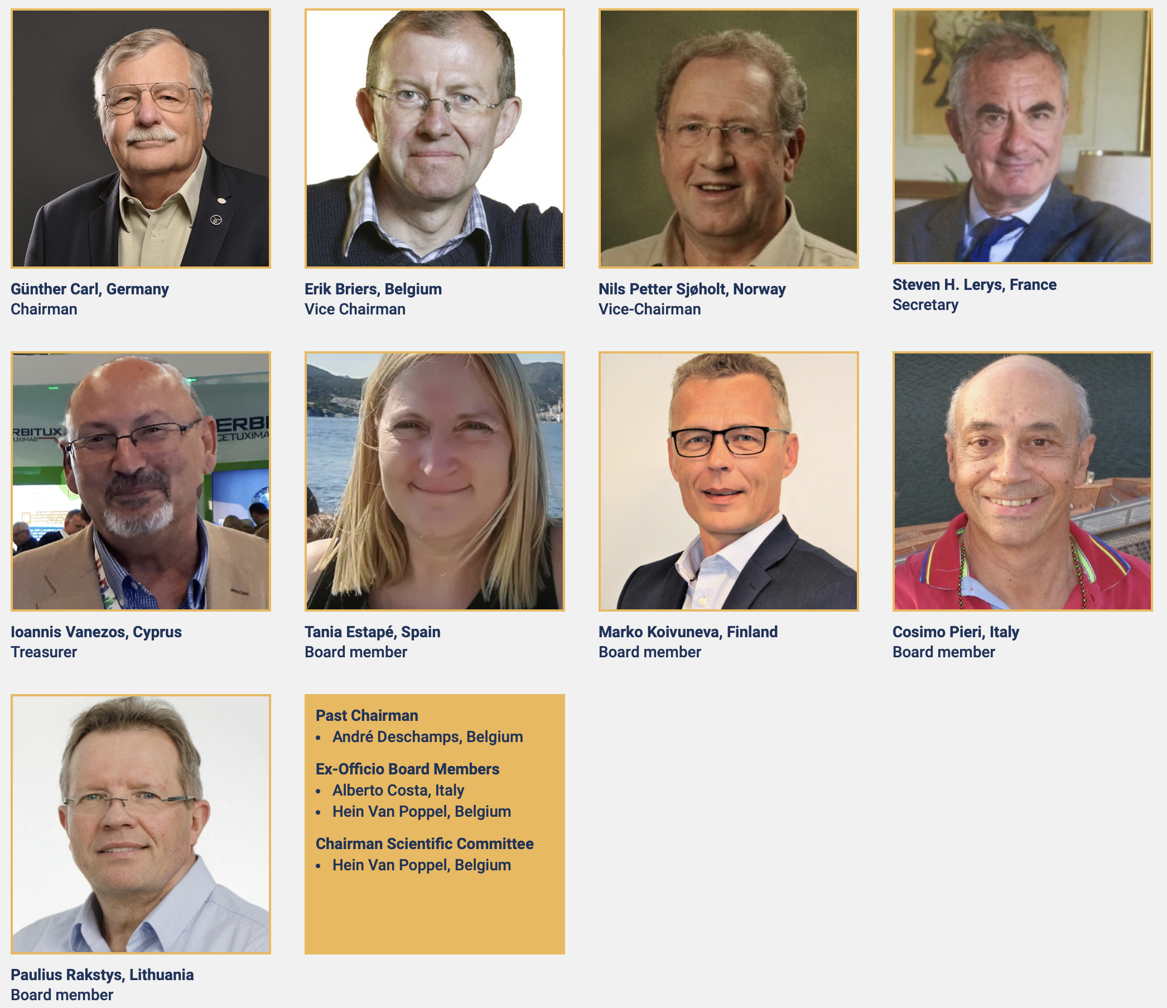
20Years of Europa Uomo
Board members 2024

Slide 10
20Years of Europa Uomo
Past Chairmen:
Tom Hudson (2002-2013)
Hans Randsdorp (2013-2014)
Ken Mastris (2014-2018)
André Deschamps (2018-2022)
Present Chairman
Günther Carl (2022- )
Scientific Committee
Chair: Prof. Hein Van Poppel
Peter Albertsen, Walter Artibani, Thorsten Bach, Chris Bangma, Joaquim Bellmunt, Alberto Bossi, Christopher Chapple, Olivier Cussenot, Sara Faithfull, Freddie Hamdy, Timo Joensuu, Steven Joniau, Nora Kearney, Michael Marberger, Francesco Montorsi, Chris Parker, Monique Roobol, Roman Sosnowski, Cora Sternberg, Ian Tannock, Bertrand Tombal, Riccardo Valdagni, Tim Ward, Manfred Wirth

Slide 11
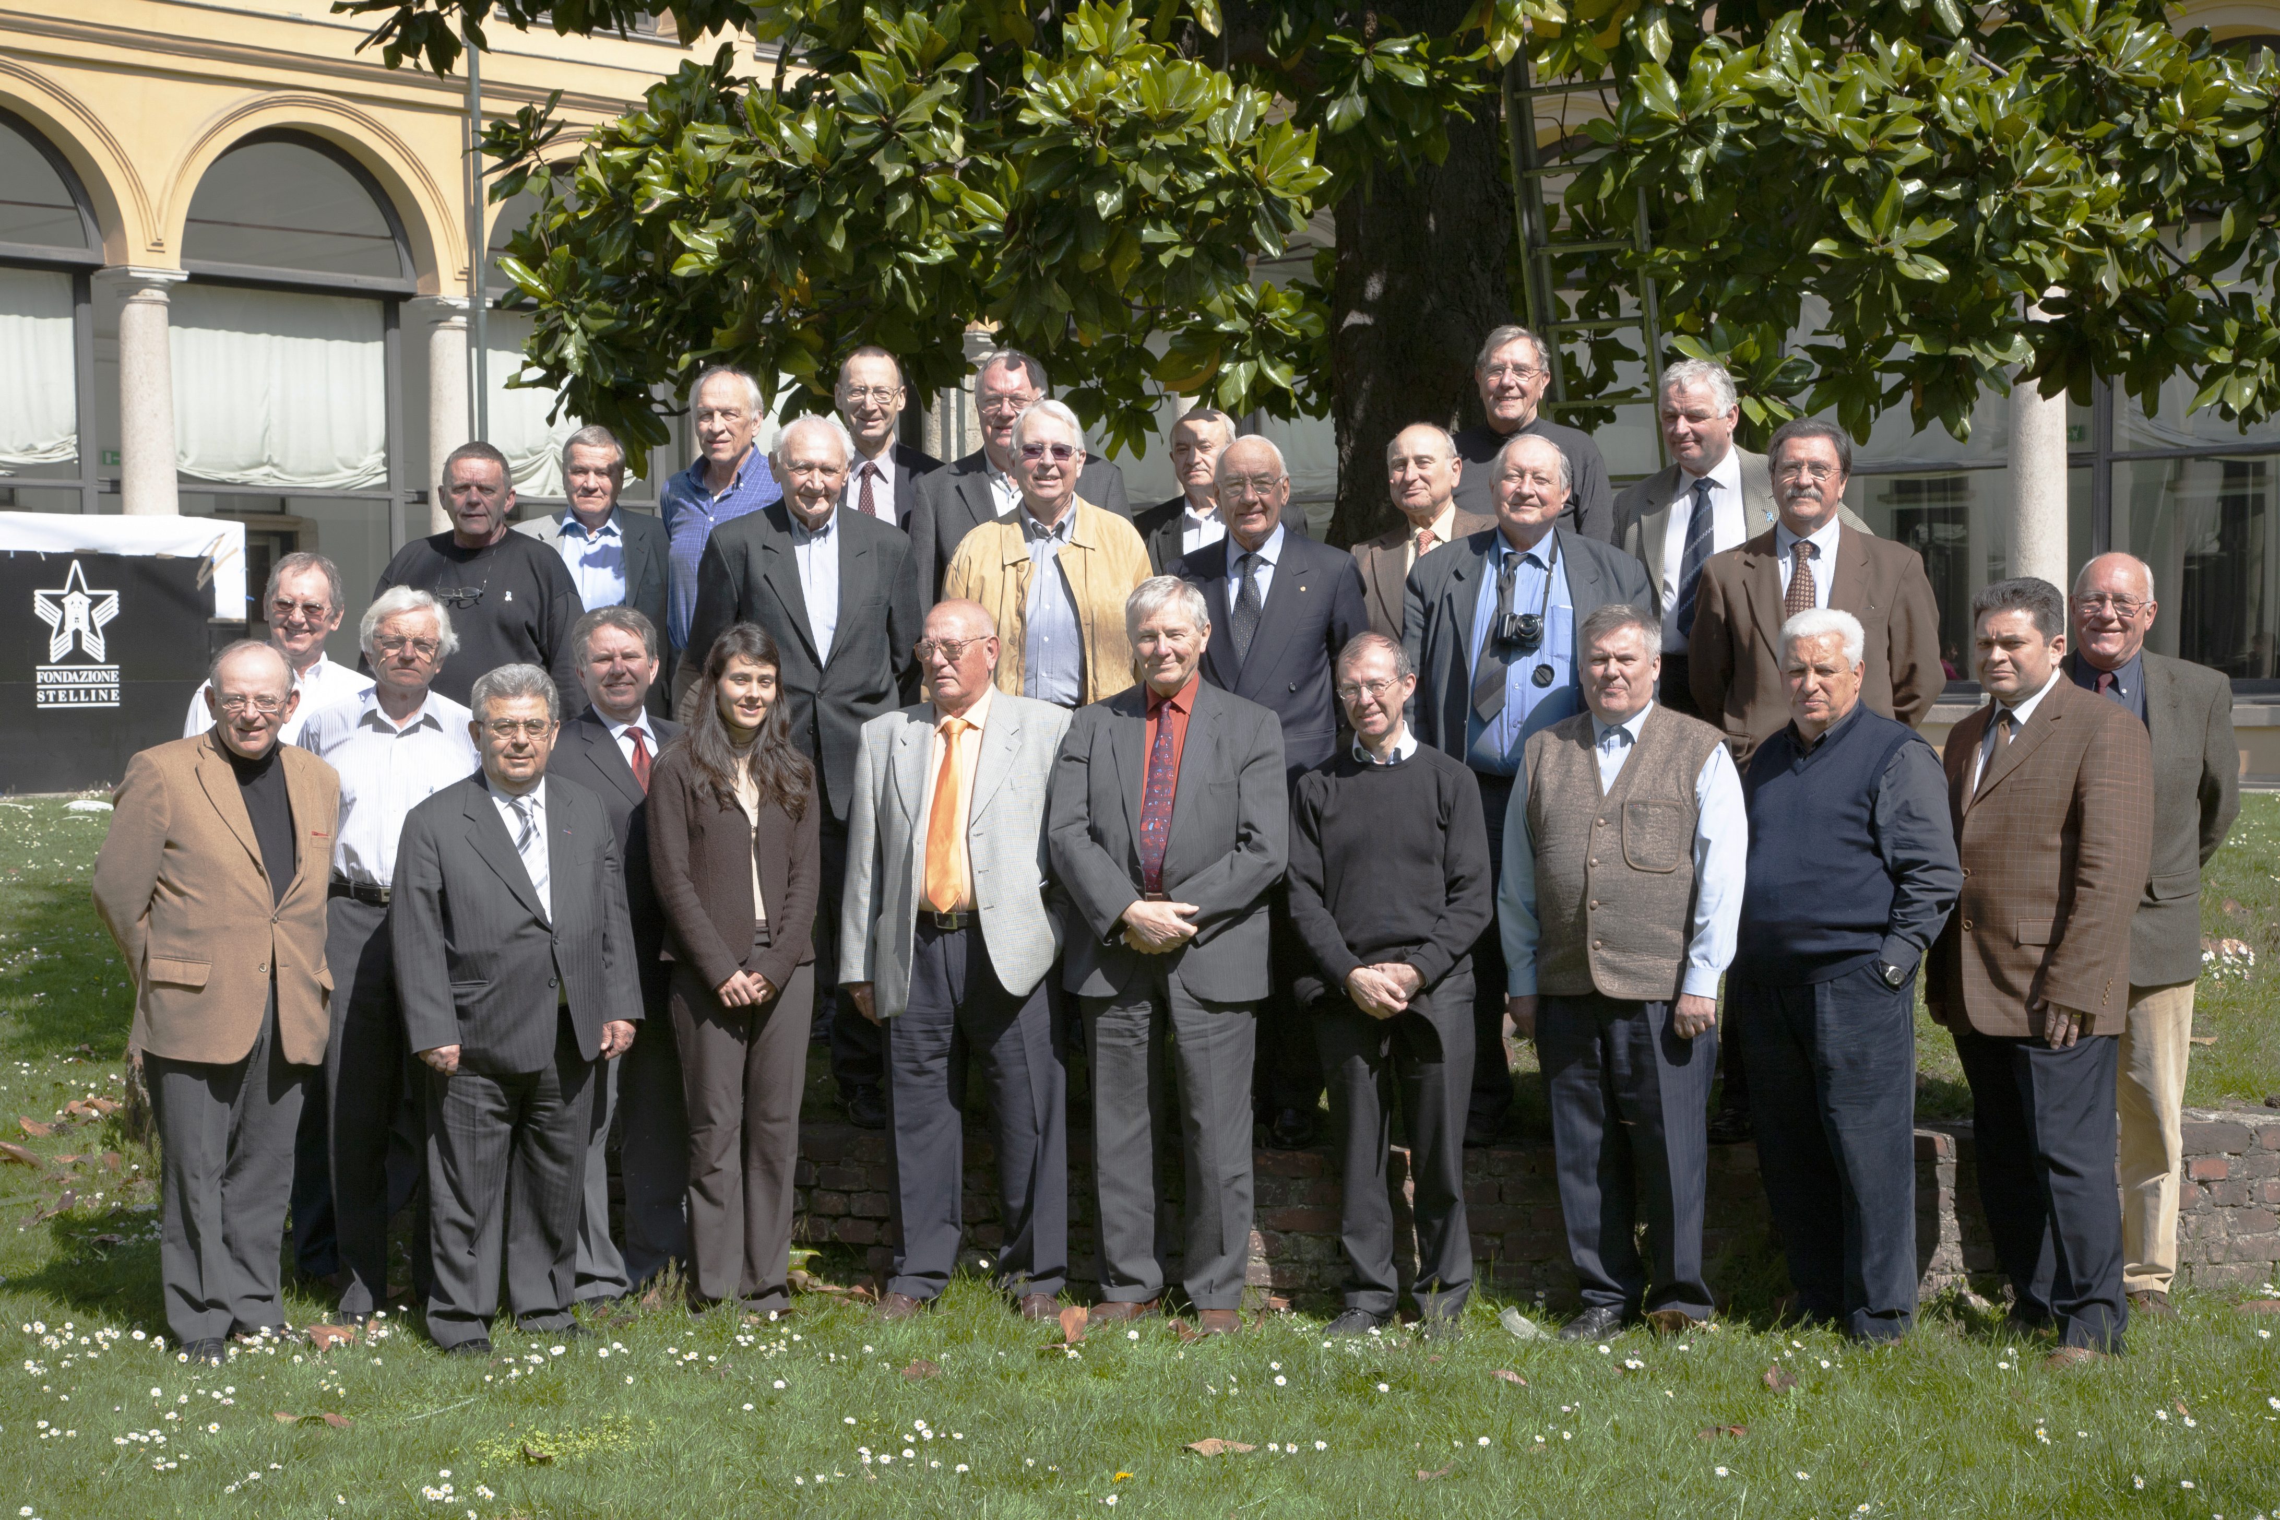
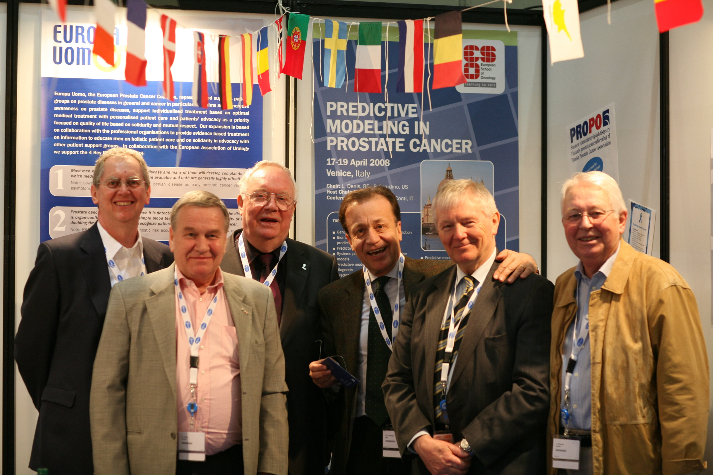
20Years of Europa Uomo
Highlights
March 2008 EAU congress Milan Italy

Slide 12
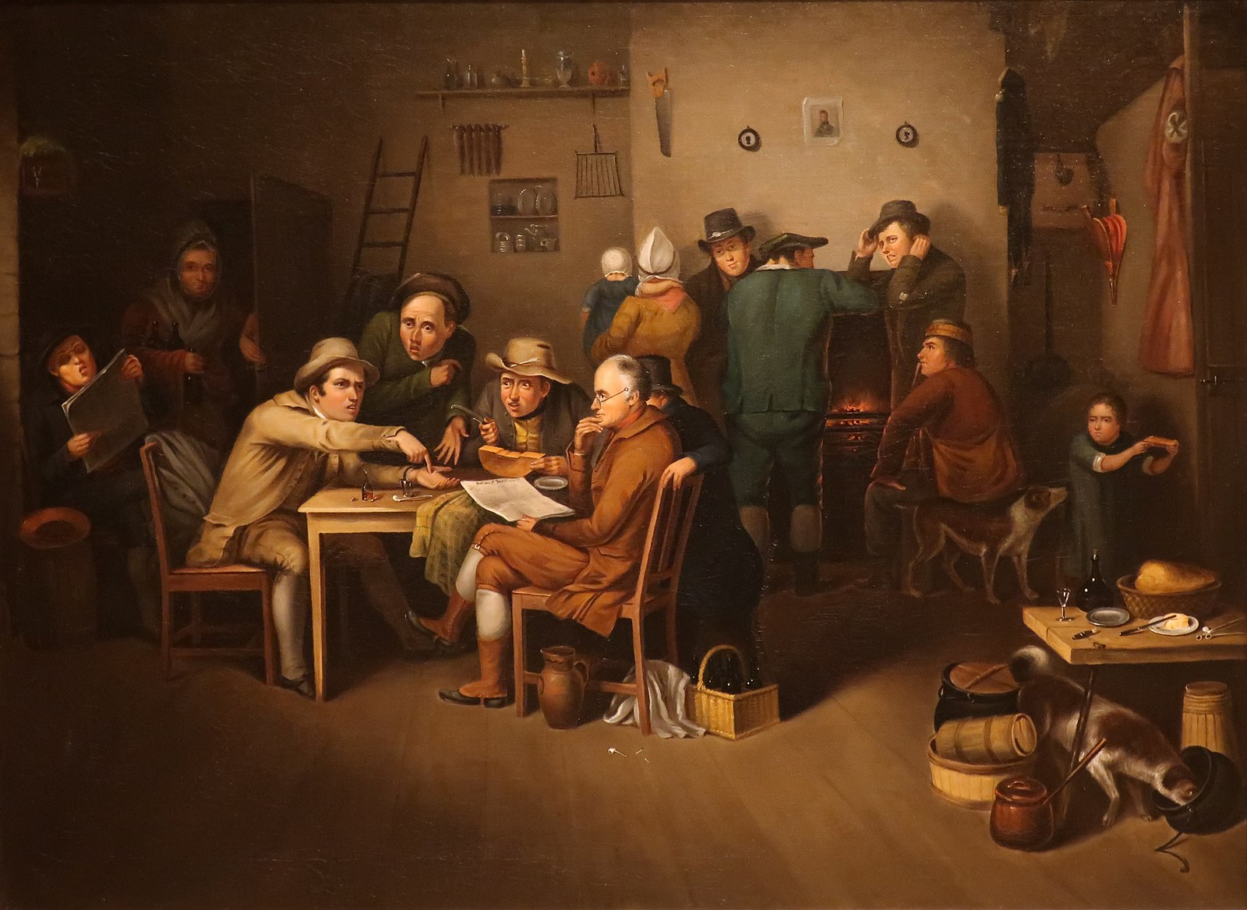
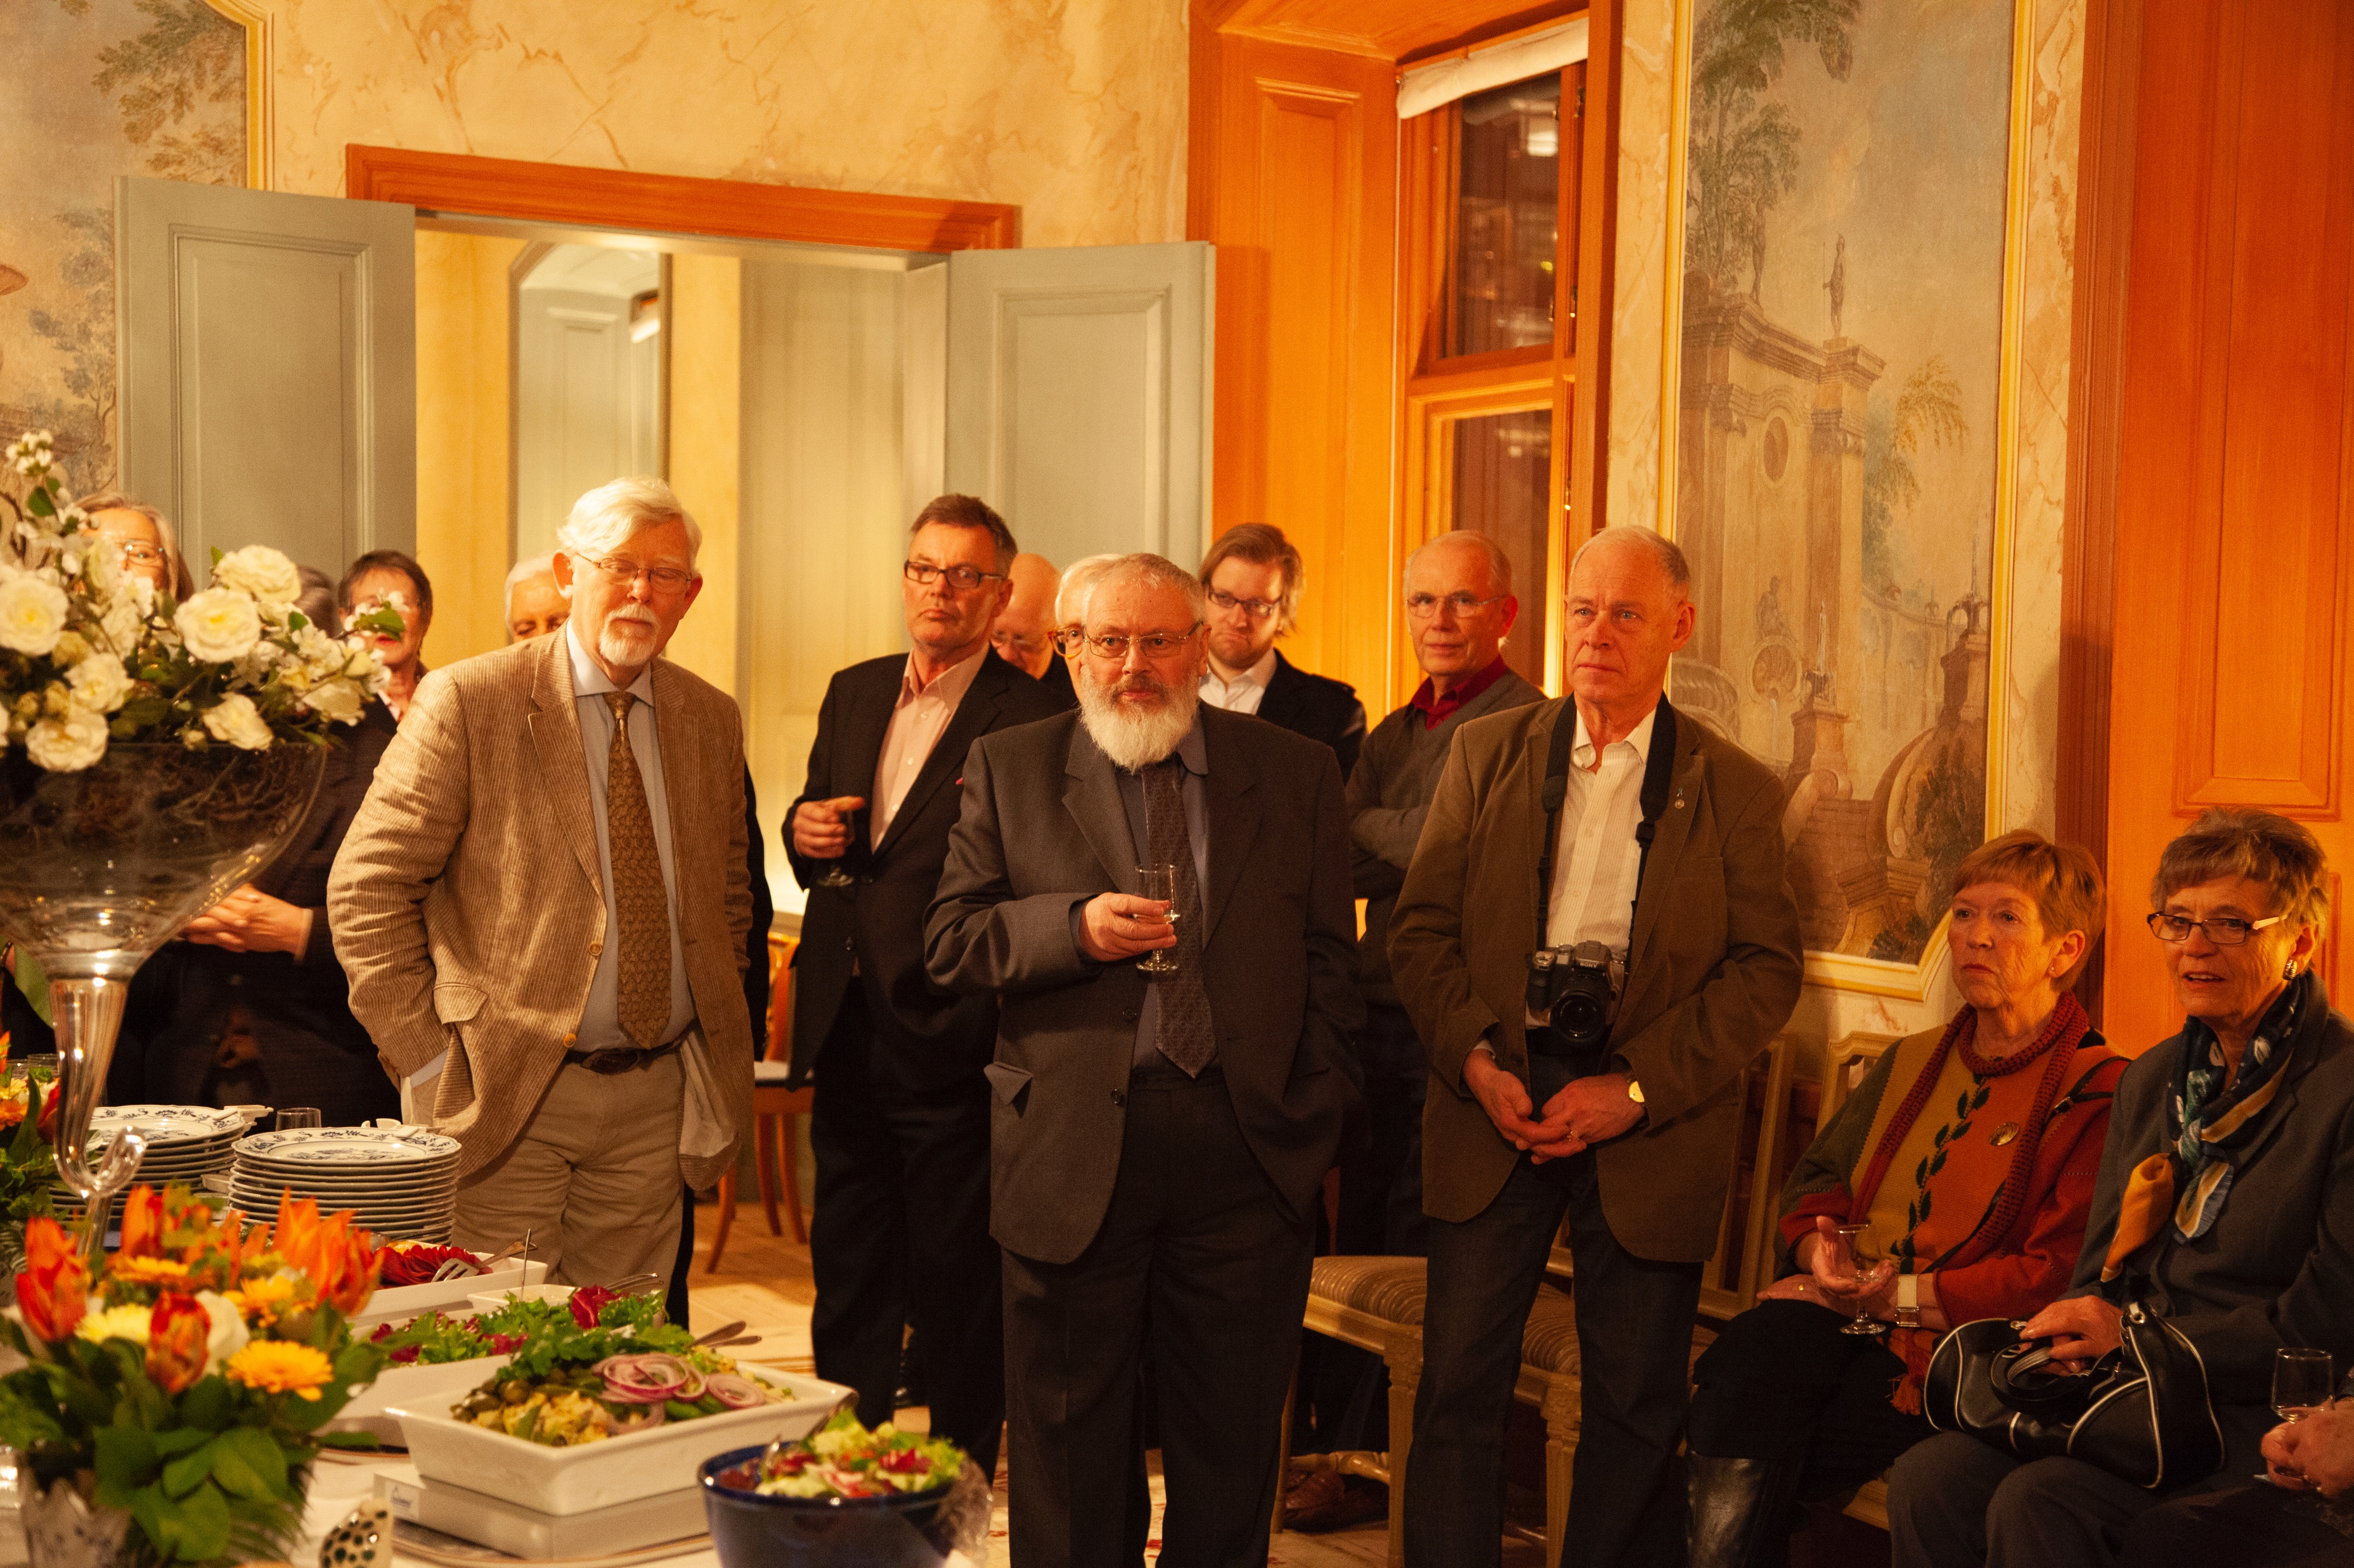
20Years of Europa Uomo
Highlights
March 2009 EAU congress Stockholm Sweden
The Village Politicians by John Lewis Krimmel c. 1819

Slide 13
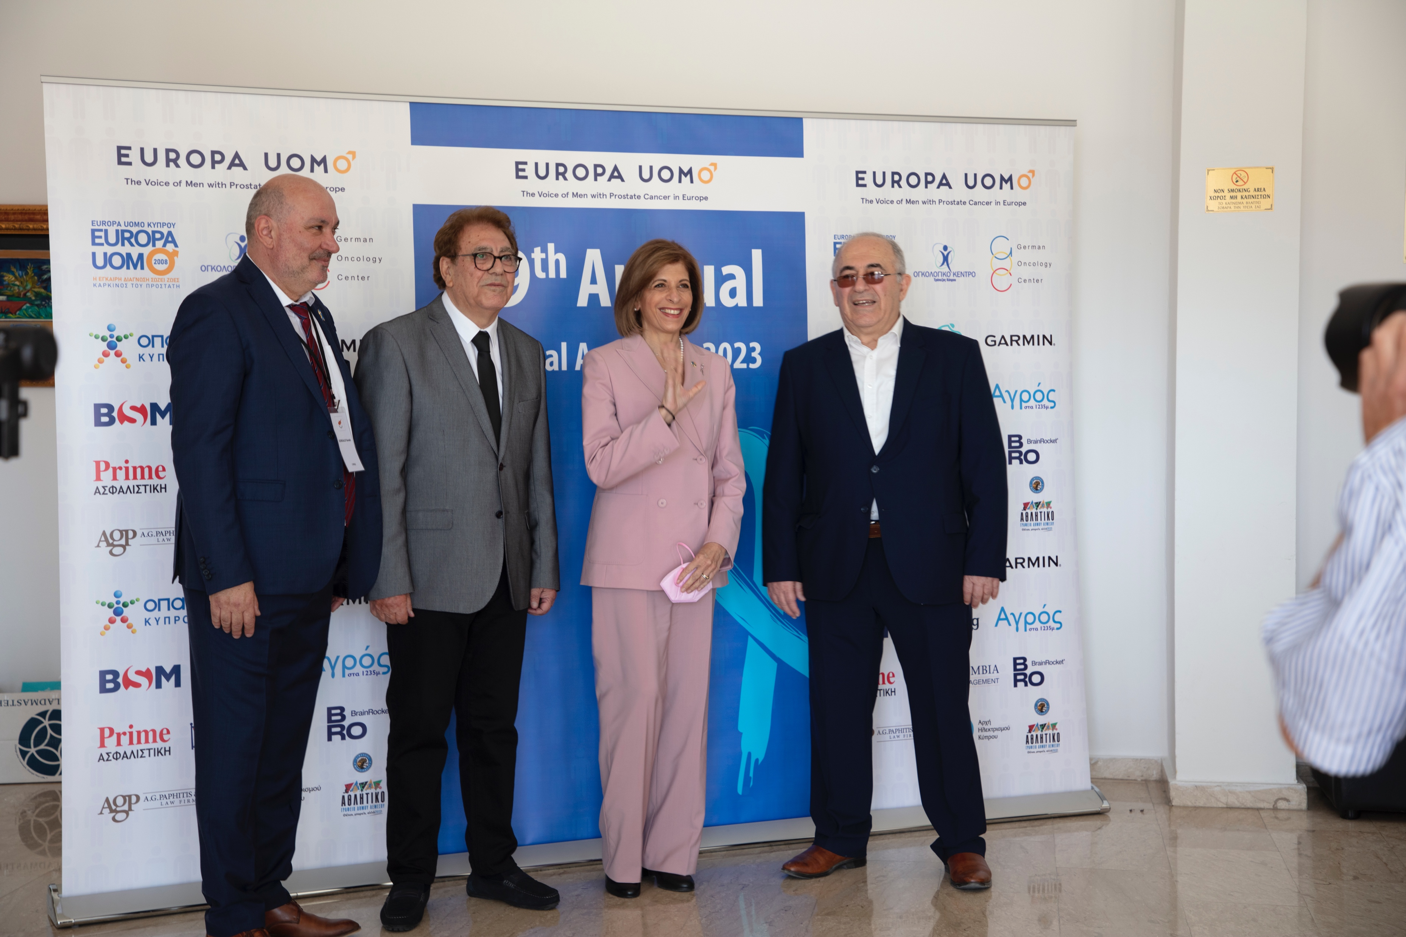
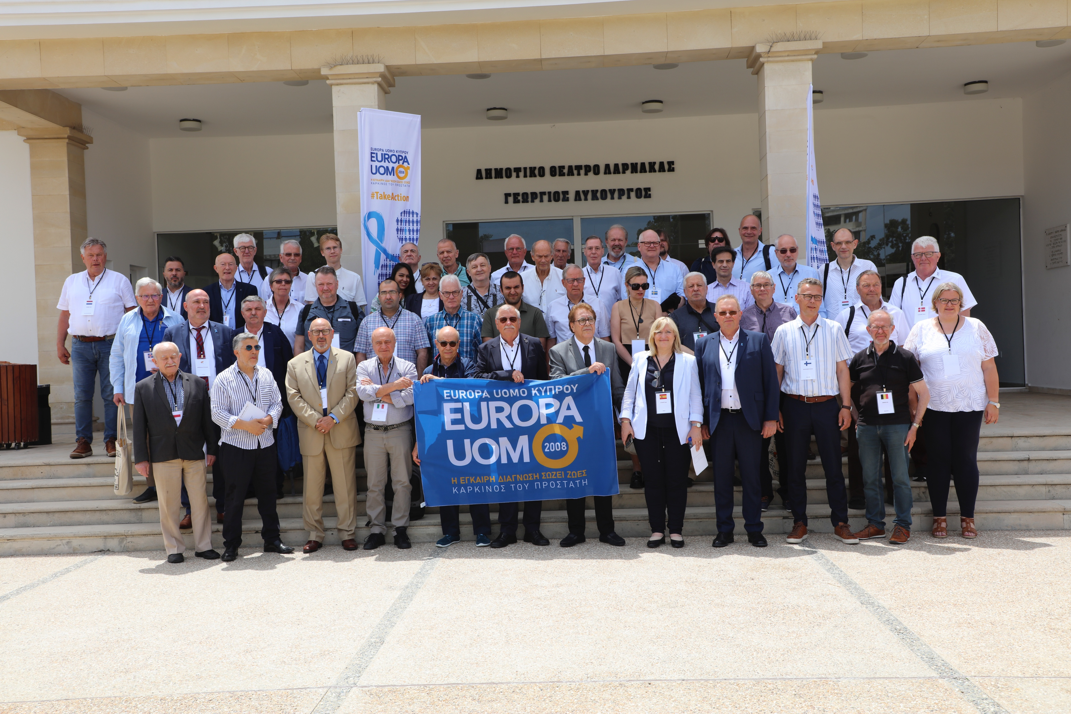
20Years of Europa Uomo
Highlights
May 2023 Europa Uomo AGM Larnaca Cyprus

Slide 14
20Years of Europa Uomo
Highlights
Therefore, we conclude
That a man who is well informed about his prostate and on the PSA test is entitled to have a PSA test and to have the chance to have prostate cancer detected early.
That doctors, urologist, will use the results of PSA tests in an intelligent way and with restraint to safeguard men from unwanted side effects.
19 September 2012 EP Brussels supported by ESO, EAU and OCA

Slide 15

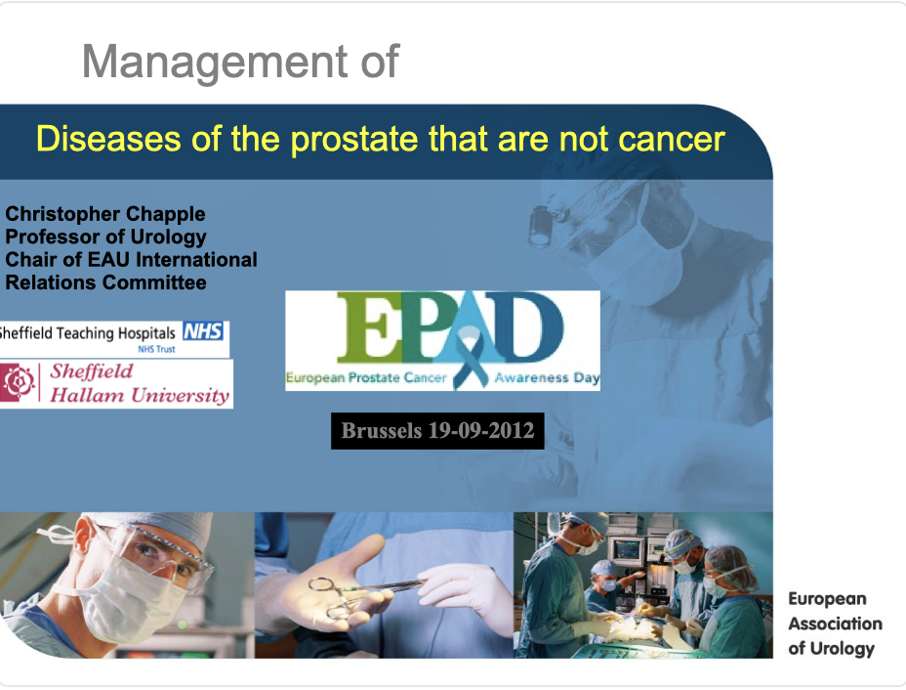


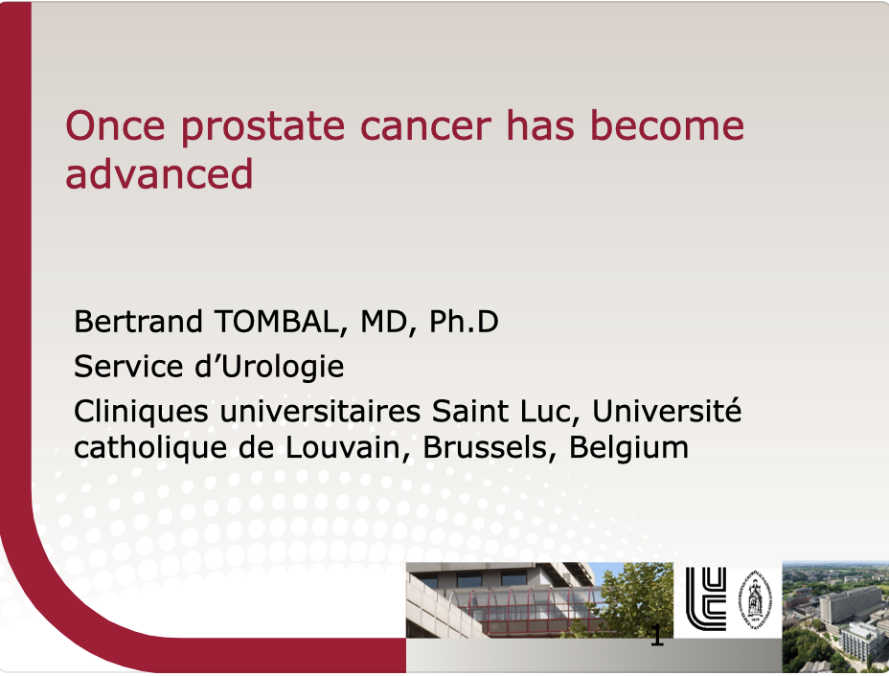

20Years of Europa Uomo
Highlights
19 September 2012 EP Brussels
Interventions:
Prof. Abrahamsson
Prof. Chapple
Prof. Van Poppel
Prof. Tombal
Louis Denis

Slide 16
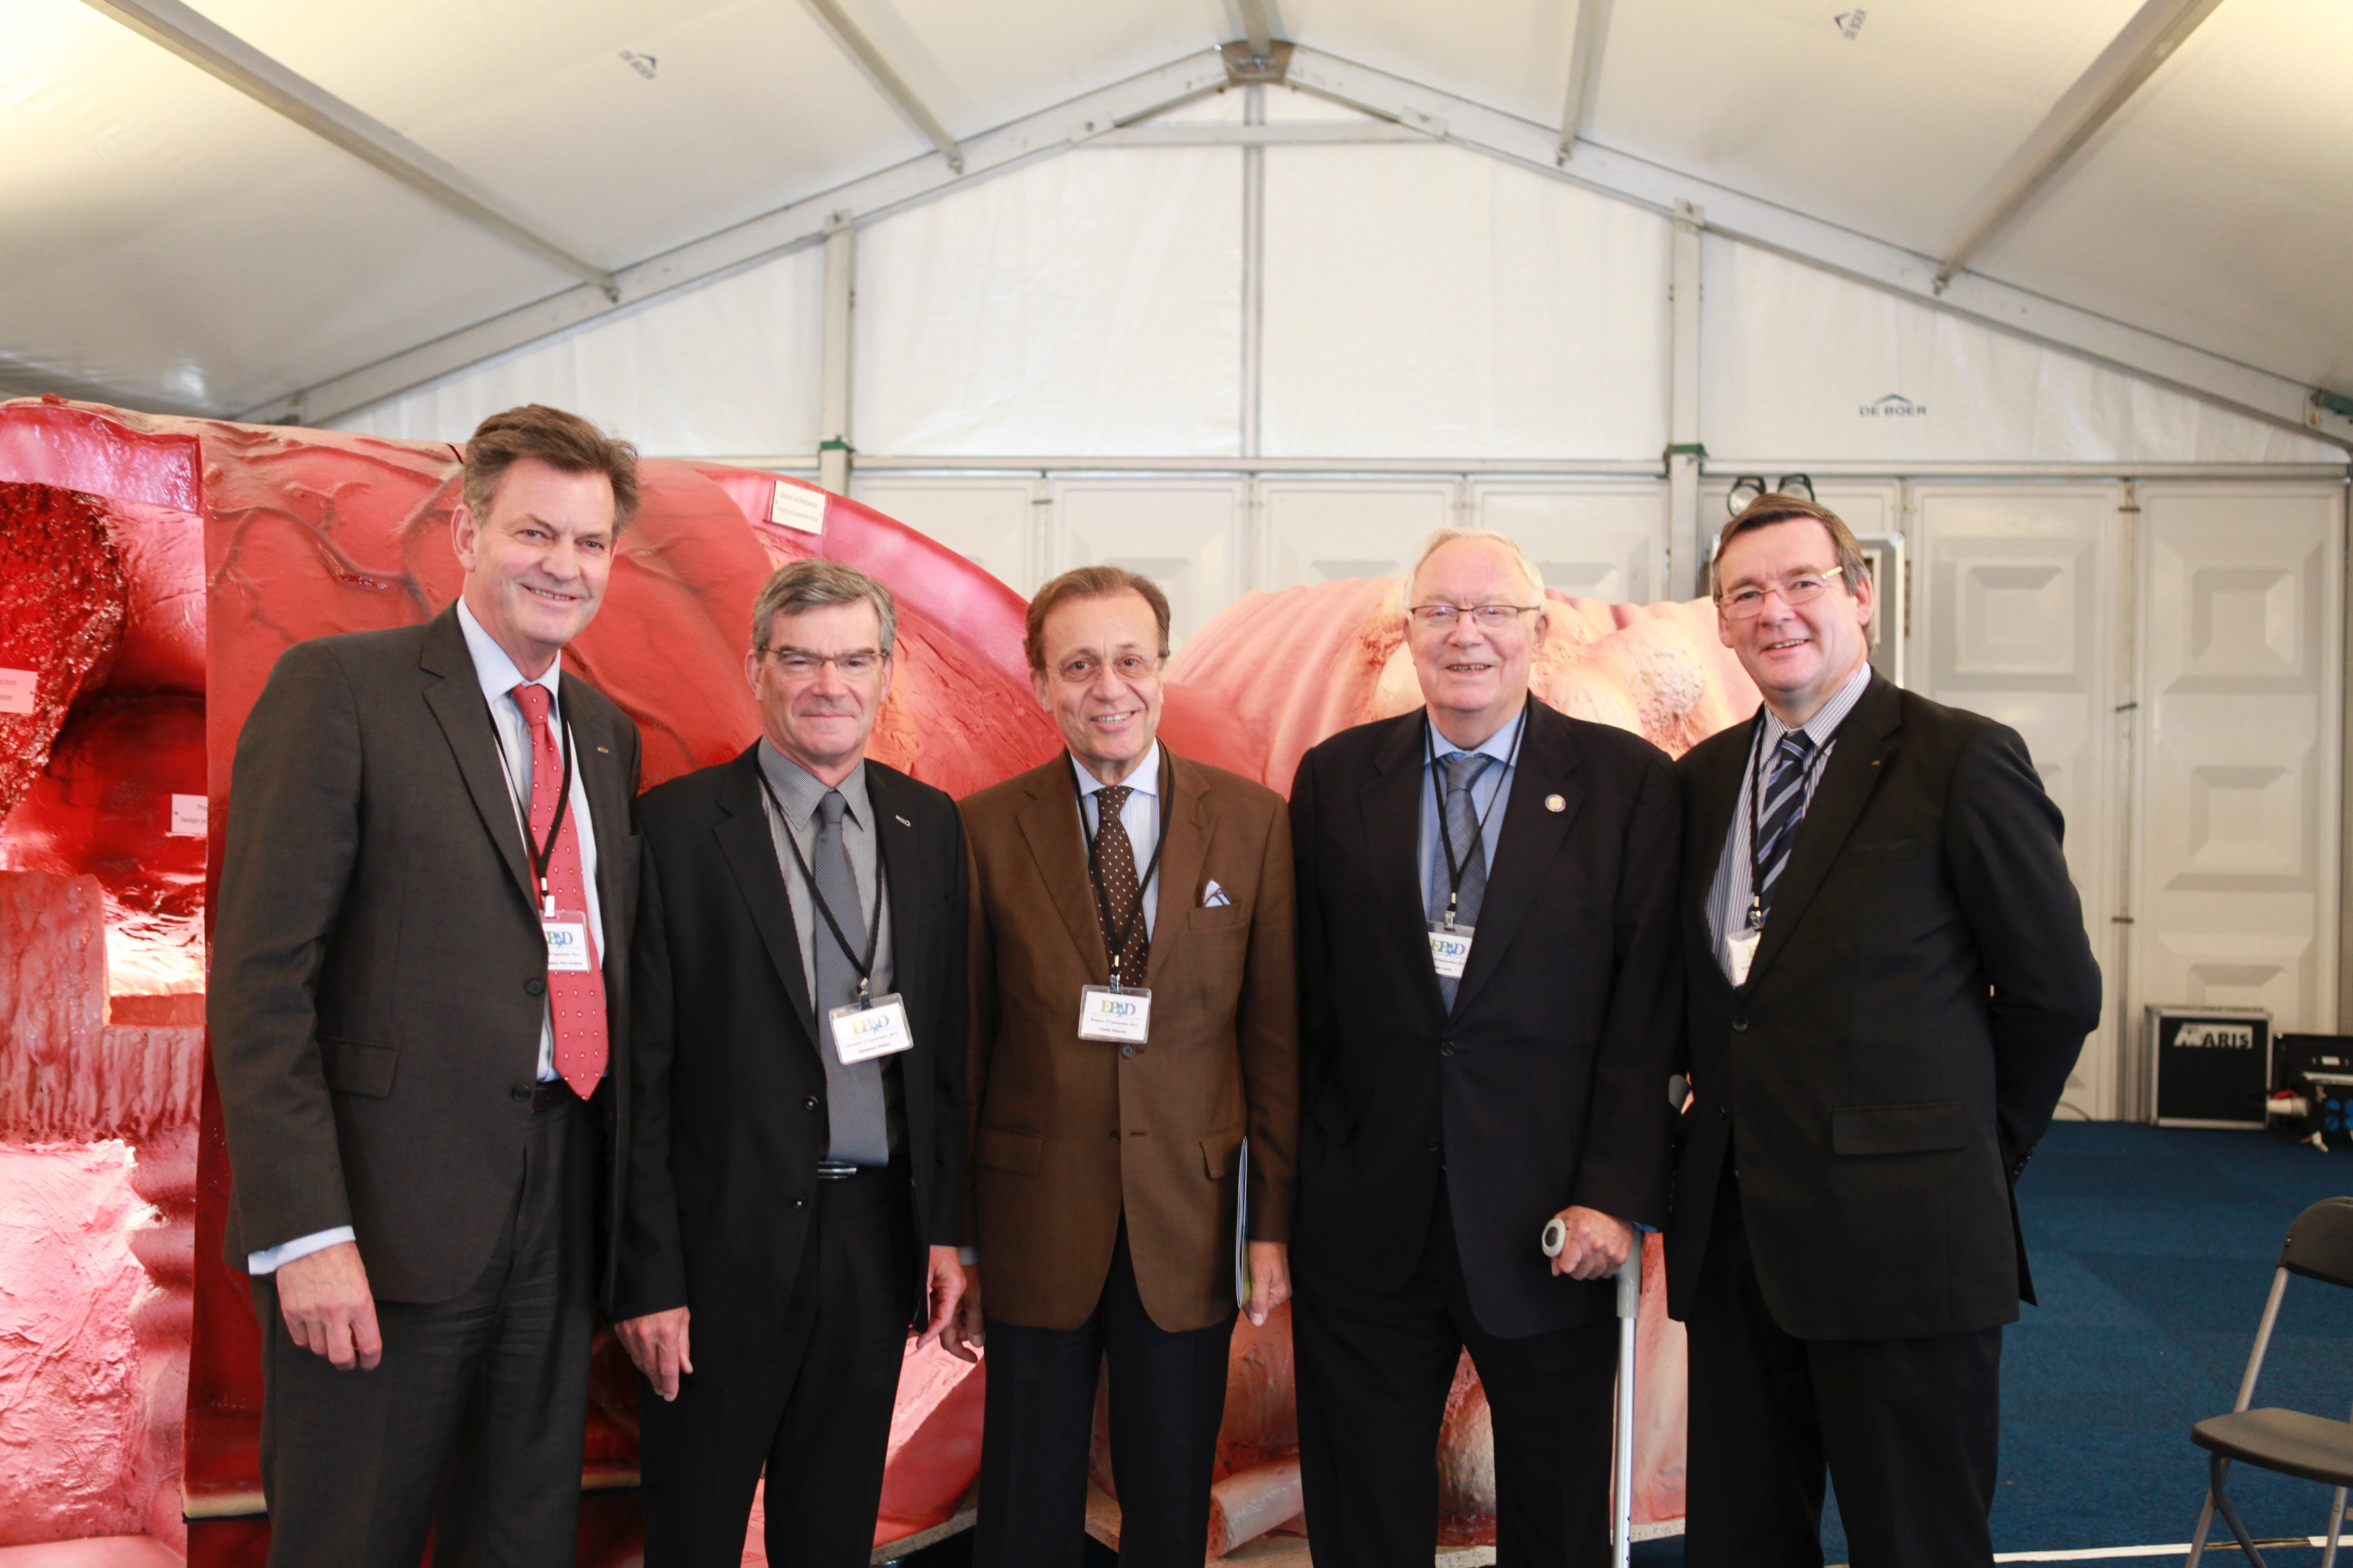
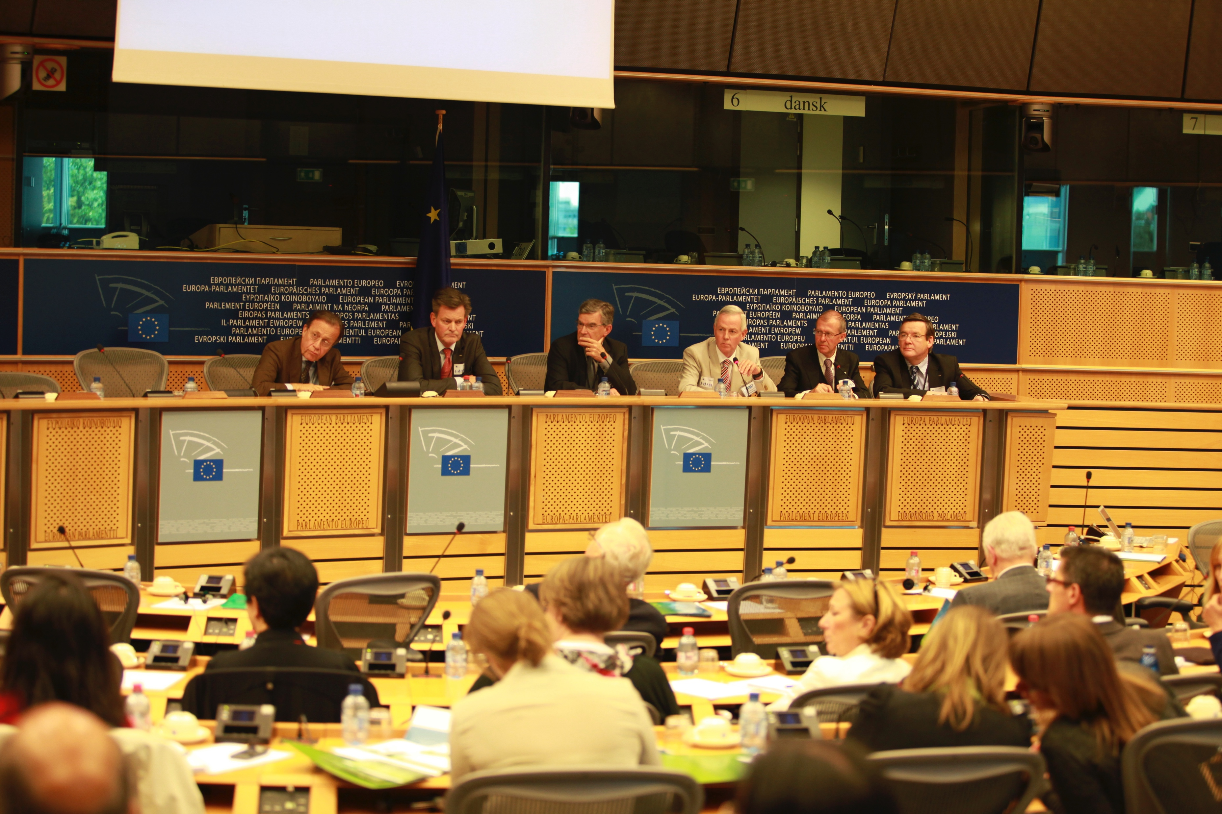
20Years of Europa Uomo
Highlights
19 September 2012 EP Brussels
Abrahamsson, Jacqmin, Costa, Denis, Chapple

Slide 17
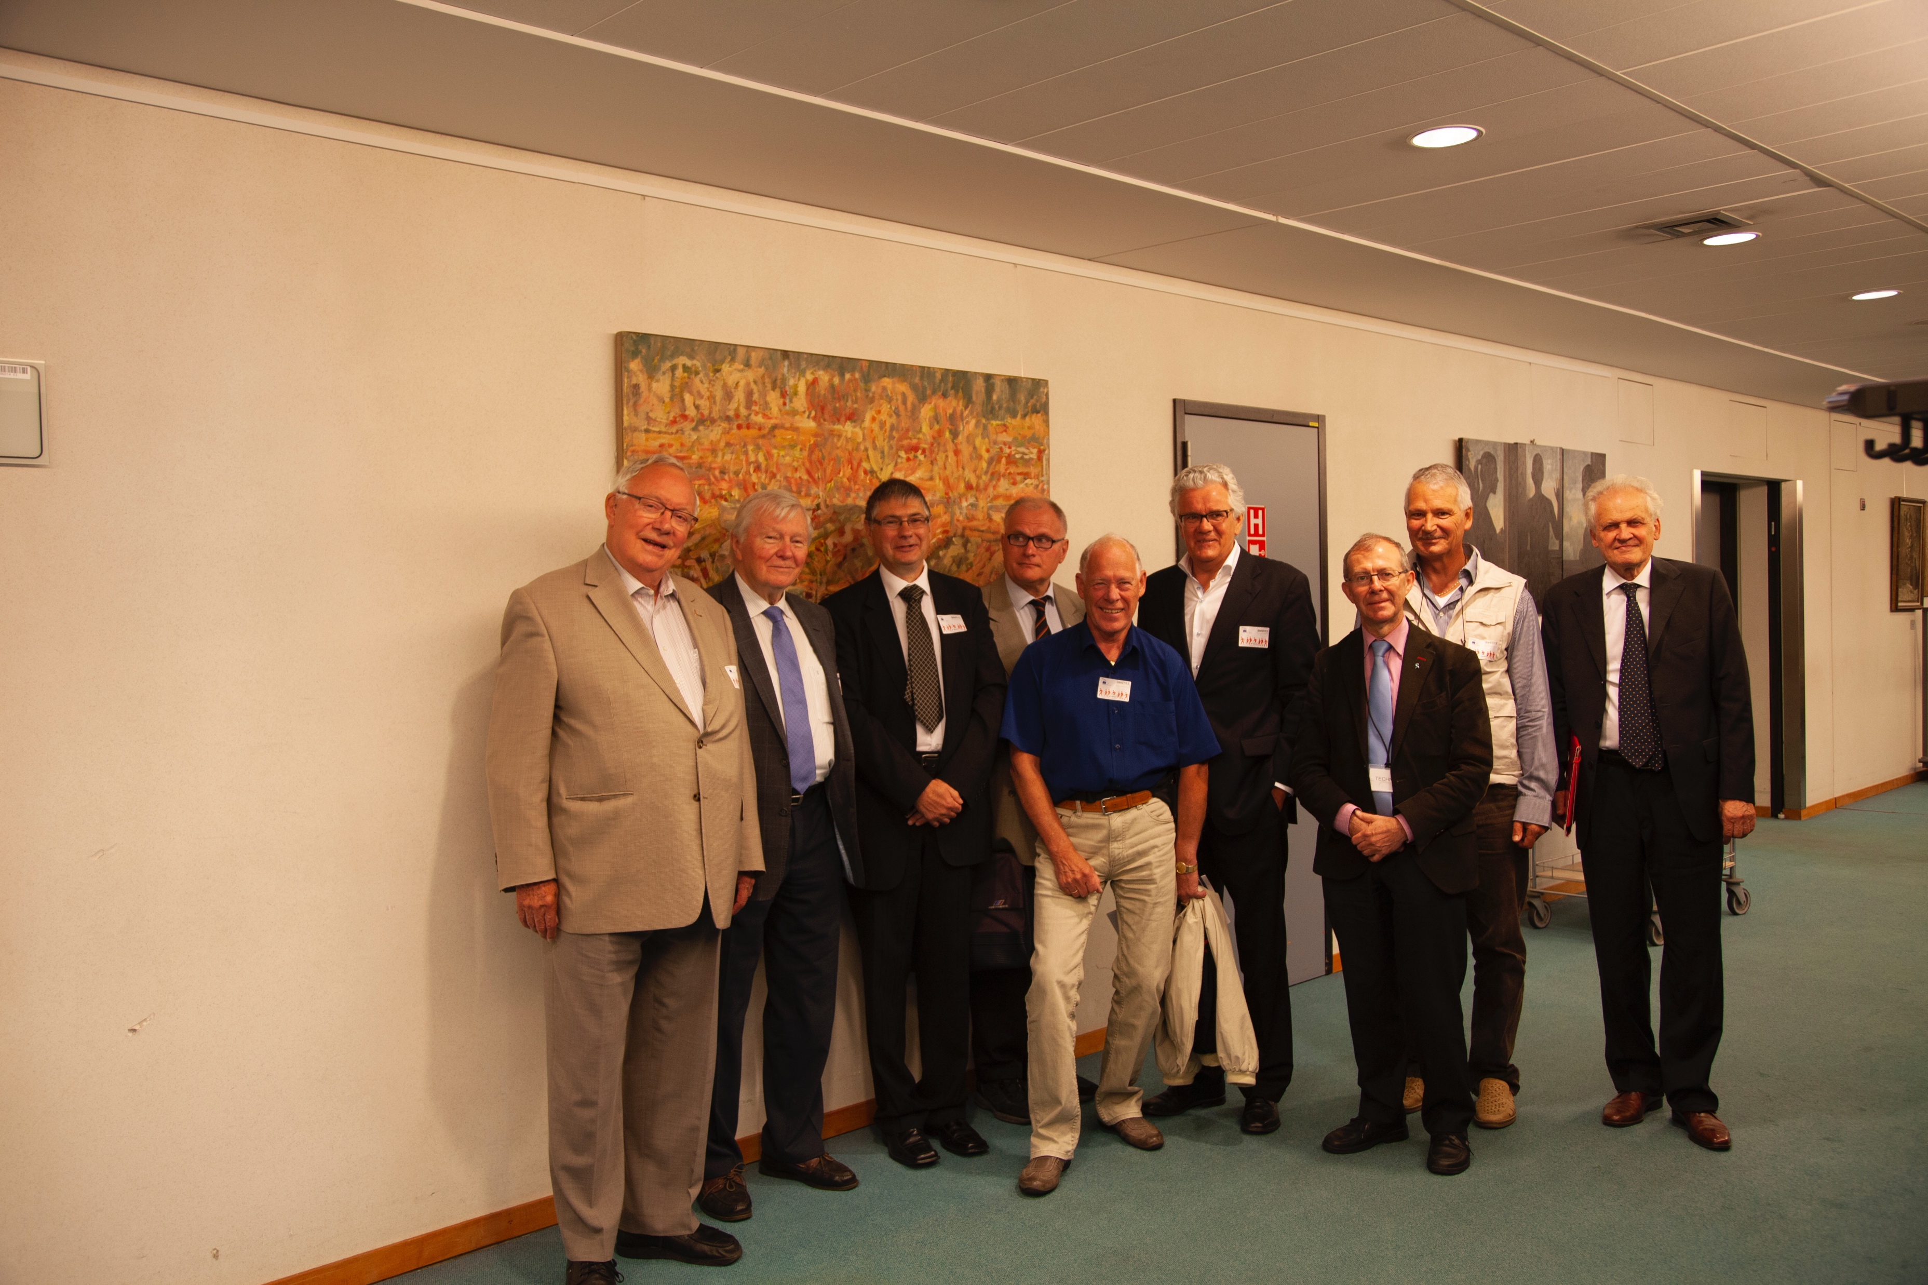
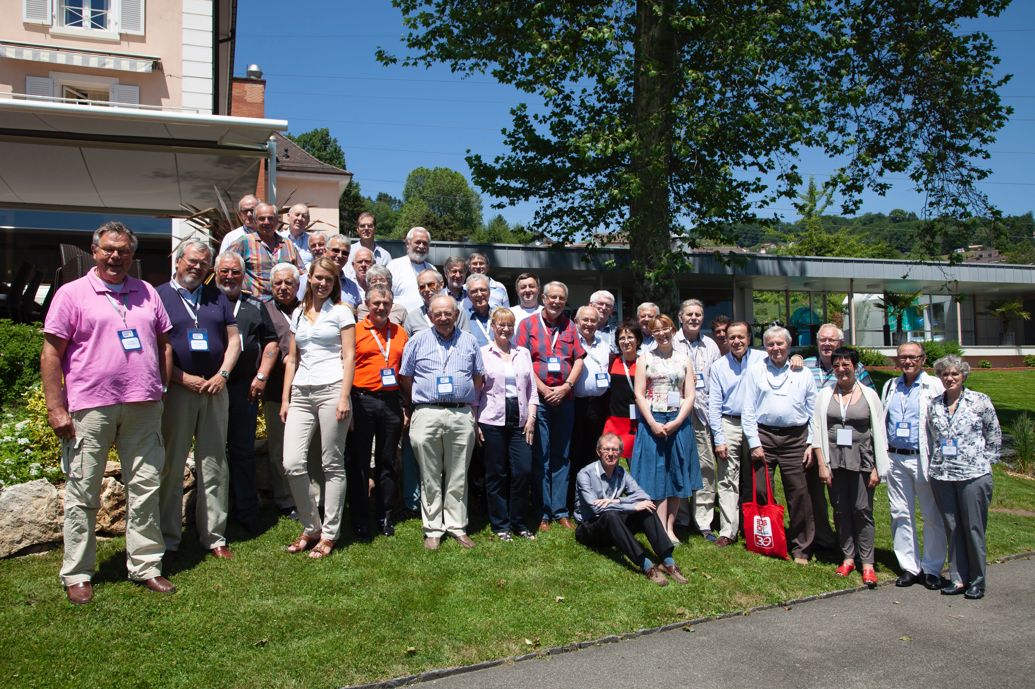
20Years of Europa Uomo
Highlights
July 2013 Europa Uomo Policy work in the EP, Brussels
June 2012 Europa Uomo Summer school Jongny Switserland

Slide 18

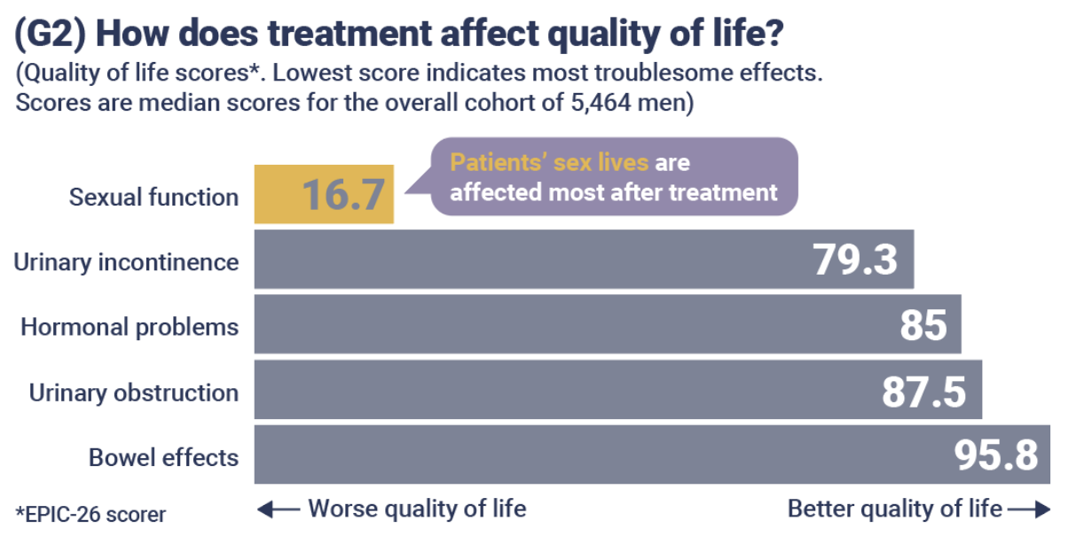
20Years of Europa Uomo
Highlights
About the respondents (2019 & 2022)
5464 responses from 32 countries
Average age: 70
Average age at diagnosis: 64
82% live with a partner
Most had had surgery as first treatment

Slide 19
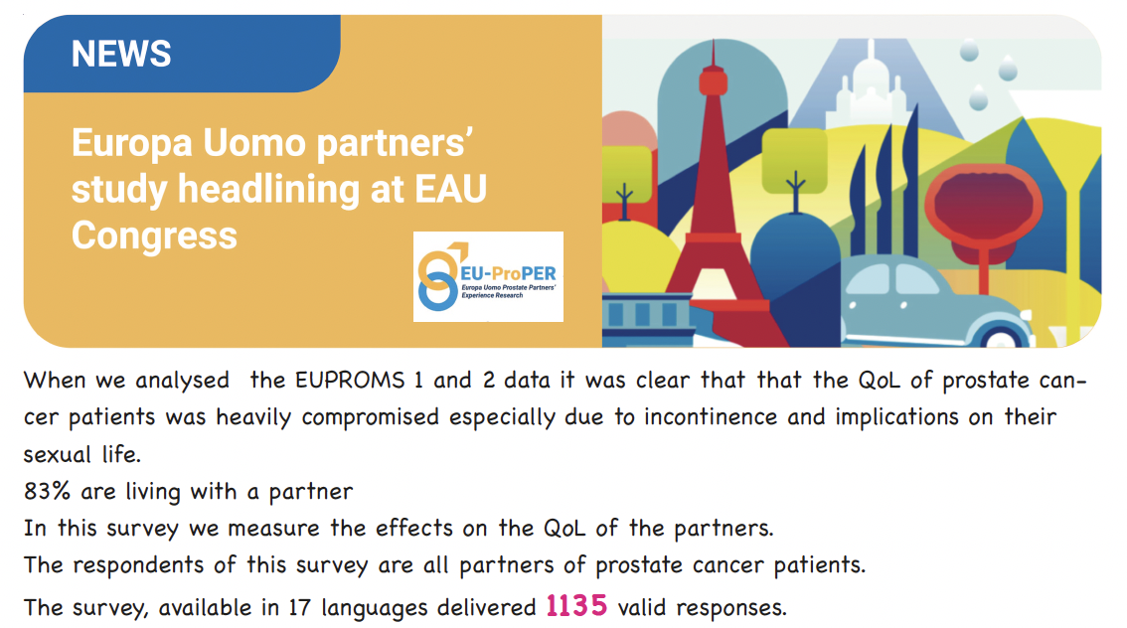
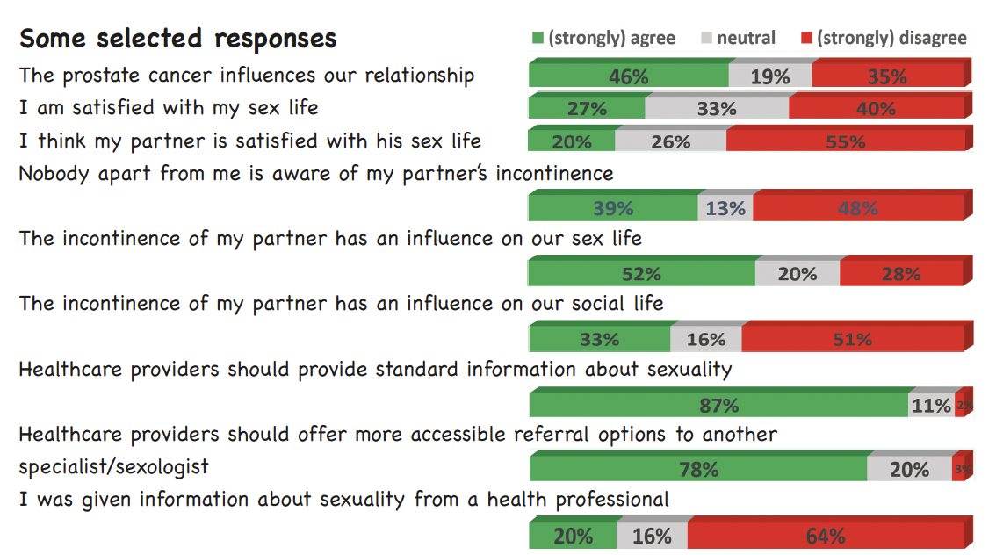
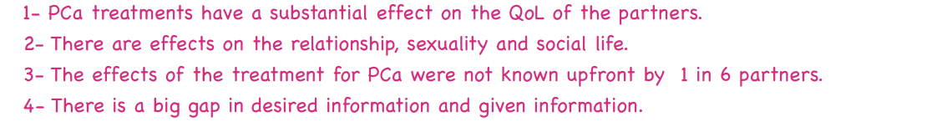
20Years of Europa Uomo
Highlights

Slide 20

20Years of Europa Uomo
Highlights
NEW

Slide 21

20Years of Europa Uomo
Highlights
NEW

Slide 22

20Years of Europa Uomo
Thank you for continued support!

