Slide 2
The EUPROMS study
Europa Uomo Patient Reported Outcome Study
The first ever prostate cancer quality of life survey conducted by patients for patients

Slide 3
About this presentation
This presentation is for prostate cancer patient groups and the general public.
You are welcome to publicise the results without permission, but you must always credit Europa Uomo and the EUPROMS study.
If you reproduce any of the charts, they must be credited to the EUPROMS study.

Slide 4
About EUPROMS

Slide 5
About EUPROMS 1
EUPROMS stands for Europa Uomo Patient Reported Outcome Study
It is the first major study on quality of life after prostate cancer treatment to be conducted by patients themselves
It provides a new perspective because most other quality of life studies are conducted by and with doctors in a clinical environment
Notes:
It is important to understand how this study differs from previous studies, and why this is important. Most studies about quality of life in men with prostate cancer are conducted in a clinical environment. In other words, men are asked questions by doctors and nurses, or they complete questionnaires while they are visiting hospital for treatment or check-ups. This online survey was completed by men in their own time, and in the comfort of their homes. This means that they may have more time to consider their answers and may feel more at ease saying how they really feel.

Slide 6
About EUPROMS 2
The EUPROMS findings are based on responses to two online questionnaires asking comparable questions:
EUPROMS 1.0
Started August 2019, first reported January 2020
3,000 responses
EUPROMS 2.0
Started October 2021, first reported July 2022
3,571 responses

Slide 7
About EUPROMS 3
The survey findings provide a “snapshot” picture of the quality of life issues experienced by men with prostate cancer across Europe at a particular point of time
They provide information that may help patients and their doctors make decisions about treatments
They may help in campaigning for early diagnosis of prostate cancer and promoting approaches such as active surveillance
Notes:
This survey presents a cross-sectional picture of a population of men who have been treated for prostate cancer across Europe. The survey asked: ”What is life like for you at this particular time?”
The study could not look at individual respondents’ medical condition before treatment, or how prostate cancer patients differ from the population in general. That would have been a different kind of study.

Slide 8
About EUPROMS 4
Europa Uomo has reported EUPROMS findings at many important medical conferences including:
European Association of Urologists (EAU) Congress
The EAU Section of Oncological Urology annual meeting
The European Society for Medical Oncology (ESMO) Congress
The European Multidisciplinary Congress on Urological Cancers (EMUC)
European Organisation for Research and Treatment of Cancer (EORTC) webinar
Findings have been published in various publications including European Urology Focus magazine

Slide 9
How EUPROMS was conducted

Slide 10
The questionnaires
Two separate online surveys, conducted in 2019 and 2022
For all men who have received treatment for prostate cancer
Both used questions based on validated quality-of-life questionnaires: EPIC-26 and EORTC-QLQ and EQ-5D-5L
Available in 19 languages
Responses were anonymous
Notes:
The survey included questions to establish demographics and a range of questions to establish health, daily living activities and quality of life using three validated measures commonly used in health research:
EQ-5D-5L
EORTC-QLQ-C30
EPIC-26.

Slide 11
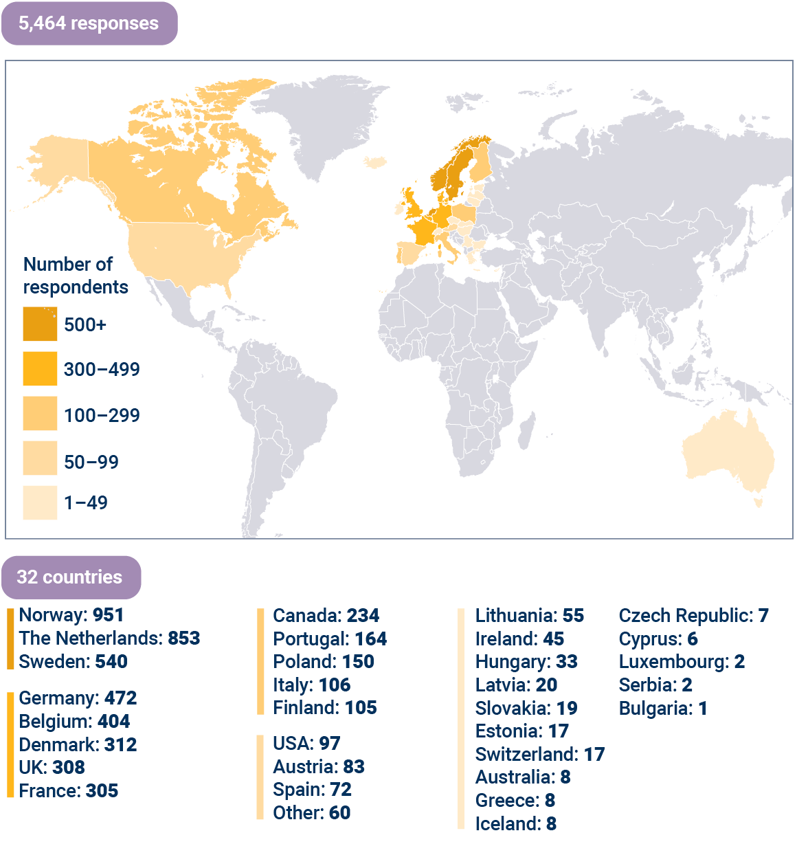
Geographical response
EUPROMS 1.0
3,000 responses
EUPROMS 2.0
3,571 responses
“Unique” responses combined
5,464 responses
Notes:
The sample size was very large, which makes the results authoritative.
There was a wide response across 32 countries, mainly from Europe but also from North America and Australia.

Slide 12
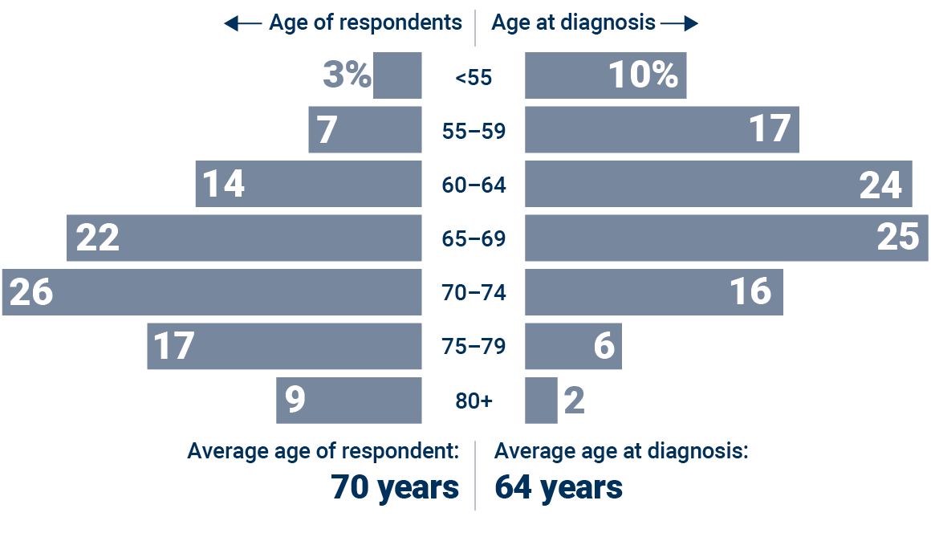
Respondent profile
Notes:
The average age at diagnosis was 64 and on average men were reporting five years after having treatment. For some men treatment was 10 years ago, and for others it had just finished.
As you will see from the distribution graph of age at first diagnosis, more than 50% of respondents were diagnosed before they were 65. This counters the idea that prostate cancer is a disease of old men.

Slide 13
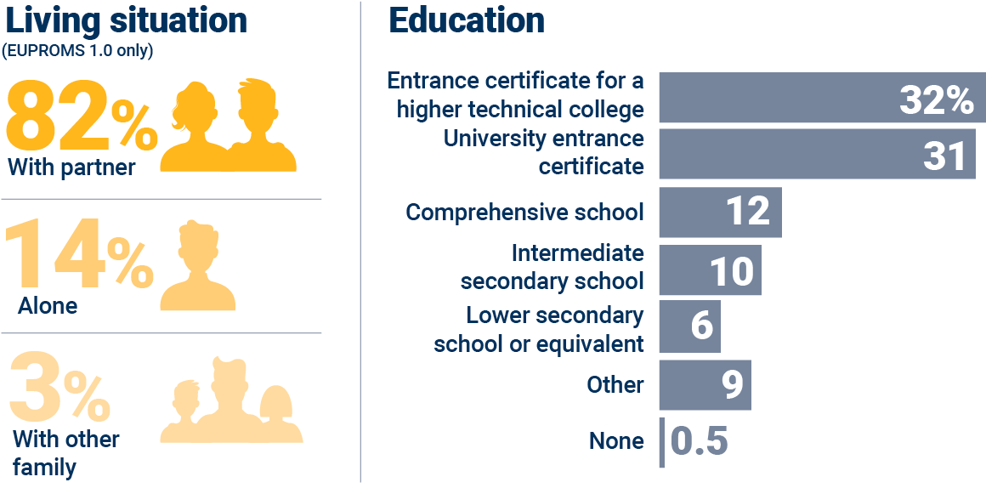
Respondent profile
Notes:
Most respondents were living with a partner, which is important given the effects that treatment can have on sexual function.
There is a slight bias in respondent profile towards a higher level of education.

Slide 14
Treatment profile
Notes:
Most patients had only received one treatment up to the start of the survey.
57% of respondents had received radical prostatectomy, so the overall results will be influenced by the effects on quality of life of that particular treatment.

Slide 15
The analysis
Analysis of the data was conducted by Professor Monique Roobol and her team at Erasmus University Medical Centre, Department of Urology, Rotterdam.
Their analysis of EUPROMS 1.0 and EUPROMS 2.0 data provided the combined findings presented here.
Some of the findings here are based on raw survey responses, and statistical significance has not been calculated or displayed.
All findings help to provide vital information for clinical decision-making, making them clinically relevant

Slide 16
EUPROMS results
General quality of life

Slide 17
Notes:
This chart shows all the respondents rating their quality of life from one to seven, and the percentage in each category. You will see that respondents’ quality of life is generally good. However, as we will see in the next slide, some aspects of life are better than others.

Slide 18
Notes:
This slide shows quality of life scores, so the lower the score the worse the quality of life.
These find that lack of sexual function, and to a lesser extent incontinence, affect men’s quality of life much more than other treatment after-effects.

Slide 19
EUPROMS results
Results: Discomfort, tiredness, insomnia
Notes:
After those general findings, now let’s look at some specific aspects of quality of life after prostate cancer treatment.
First, the discomfort, tiredness and insomnia men experience after treatment.

Slide 20
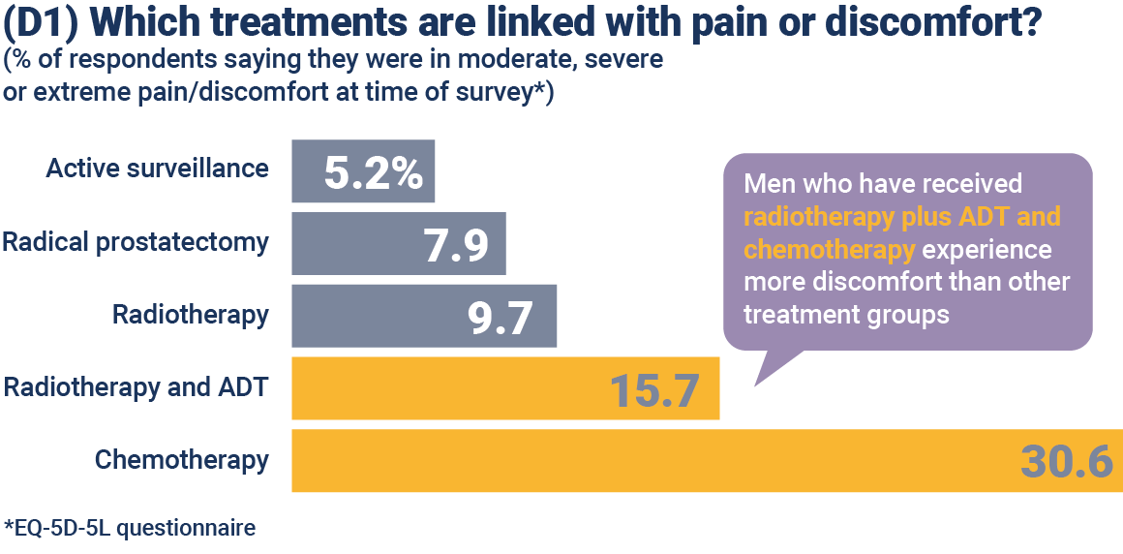
Notes:
You can see from this slide that discomfort increases as men move through the treatment stages. Once you get to chemotherapy at the advanced stages, more than three times the pain and discomfort is reported compared to early-stage treatments.

Slide 21
Notes:
More than one third of men who have received chemotherapy say they have felt tired in the past week. Tiredness levels are comparatively lower for the other treatments, but radiotherapy seems to be linked with more tiredness than surgery.

Slide 22
Notes:
The study found that insomnia seems to affect men a lot after radiotherapy with ADT, and also after chemotherapy. Tiredness doubles as treatment progresses from, say, prostatectomy to chemotherapy.

Slide 23
EUPROMS results
Mental health

Slide 24
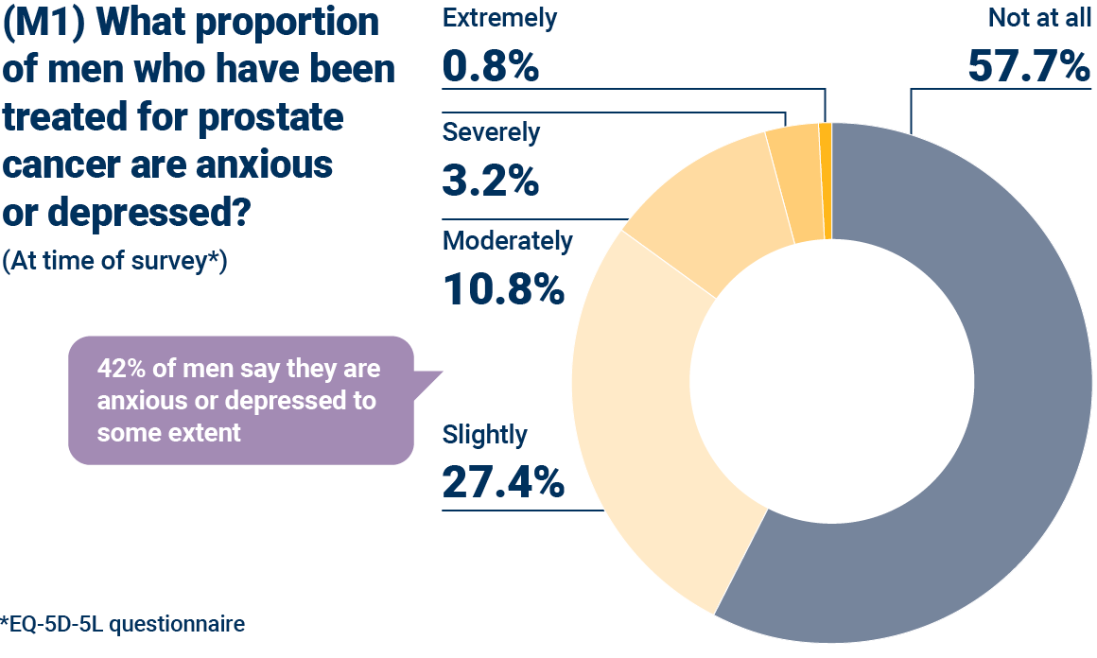
Notes:
The study found that 42% of men who have been treated for prostate cancer are anxious or depressed to some extent.

Slide 25
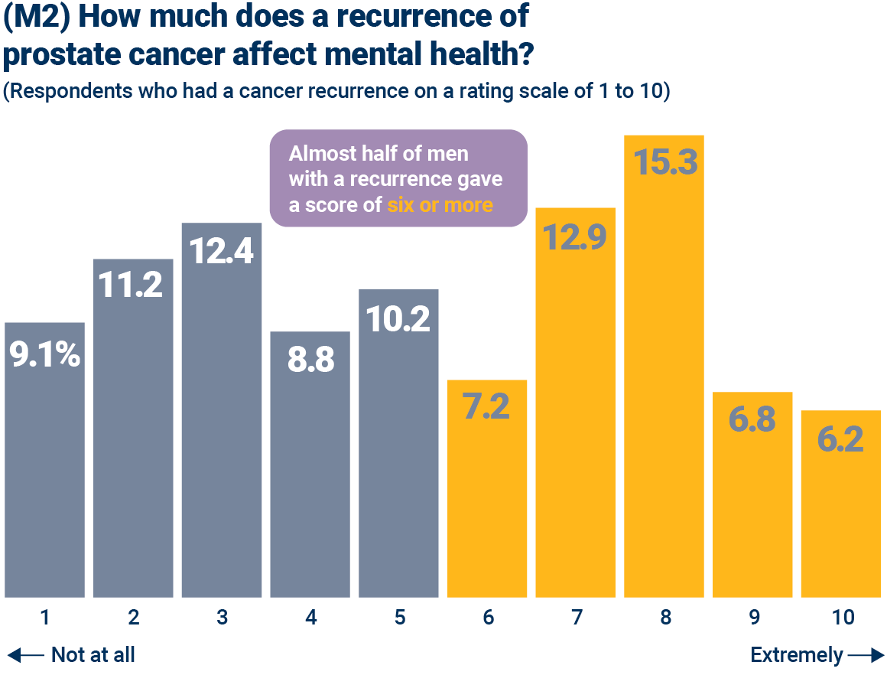
Notes:
A recurrence of prostate cancer seems to have a major impact on mental health. You can see here that more than half of the respondents who had a recurrence rate the effect on their mental health as six or more – in other words, it had a significant effect.

Slide 26
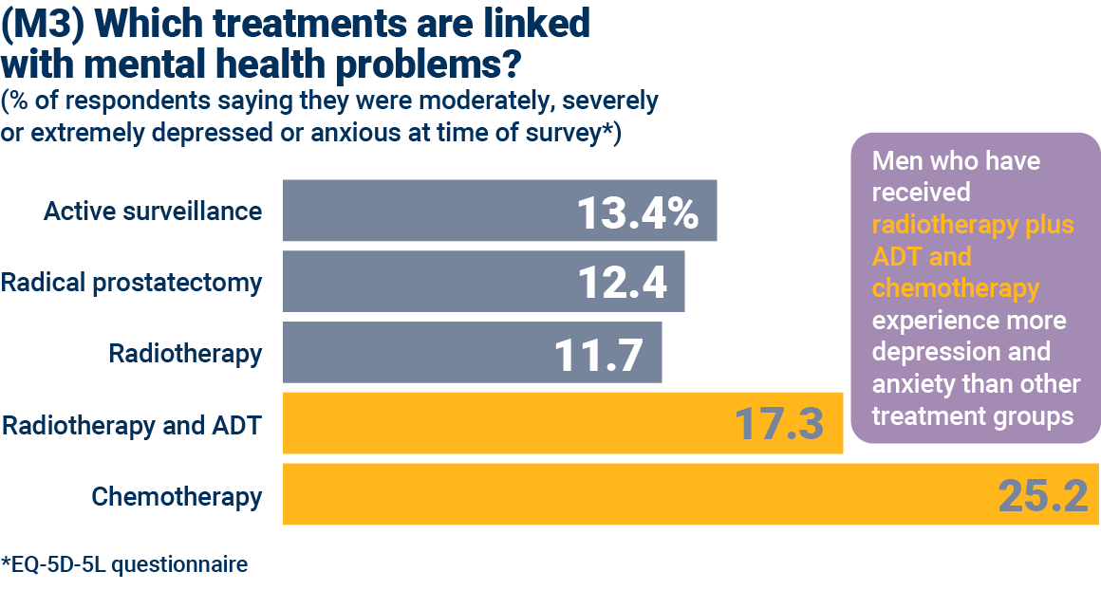
Notes:
You can see here that the mental health problems seem to get worse the more advanced the cancer.
It is interesting to note that active surveillance is associated with higher levels of depression or anxiety than some treatments, such as radical prostatectomy and radiotherapy. This may be related to the long-term worry that can be brought by regular testing, and the fact that treatment decisions may still have to be made. A survey of men on active surveillance by one of Europa Uomo’s members, the Danish prostate cancer patients’ organisation PROPA, found that 37% felt seriously or moderately worried.

Slide 27
EUPROMS results
Sexual function

Slide 28
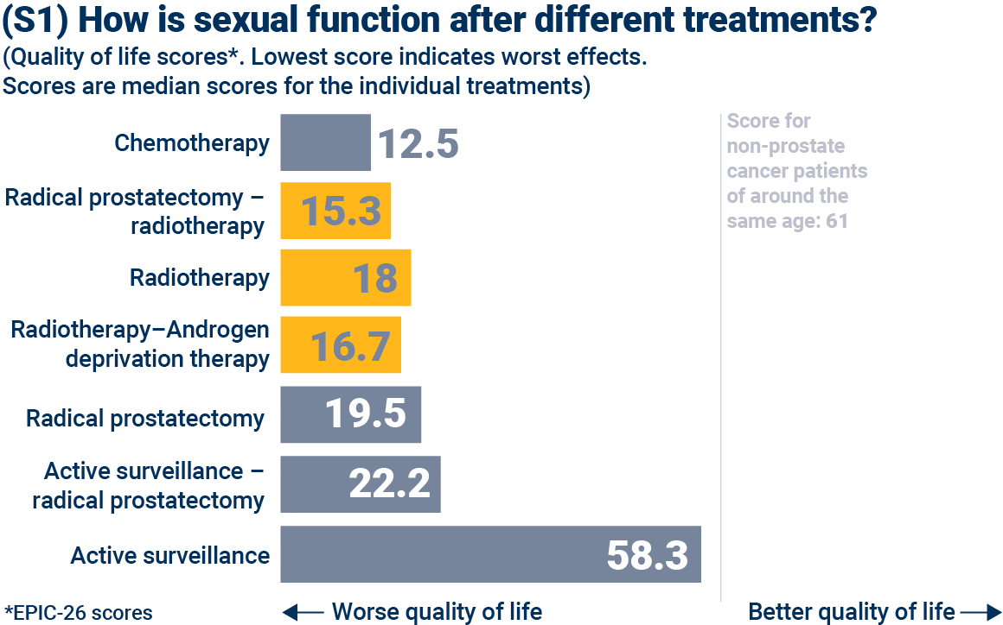
Notes:
This slide again shows quality of life score: the bigger the score the better quality of life. It shows quality of life as it relates to sexual function, after different treatments.
Quality of life scores for all treatments are obviously low compared with active surveillance.
Why is the active surveillance score not 100, which is the top of the scale in the EPIC score? It is because at these ages (the average age of the study is 70) sexual function is not normally 100%.
Comparing these figures to the general population, the average EPIC sexual function score for men without prostate cancer is 61, which is clearly very similar to the active surveillance score here.

Slide 29
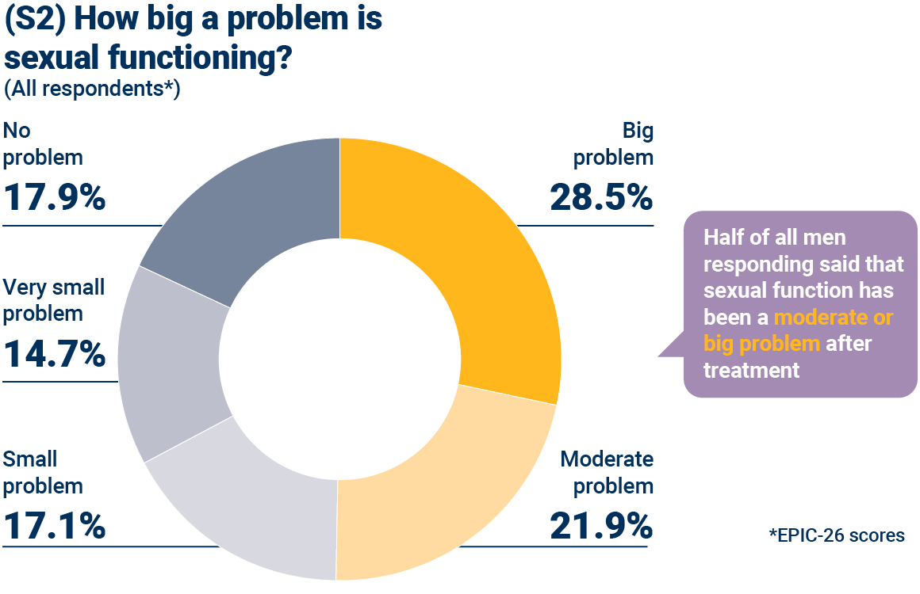
Notes:
How big a problem, then, is sexual functioning? You can see it is a big or moderate problem in around half of men. It would be interesting to get partners’ perspective on the same question.

Slide 30
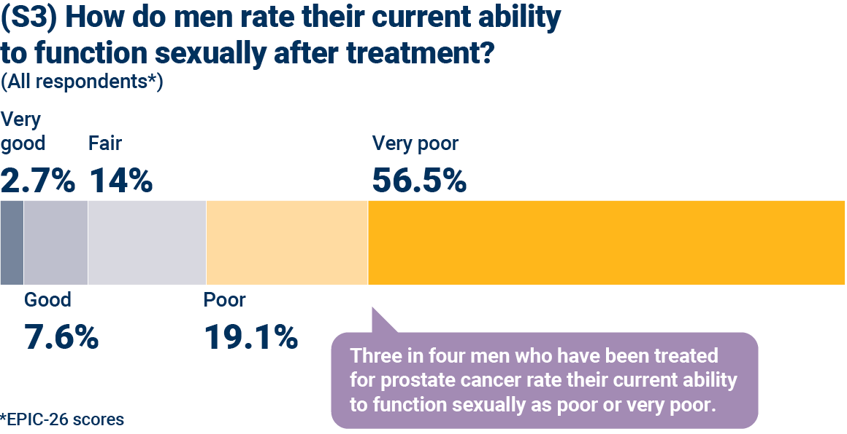
Notes:
Around three quarters of men who responded to the survey rated their current ability to function sexually poor or very poor. This is clearly, in part, a reflection of the age of respondent, as well as the effects of treatment.
However, for comparison, it is interesting to look at a 2017 study of men of slightly older age (average age 74.5) who did not have prostate cancer, which used the same EPIC-26 measures (Venderbos et al, PMID: 28168601). It found that 50% of these men rated their ability to function sexually as poor or very poor. Clearly, this is a significantly lower percentage than the 76% of men with prostate cancer in our study.

Slide 31
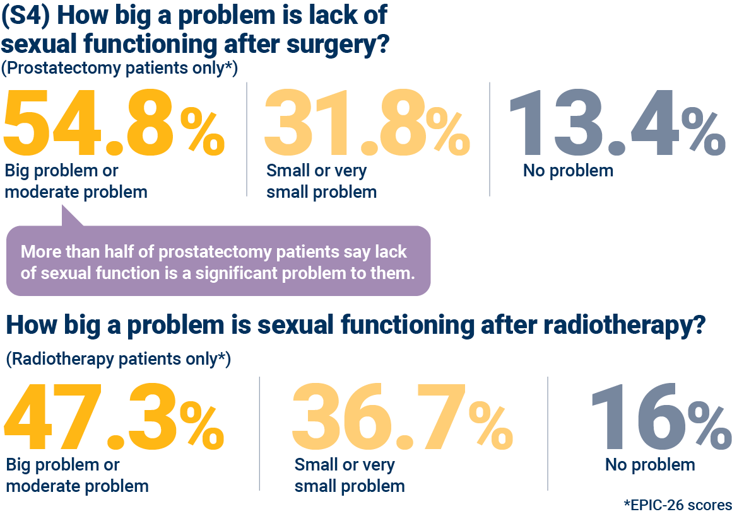
Notes:
Looking at how different treatments affect sexual function, you can see from the line of figures at the top that more than half of men who have had a prostatectomy find that sexual functioning is a big or moderate problem for them. That is a significant proportion.
The figures below show that sexual functioning seems to be a slightly less significant problem after radiotherapy: 47.3% for radiotherapy had significant problems compared with 54.8% for prostatectomy.
But both findings indicate that, when it comes to sexual function, the two major first treatments for prostate cancer have an important effect on quality of life.

Slide 32
Notes:
Only a third of men responding to the survey had tried medications and devices to improve erections. Given the prevalence of sexual function problems at treatment, there is clearly a gap here, and a need to give men more advice on these approaches.

Slide 33
EUPROMS results
Urinary incontinence

Slide 34
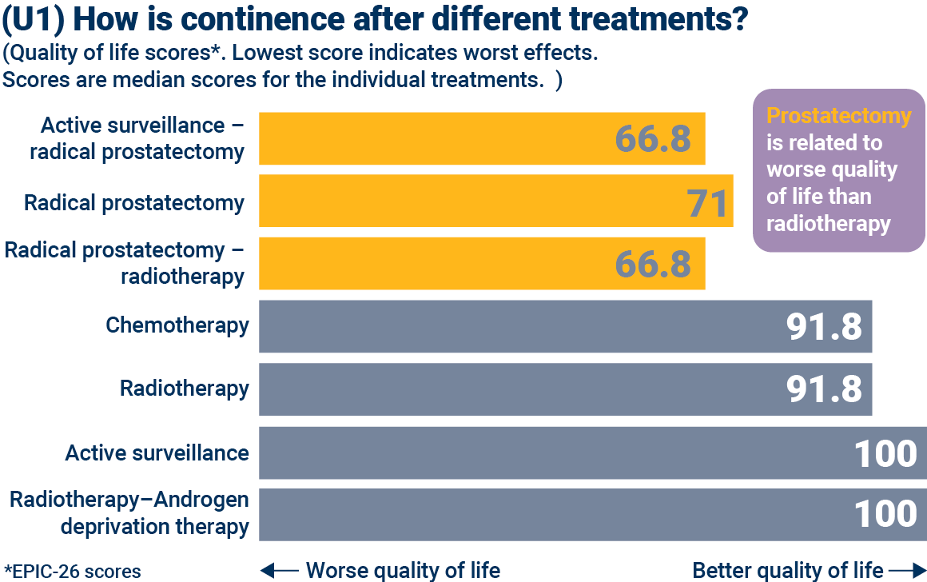
Notes:
Moving on to urinary incontinence, we have done exactly the same analysis as for sexual function. First of all, we compared the different treatments. You will see that prostatectomy is related to lower quality of life than radiotherapy. The other treatments show fewer effects.
Comparing these figures to the general population, the average EPIC urinary function score for men without prostate cancer is 89.5.

Slide 35
Notes:
Looking specifically at urinary control, overall 60% of men surveyed had problems. Surgery seems to be associated with the most significant problems. Comparing the surgery figure with active surveillance suggests that surgery doubles the rate of incontinence. It should be noted that even during active surveillance, however, there are problems with dripping. This is a reflection of the average age of respondents.

Slide 36
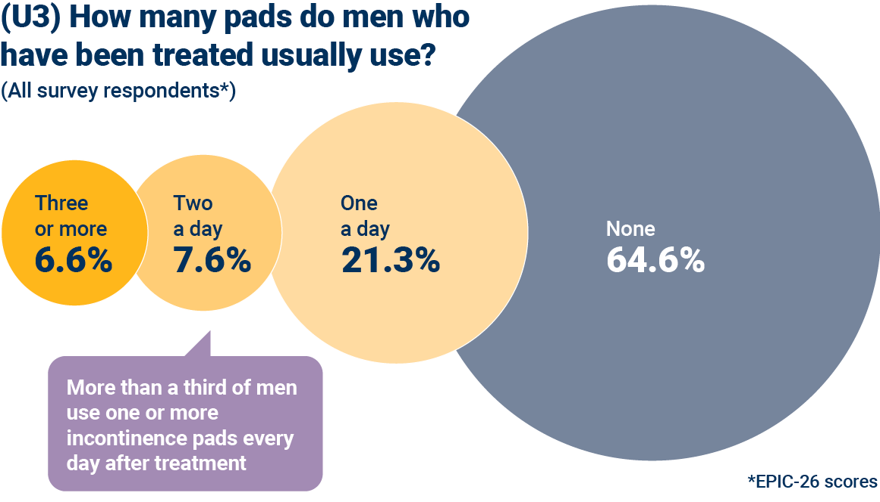
Notes:
What does this mean for patients in practical terms? The survey asked men how many incontinence pads they used each day, and across all the survey respondents more than a third use one or more pads a day. This may reflect the fact that the majority of survey respondents had had a radical prostatectomy. Of respondents who had had a prostatectomy, half were using pads.
To put this into perspective, a 2017 study of men with roughly the same age profile who had NOT been treated for prostate cancer found that around 5% wear pads (PMID: 28168601). So there is clearly a significant effect here.

Slide 37
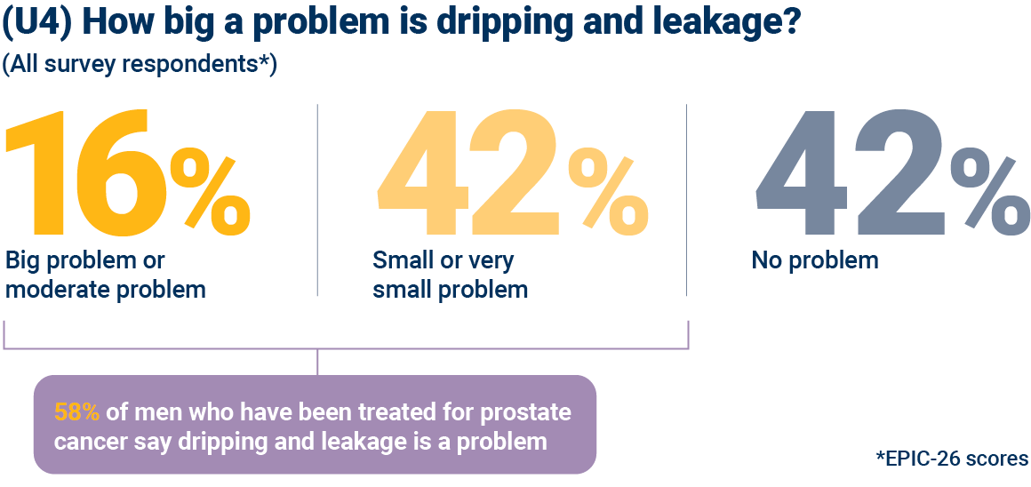
Notes:
Looking at how big an effect dripping and leakage has on men’s lives, 16% of all the survey respondents judge it to be a big or moderate problem.

Slide 38
Notes:
If you break down this figure into those who have received prostatectomy and radiotherapy you will see the influence of treatment type on the problem.
Looking at prostatectomy patients, in the top line of figures, you will see that 68% say dripping and leakage is a problem.
Compare that with radiotherapy patients, in the second line, where a total of 47% of patients say that dripping and leakage is a problem.

Slide 39
EUPROMS study
Take home messages

Slide 40
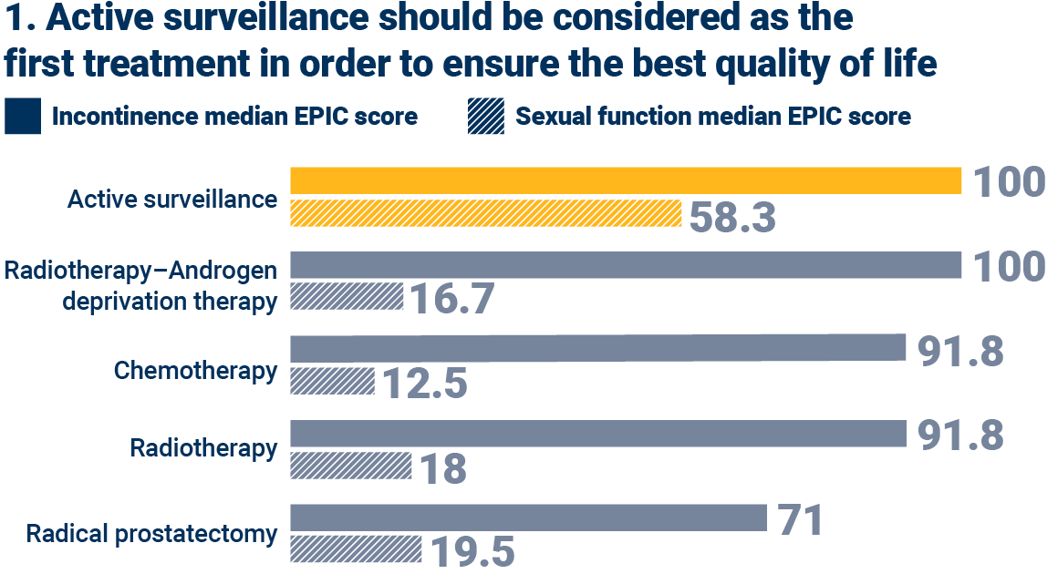
Take-home messages
Notes:
There are three main take-home messages that we can draw from these EUPROMS findings.
The first is that active surveillance should be always be considered, if it can be applied safely, because overall it best protects quality of life. Certainly, in terms of incontinence and sexual function, the contrast between this and other approaches is clear.

Slide 41
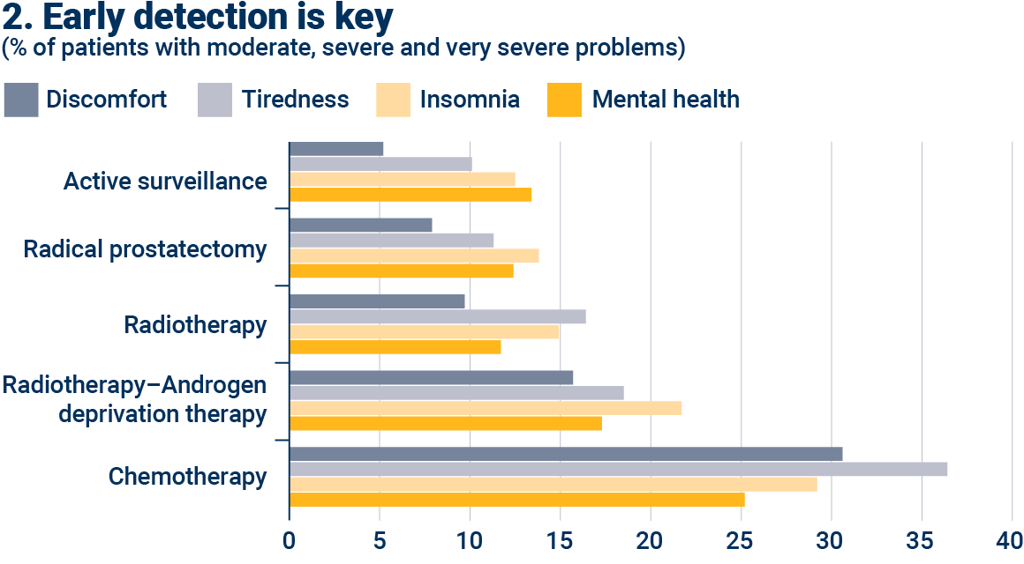
Take-home messages
Notes:
The second take-home message is that early detection of prostate cancer is of the utmost importance. The more advanced the prostate cancer at diagnosis, the worse the effects of treatment on quality of life. The graph here shows that, looking at many factors together – discomfort, tiredness, insomnia and mental health – all of these are experienced more severely with treatments associated with more advanced prostate cancer.

Slide 42
Take-home messages
3. We need cancer centres with multidisciplinary teams
Notes:
And the third message we can take from all the data from the EUPROMS study is that high quality treatment and support are essential. The EUPROMS results show the severe effects that can come with treatment for prostate cancer. Men need all the expertise and experience they can get during treatment and after, with information and support at each stage of the journey. Every man with prostate cancer should be treated in a cancer centre with multidisciplinary teams.

