Slide 1
The real effects of prostate cancer treatment: EUPROMS
First ever prostate patient-driven quality of life study

Slide 2
Europa Uomo
André Deschamps Ing. MBA, Chairman
Ernst-Günther Carl, board member
John Dowling, board member
Department of Urology, Erasmus University Medical Center, Rotterdam
Prof.dr. Monique J. Roobol Sebastiaan Remmers, MSc
Lionne Venderbos, PhD

Slide 3
Disclosures
Sponsored by three pharmaceutical companies
They have had no role or influence in any aspect of the study and this will remain the position

Slide 4
EUPROMS
Methodology and sample profiles

Slide 5
Methodology
20-minute online survey
Patients with PCa who received treatment
Observational one arm study
Aim: examine the quality of life of PCa patients Europe-wide
Using validated quality of life questionnaires
EPIC-26
EORTC-QLQ-C30
EQ-5D-5L
Questionnaire available in 19 languages

Slide 6
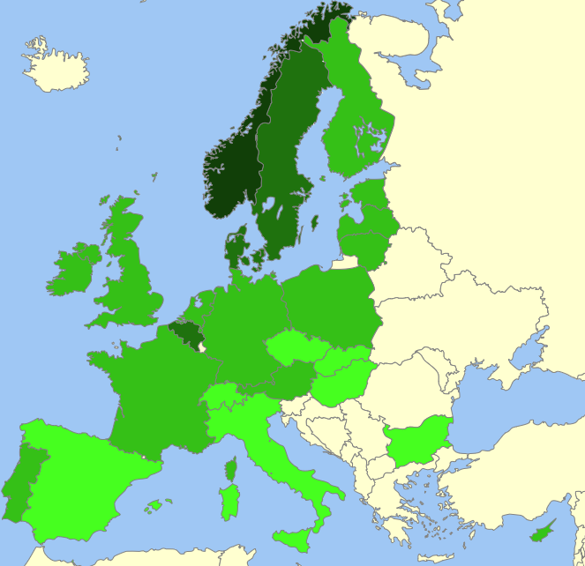
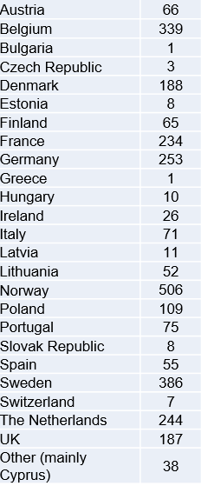
Geographic coverage and valid answers
2943 answers
24 countries
Estimated 0,1%
of patient population

Slide 7
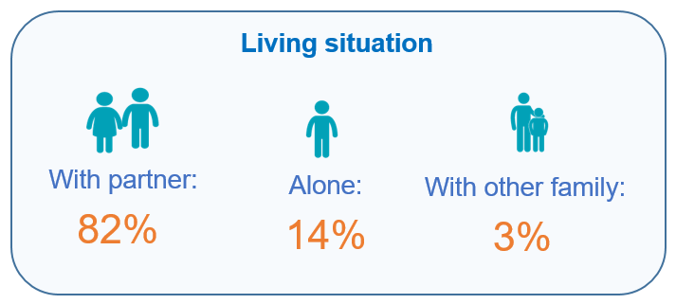
Respondents profile

Slide 8
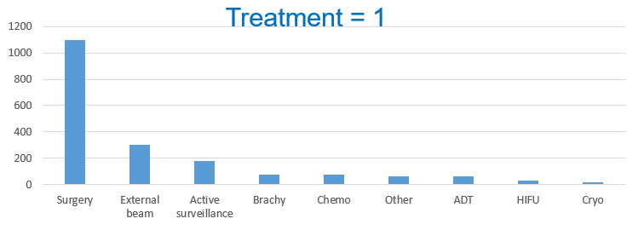
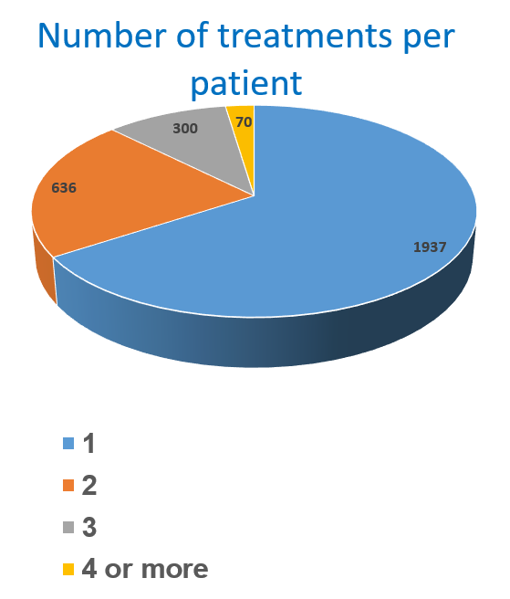
Treatments profile
66 %
22 %
10 %
2 %

Slide 9
EUPROMS
EORTC-QLQ-C30 and EPIC-26 Results

Slide 10
EORTC-QLQ-C30 Symptom score
Low score is positive

Slide 11
EORTC-QLQ-C30 Fatigue
RT doubles the reported fatigue
Chemo leads to an increase in reported fatigue
Low score is positive

Slide 12
EORTC-QLQ-C30 Insomnia
Progression of disease ?
Chemo leads to an increase in reported insomnia
Low score is positive

Slide 13
EPIC-26 domain scores
Sexual function is the most impacted area
High score is positive

Slide 14
EPIC-26 Urinary incontinence
RP leads to more urinary incontinence than RT
High score is positive

Slide 15
EPIC-26 Sexual functioning
RT leads to lower sexual function scores than RP
Men who underwent chemo -> lowest sexual functioning scores
High score is positive

Slide 16
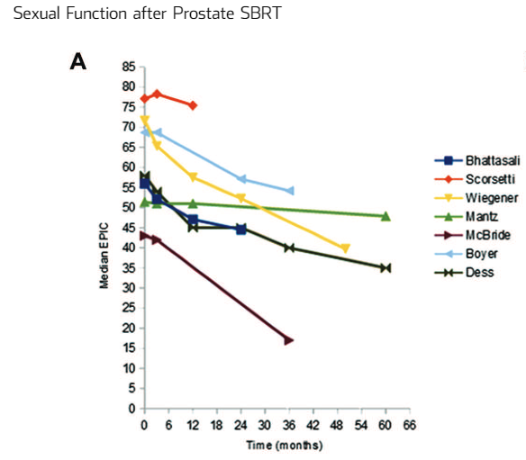
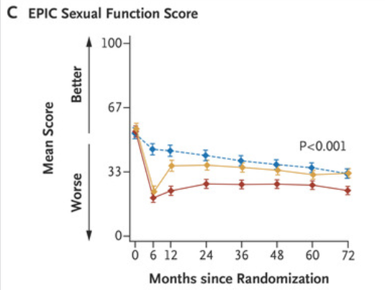
Difference compared with PRO in clinical environment
EUPROMS
AS = 57
EUPROMS
RP = 21
RT = 17
EUPROMS
RT =17

Slide 17
Key messages [1]
The data collected and the analysis done provide patients and health care professionals a “snapshot” on the impact of treatments based on the experiences of fellow patients.
The results of this survey are as such not comparable to the results of clinical studies using the same validated questionnaires. Further investigation in this issue is ongoing.

Slide 18
Key messages [2]
Urinary incontinence score lowest for radical prostatectomy.
Sexual function score lowest for radiation therapy.
Fatigue and insomnia scores are highest for radiotherapy and chemotherapy.
Chemotherapy leads to the worst outcomes in QOL.

Slide 19
Key messages [3]
Self-reported QoL is best in patients where PCa is discovered in an early, curable stage. Efforts towards early detection and awareness are essential to avoid unnecessary deterioration of QoL.
QoL is negatively impacted by any treatment for PCa other than active surveillance and should be promoted as the first option for treatment for those men where it can be offered safely.

Slide 20
Key messages [4]
We hope these results will be used to establish and disseminate realistic expectations on the effects of the different treatments for PCa on QoL.

